Slide 1
F-950 Three Gas Analyzer
Training conducted by:
Brienne Meyer
Application Scientist
bmeyer@felixinstruments.com

Slide 2
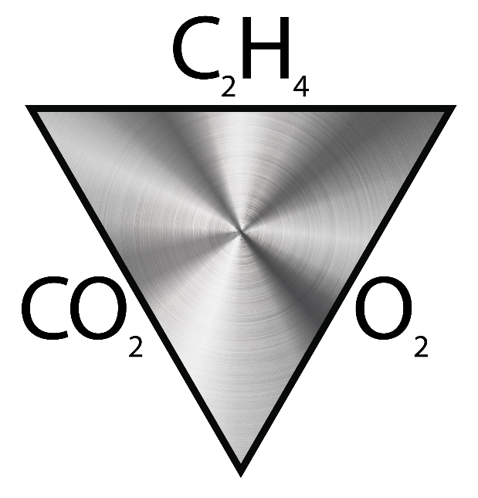
F-950 Features
Portable, lightweight and easy to operate.
Rapid response time, with data points saved every second.
Repeatable, precise measurements.
Accuracy of C₂H₄, CO₂, and O₂ at +/- 5%.
Three versatile modes of operation: Continuous, Fixed Volume, or Trigger
Removable, re-chargeable standard sized batteries.
Included:
Two sets of batteries
Stand-alone battery charger
Additional button-top 19670 (or protected 18650) batteries can be purchased from your preferred battery vendor.

Slide 3
F-950 Specifications
Air Sampling Rate | 60-500 ml/min (default: 67 ml/min)
Measuring Rate | Open loop at 1 second intervals
Data Storage | Removable 4 GB SD card
Display | Sunlight visible transflective LCD
Operating environment | 0°C - 45°C (0-90% humidity non-condensing)
Battery Capacity | 7 hours
Dimensions | 7.1 x 4.75 x 1.75 inches (18 X 12 x 4.5 cm)
Weight | 2.43 kg
Enclosure | Powder coated aluminum
Warm-up time | < 3 minutes

Slide 4
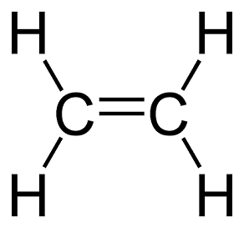
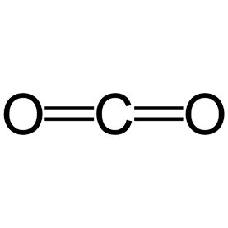
F-950 Sensors
Ethylene Sensor | electrochemical
Nominal Range | 0 – 200 ppm
Lower Detection Limit | 0.5 ppm
Resolution | < 0.1 ppm
Accuracy | ±5% Continuous mode ±10% Fixed Volume mode
Carbon Dioxide Sensor | Infrared Sensor, Pyroelectric detector
Nominal Range | 0 – 20% (200,000 ppm)
Full scale resolution | 0.01% (100 ppm)
Accuracy | ±5% Continuous mode ±10% Fixed Volume mode
Oxygen Sensor | Electrochemical
Nominal Range | 0-100%
Resolution | 0.1%
Accuracy | ±5% Continuous mode ±10% Fixed Volume mode

Slide 5
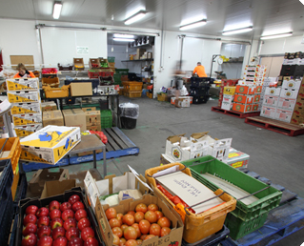
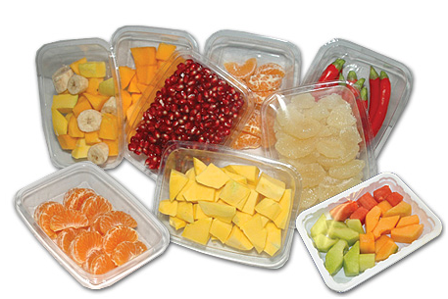
F-950 Uses
Inspect storage and packing environments
Verify ethylene mitigation efficacy
Optimize ripening storage atmosphere conditions
Quality assure MAP for ethylene-sensitive products
MAP = modified air packaging

Slide 6
Using the F-950
Operating Modes
Interfering Gases and PolarCept
Auto-escape
Navigate menus
Weekly Calibration
Data
WARNING: Do not store the F-950 without batteries!
Batteries must be present in the instrument to maintain the accuracy of the sensors, even when the unit is powered off.
If batteries are not present, replace with charged batteries and allow to stabilize for 48 hours before use.

Slide 7
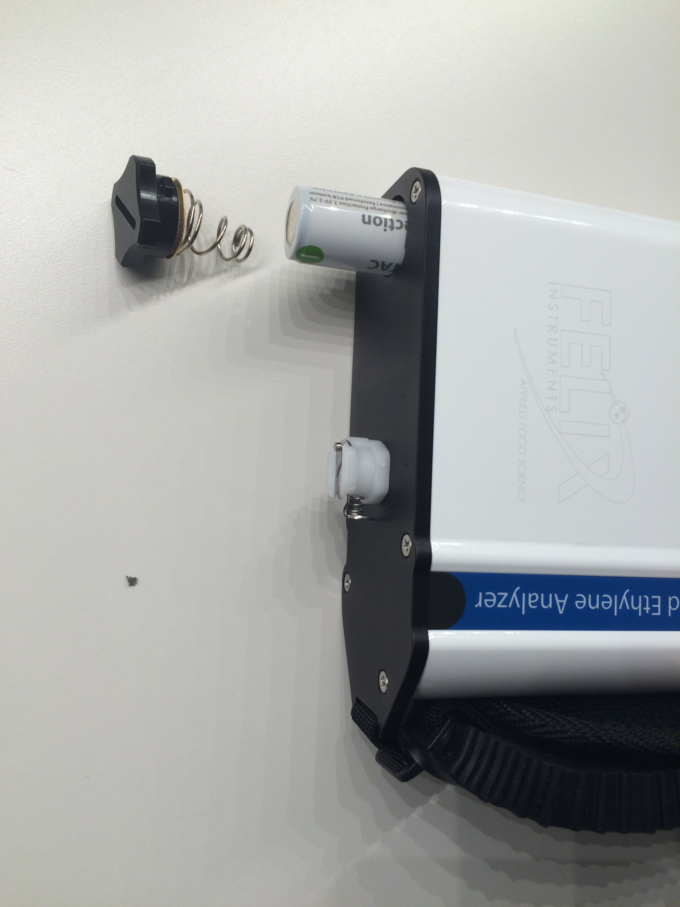
Loading the Batteries
Remove bottom rubber cap.
Twist open battery compartment.
Spring loaded!

Slide 8
Continuous Mode
Measures the air coming through the input of the instrument
Flow rate of 67 mL/minute (Default)
Default to Loop “Open” and Pump “On”
Data saved every second
Can be used with or without:
Sample port/needle
PolarCept external filter

Slide 9
Fixed Volume Mode
Sample small set (fixed) volume of gas (default 15 ml)
Use sampling port and needle
Purging for 5 seconds
Right arrow to purge for 5 more seconds
Allow sensors to stabilize
Connect to sample and press Start
Pump will run until volume is drawn into F-950
Loop will close while sample is analyzed

Slide 10
Fixed Volume Results
Disconnect from sample while it is processing/analyzing
Final values for ethylene, O₂ and CO₂
Press Start to begin another measurement

Slide 11
Trigger Mode
Begins with the valve closed and the pump off.
Press the square start button on the key-strip of the F-950 to begin a measurement.
The pump will run and air will enter the F-950 until:
a stabile reading has been reached for all sensors
stops the measurement by pressing the start button again
MOST FREQUENTLY USED MODE
With ample sample volume available

Slide 12
Trigger Mode Results
The final values will be displayed under the word “last” in the graph and saved to the SD card.
The pump will then turn off until the user initiates a new measurement.
Used with or without the sample port attached to the front of the instrument.

Slide 13
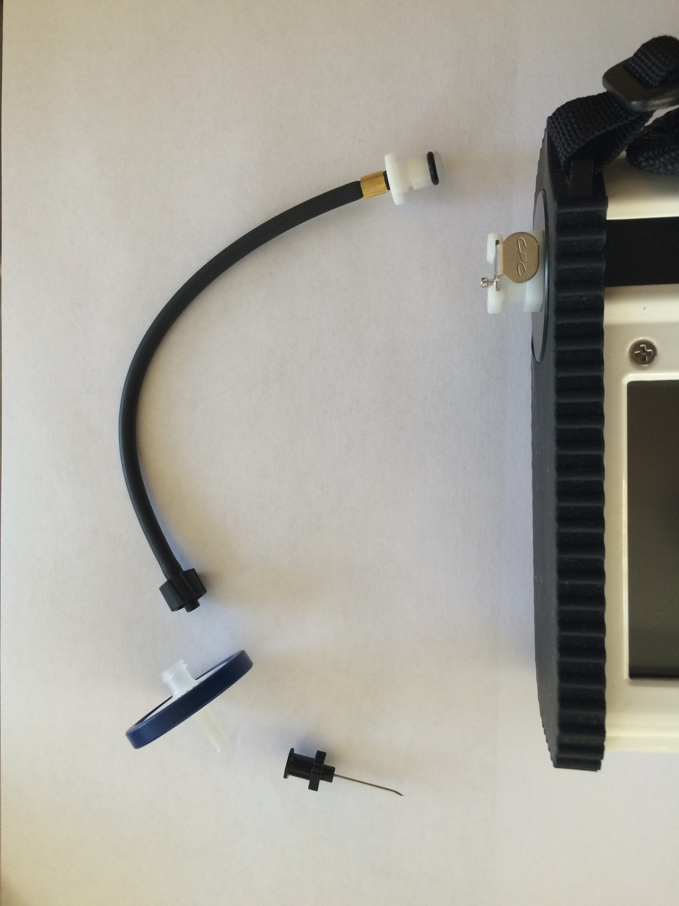
Sample Probe
Connect the “Fixed Volume Needle Probe” black tubing to the intake
Twist on hydrophobic filter to the end of the tubing
Attach a sterile needle to the filter

Slide 14
Interfering Gases
Fruits and leaves emit a mixture of hydrocarbons, including ethylene
Oxidation of these other gases cannot be readily distinguished from ethylene by the electrochemical sensor
Causes ethylene value to be falsely high in the presence of other interfering gas
PolarCept: uses distilled water in an external chamber and has been shown to filter out some polar hydrocarbons and alcohols to produce less interference

Slide 15
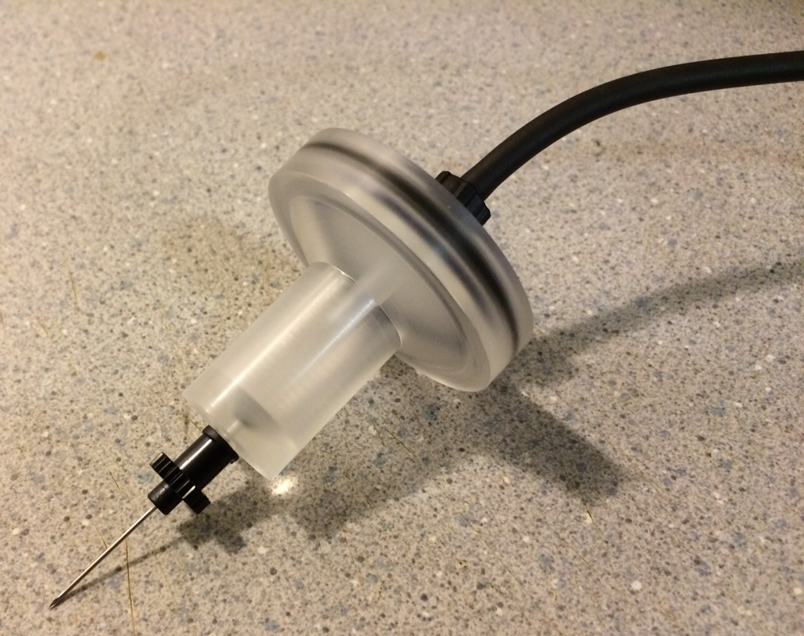
PolarCept
1.5 ml of distilled water
Can be used in any measurement mode
Recommended for sampling produce storage or fruit
Water becomes saturated and needs to be replaced
VOC concentration | PolarCept saturation (min)
3 ppm | 20
100 ppm | 1

Slide 16
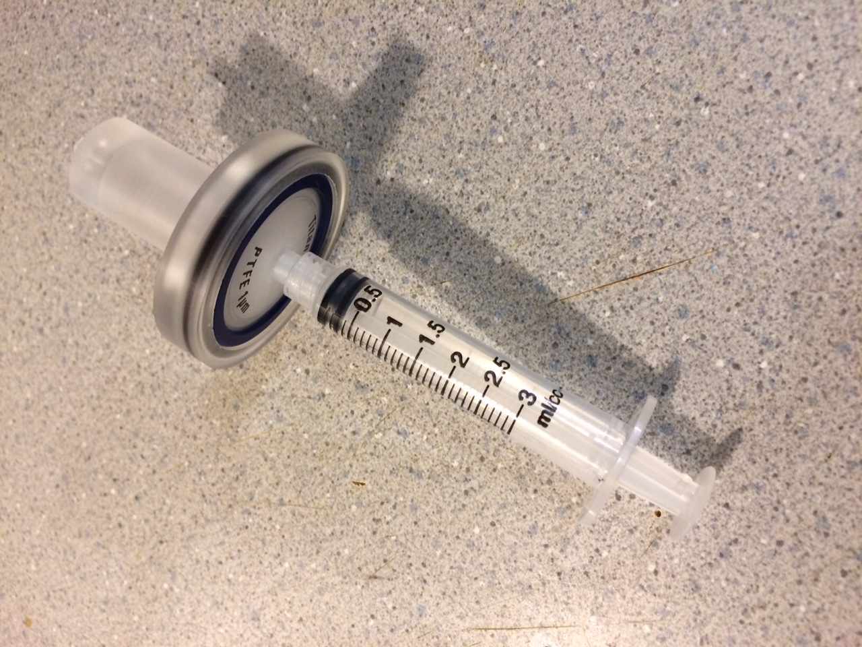
PolarCept Fill and Empty
To fill:
attach an empty syringe to the hydrophobic filter
plunger of the syringe should be depressed
Lower PolarCept over a cup of distilled water and draw in 1.5 mL
Attach the sample needle and fixed volume tubing to stop leaks
To empty PolarCept, re-attach the syringe and push the water out the sample needle end.
Keep sample needle pointed downwards, water in filter should bubble

Slide 18
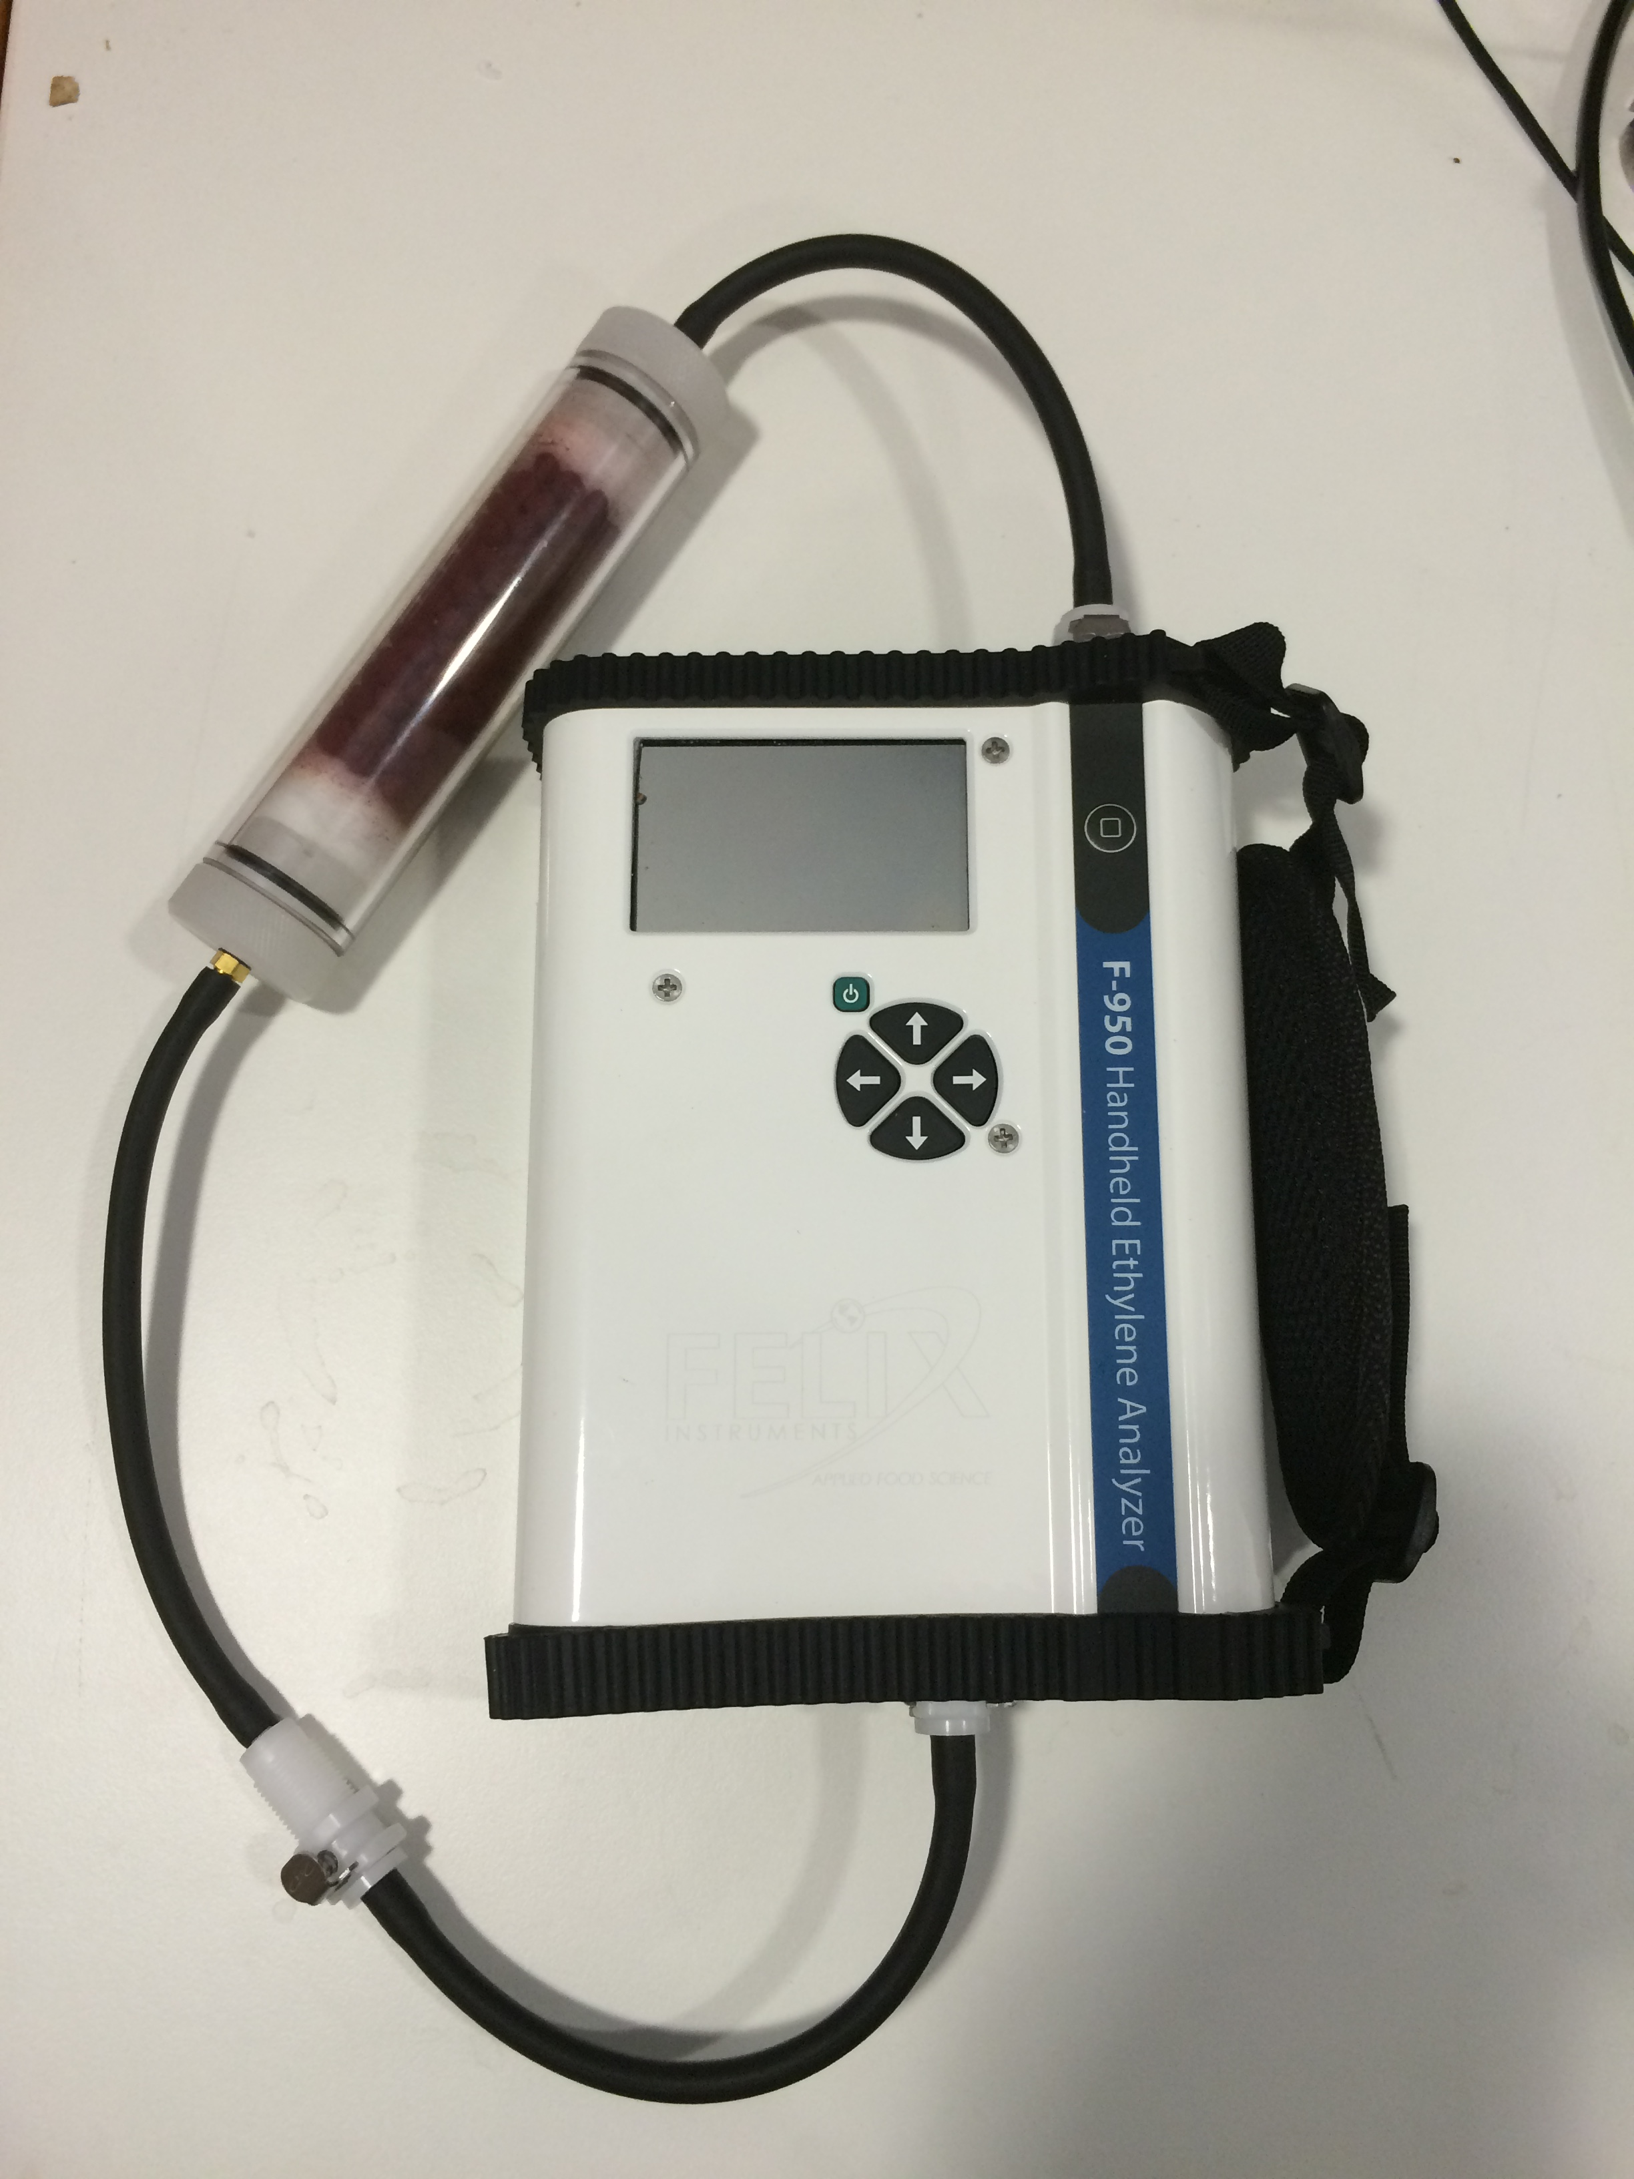
Auto-Escape Feature
Upper limit auto-escape
Over 200 ppm ethylene detected, F-950 will exit from monitor mode to main menu
Prevent electrode poisoning
“sensor out of bounds”
Attach KMnO4 and allow to stabilize

Slide 19
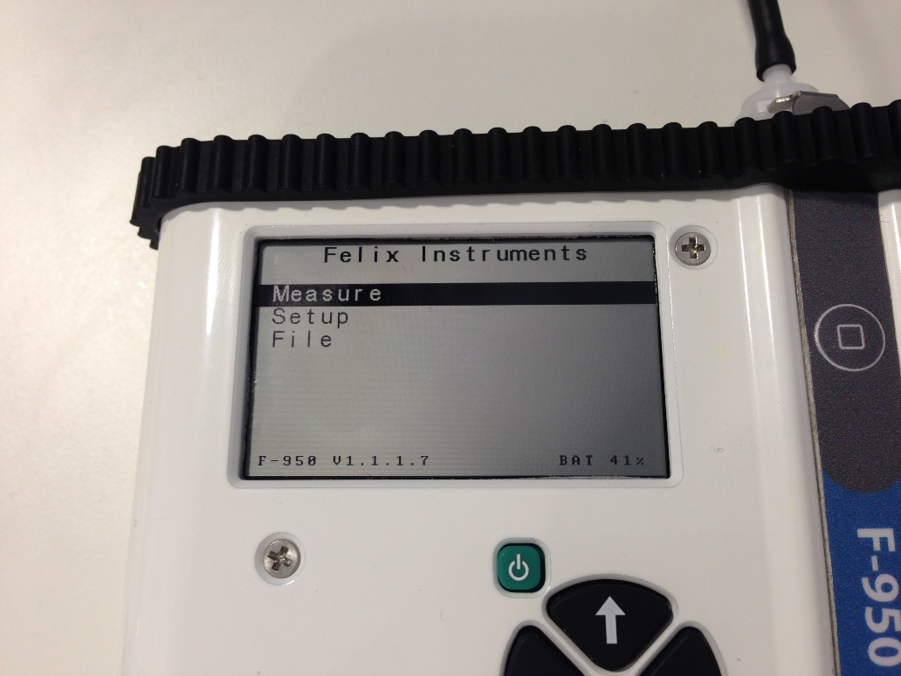
Navigating Menus
Measure
Setup
Files

Slide 20
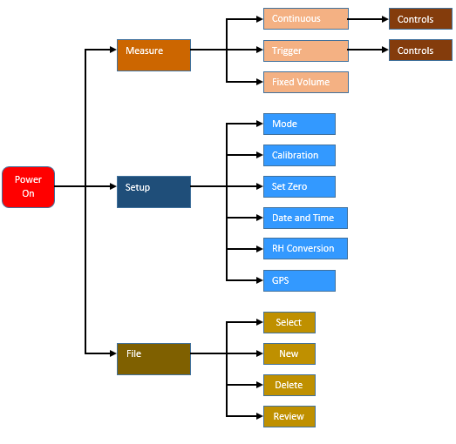

Slide 21
Measure
Fixed Volume, Continuous, Trigger Mode
Current measurement mode is displayed in the upper right corner
Graph displaying the ethylene value over time.
X-axis of the graph is time
Y-axis of the graph displays the range of the concentration in ppm
Dynamic range is labeled at the top
Press the right arrow to view and change the controls

Slide 22
Setup
Mode
Calibration
Set Zero
Date and Time
RH Conversion
GPS
Factory Setup (Restore Factory Defaults/Back Up)

Slide 23
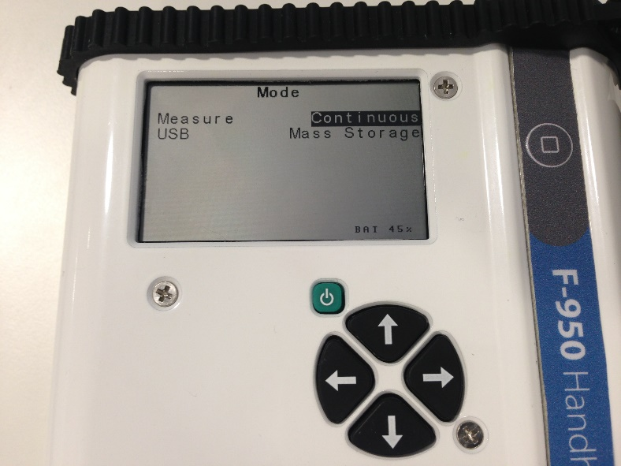
Setup>Mode
Measure Mode
Continuous
Fixed Volume
Trigger
USB should be set to Mass Storage (Sdcard)

Slide 24
Setup>Calibration
Lists the C₂H₄ Offset, C₂H₄ Gain, Internal Volume, Fixed Volume, Flow Rate
C₂H₄ Offset, C₂H₄ Gain, Internal Volume values are set during calibration
should not be changed unless instructed by a technician.
Fixed Volume and Flow Rate may be changed to accommodate various applications, but may affect the accuracy of the device.
The default Fixed Volume is 15 ml.
The default Flow Rate is 67 ml/min.
Calibration
C2H4 Offset 0001672
C2H4 Gain 0000545
Internal Volume 016.2
Fixed Volume 15.0
Flow Rate 067

Slide 25
Setup>Set Zero
Sets a new baseline, or zero, for the C₂H₄ sensor
Perform Weekly
To set a new zero:
Connect the external conditioning tube filled completely with potassium permanganate (KMnO₄) to the inlet
Use the right arrow to enter Set Zero
A reminder for using KMnO4 appears:
Runs automated process to set a new baseline for future measurements
Zero C2H4 Sensor
Use KMnO4 filter
C2H4 offset…..1349.1

Slide 26
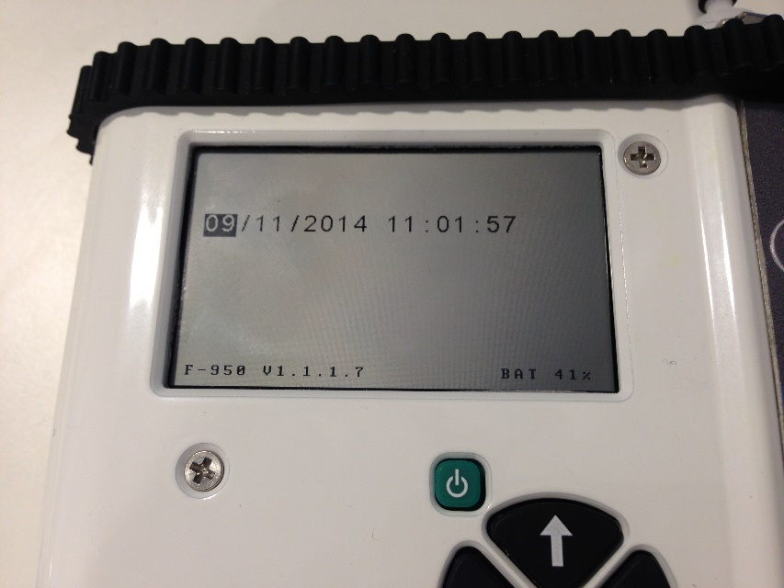
Setup>Date and Time
Right and Left arrows to move between Month/Day/Year and Hour/Minute/Second
Up and Down arrows to change the values
Left arrow to exit to the Setup menu

Slide 27
Setup>RH Conversion
Used to correct for temperature sensor being inside F-950 housing
Temp is usually several degrees above ambient
Enter the correct temperature (measured from an external temp sensor)
F-950 will use this temp for RH %
RH Conversion
Enter Sample T(C) 25.0
Use Sample T Yes
(for measurements)
Internal RH (%) 43.6
Sample RH (%) 47.3

Slide 28
Setup>GPS
Setup GPS
Enable GPS Yes/No
Acquiring GPS data…..
Longitude 122.558
Latitude 45.59
Accurate to within 10 meters
Works outdoors or near window
Data saved to .csv file
Enable it here to see GPS data in file

Slide 29
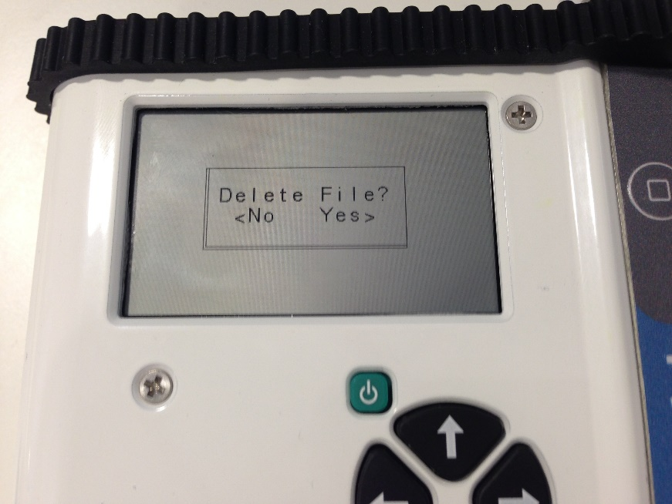
File
Select
A list of .csv files on the F-950 SD card
If the unit is powered on and no file is selected, the data will be default saved to the file “data.csv”
Create
Press the Right arrow to create a new file
Naming scheme: XX_XX_XX_X or Year_Month_Date_Ordinal
Delete
Review

Slide 30
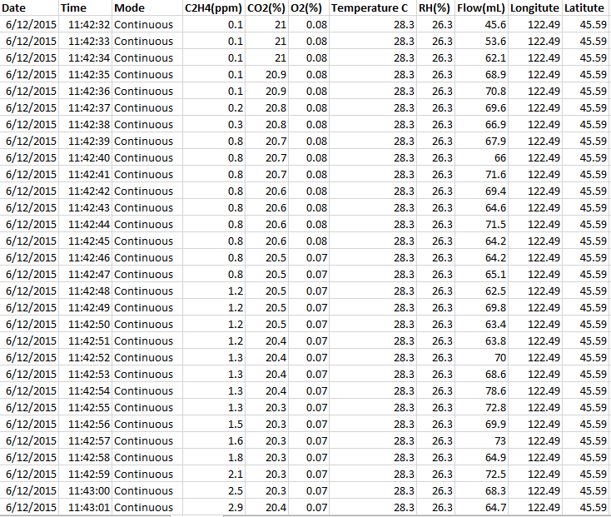
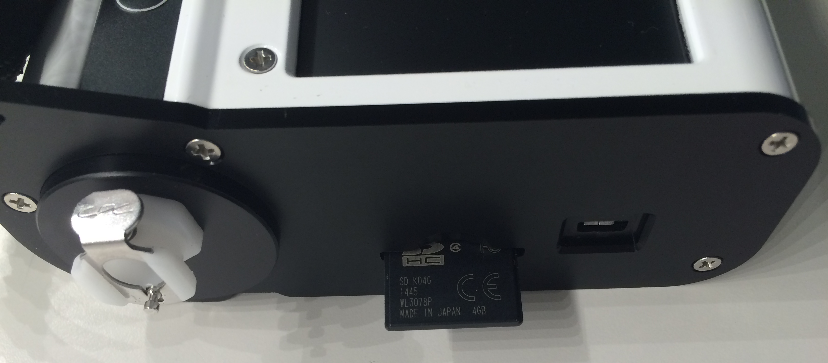
Example Data Spreadsheet

Slide 31
F-950 Controller Software for Calibration
Perform calibrations with software for C2H4, CO2 and O2
Requires standard gas:
Ethylene calibration gas (20 ppm recommended)
Ethylene verification gas (10 ppm recommended)
CO₂ calibration gas (16% recommended)
CO₂ verification gas (5% recommended)
O₂ calibration gas (21% recommended)
100% Nitrogen (N₂) gas for zeroing sensors (MUST be done prior to span calibration)
Sensor Span Calibration Schedule and Lifetime:
C2H4: 6 months calibration, 1 year lifetime
O2: 6 months calibration, 1 year lifetime
CO2: 1 year calibration, 5 year lifetime

Slide 32
Questions?

Slide 33
F-950 Controller Software
http://felixinstruments.com/support/f-950-support/software
F-950 Package Setup has firmware update program and controller software
Connect device to PC with USB cable and power on F-950
Open F-950 Controller Software

Slide 34
Begin a measurement in Continuous mode on the F-950 hardware
Click on the Serial Number of in upper left to see Monitor data. Slight lag time to see data appear in Monitor tab of software

Slide 35
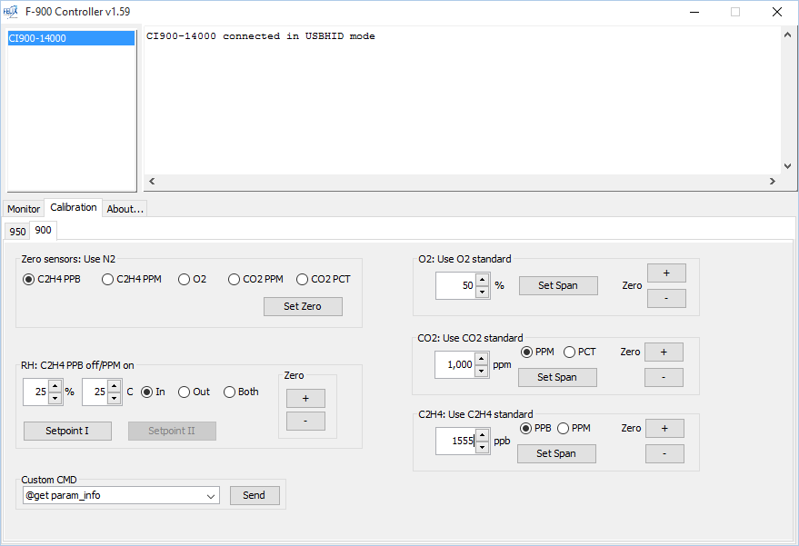
Calibration tab, select tab for F-950.
Enter correct concentration for standard.

Slide 36
Connect the ethylene standard gas to the F-950 intake
Recommend using on demand flow regulator

Slide 37
Wait at least 7 minutes once the signal has stabilized before setting the span calibration.

Slide 38
To set the span calibration, verify the correct concentration is entered in ppb in the F-950 Controller software and click the “set span” button

Slide 39
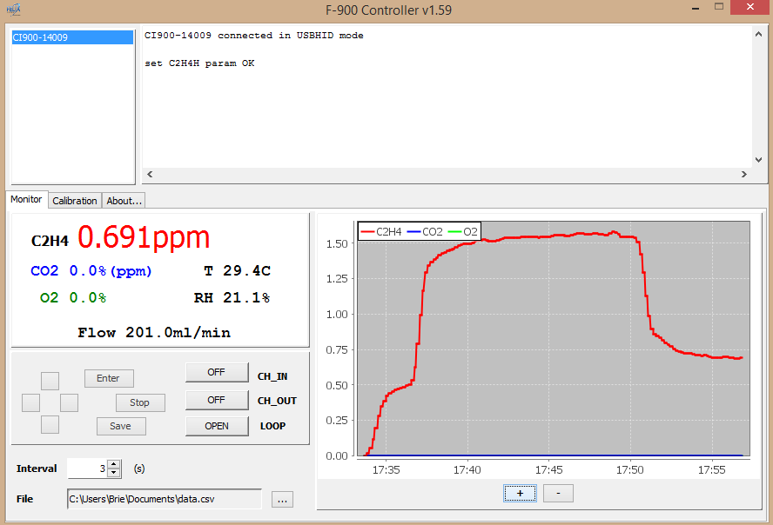
Once the set span button is pressed, the span concentration (ex: 1.555 ppm) should appear on the F-950 display and in the F-950 Controller software.
Disconnect the calibration gas and watch the data trend toward ambient ethylene levels.

Slide 40
Questions?
Online support: Skype, GoToMeeting
support@felixinstruments.com
Phone (360)833-8835

