Slide 1
F-900 PORTABLE ETHYLENE ANALYZER INSTRUMENT TRAINING
WWW.FELIXINSTRUMENTS.COM
SUPPORT@FELIXINSTRUMENTS.COM
Notes:
Hello, and welcome to Felix Instruments-Applied Food Science. Today we will be learning about the F-900 Portable Ethylene Analyzer, which provides accurate real-time measurement of ethylene gas concentrations in a compact instrument suitable for field and laboratory use. Common applications include: Ethylene monitoring, experiments involving modified atmosphere boxes, storage rooms, and various containers. The intent of the F-900’s portable design is to aid the research community in developing real-world ethylene management applications for the benefit of growers, processors, and consumers.
Please record any questions you may have along the way so we may answer them at the end of this training.

Slide 2
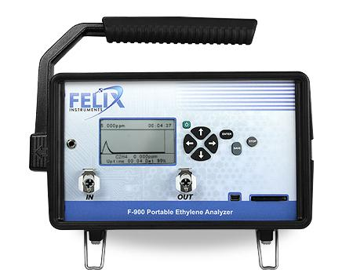
F-900 FEATURES AND SPECIFICATIONS
High C2H4 sensitivity
Compact and portable (2.43 kg)
Real-time, continuous monitoring
Internal data logging and storage
4 GB SD card
Transflective display for viewing in sunlight
Rechargeable Li-Ion battery
4 hours of field use
Notes:
The F-900 analyzes the concentration of ethylene in a gas sample for the purpose of research or ethylene management. The F-900 employs electro-chemical sensors as well as several other sensors for temperature, humidity, GPS location, and optionally carbon dioxide and oxygen. Compact and portable, the F-900 can detect Ethylene concentrations from 0-200 ppm, down to 40 ppb. These specifications can also be used for verifying ethylene scrubbers.
The F-900 comes equipped with a rechargeable lithium ion battery for hours of use in the field as well as a removeable 4 gigabyte SD card for easy data transfer.

Slide 3
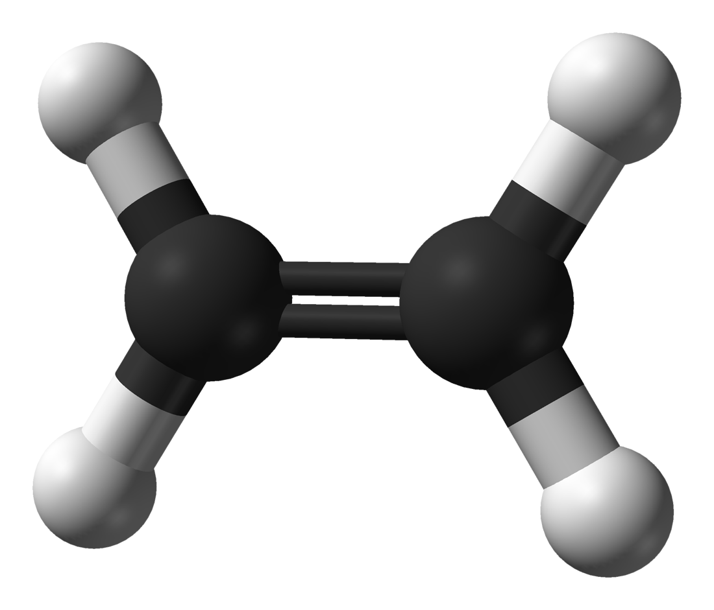
APPLICATIONS OF THE F-900
Point measurement of ethylene concentrations in real time
Single fruit
Storage container
Long term monitoring of a single location
Evaluation of multiple locations
Notes:
Ethylene is an important and sensitive indicator of ripening fruits. Monitoring ethylene concentrations in commodity storage rooms can be essential for maintaining food quality standards, experimental control, and ventilation.
Available with additional Oxygen and Carbon Dioxide sensors, the F-900 can point measure canisters, perform continuous measurements of ethylene in a room, or take fixed interval measurements for modified atmosphere packaging, also known as ‘MAP’.
The unit is capable of real-time, continuous monitoring over days or even weeks, and is compatible with tubing attachments for environments requiring long-term monitoring. When paired with a multiplexor, the unit can monitor multiple locations all at once serving as both a sensor and a controller.

Slide 4
HOW DOES THE ELECTROCHEMICAL SENSOR WORK?
Gas sample travels across the surface of the electrode and diffuses into the electrochemical where ethylene is oxidized.
The current created by the oxidation is measured and converted to ppm of ethylene.
A: working electrode
R: reference electrode
C: counter electrode
E: electrolyte
image credit: doi:10.1093/aob/mcs259
Notes:
Electrochemical sensors operate as gas travels across the surface of an electrode, diffuses electrochemically and is oxidized, resulting in a quantifiable measurement.
The electrochemical sensor uses a nafion or nafion-like membrane.
The electrode is platinum with a lead-based counter-electrode.
The lag in sensor response is a natural phenomenon for charged porous membrane electrodes.

Slide 5
C2H4 SENSOR SPECIFICATIONS
C₂H₄ PPB Sensor | Electrochemical
Nominal Range | 0- 2 ppm
Resolution | 0.001 ppm
Lower Detection Limit | 0.04 ppm (40 ppb)
Accuracy | ±10 %; adjusted for temperature and humidity
Offset Recalibration | Daily
Span Recalibration | Weekly (calibration gas required)
C₂H₄ PPM Sensor | Electrochemical
Nominal Range | 0- 200 ppm
Resolution | 0.1 ppm
Lower Detection Limit | 0.5 ppm
Accuracy | ±5 %; adjusted for temperature and humidity
Offset Recalibration | Bi-annually
Span Recalibration | Bi-annually (calibration gas required)
1 ppm = 1000 ppb
Notes:
The Ethylene Electrochemical Sensors have a detection range of zero to 2 ppm, down to 40 ppb, we recommend daily zero calibrations and weekly span calibrations to maintain sensor accuracy. For more information on calibrations of the F-900 please refer to page 30 of the user manual.
*** are we keeping the calibration schedule as it is? Different btw sensors?

Slide 6
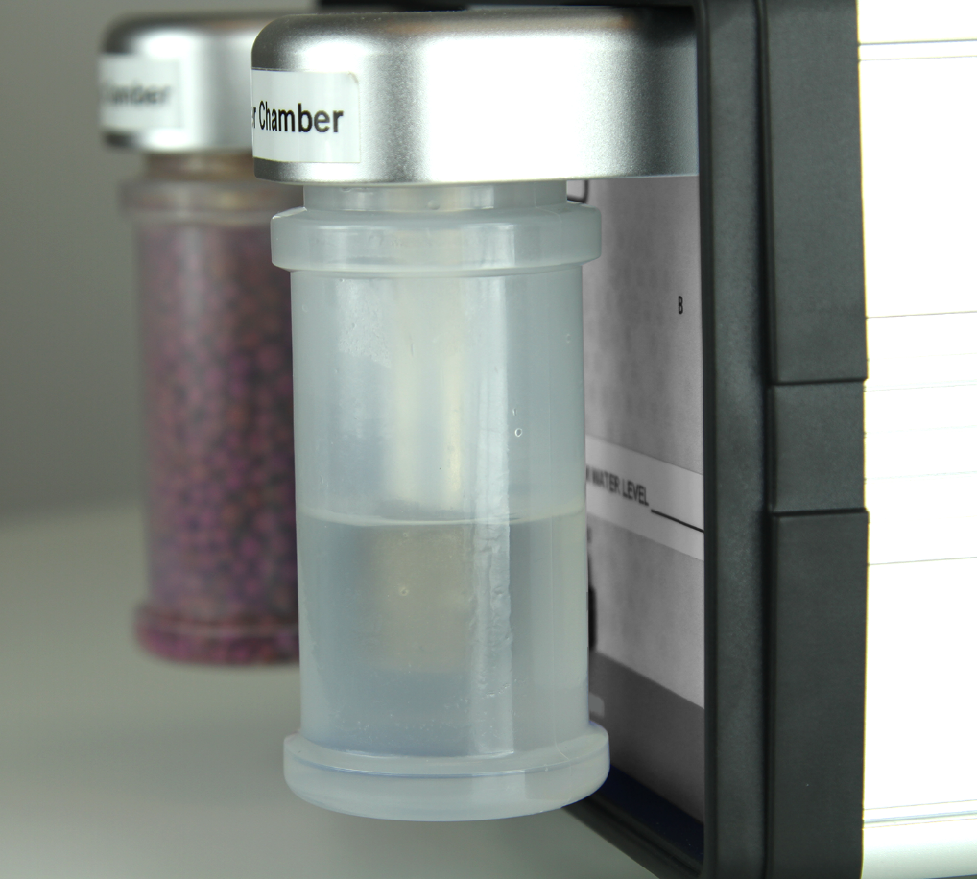
INTERFERING GASES
Fruits and leaves emit a mixture of hydrocarbons, including ethylene
Oxidation of these other gases cannot be readily distinguished from ethylene by the electrochemical sensor
Causes ethylene value to be falsely high in the presence of other interfering gas
PolarCept™ filter = Special “bubbler” mode
Notes:
Ripening fruit emit a complex mixture of hydrocarbons, including ethylene. Oxidation of these gases in the electrochemical sensor cannot be readily distinguished from ethylene. This causes the ethylene value to be falsely high in the presence of interfering gas.
To counter this, Felix Instruments designed Polarcept technology to mitigate the interference of other hydrocarbons by using distilled water as a filter.

Slide 7
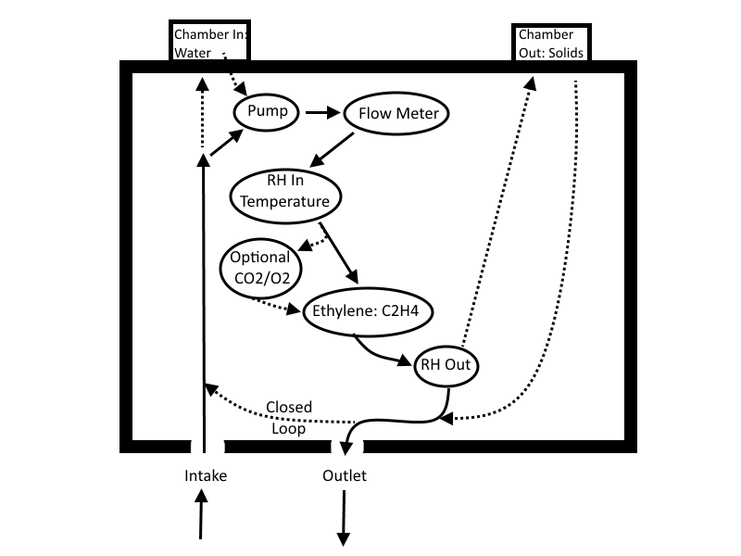
POLARCEPT™ FILTER
Notes:
PolarCept is the use of distilled water in conditioning Chamber ‘In’ to filter out or trap some of the interfering gases. Gas from the sample environment is passed through the water trap.

Slide 8
POLARCEPT™ INTERFERING GAS TRAP OPERATION
Gas passes through trap. Ethylene passes beyond the trap to the sensor = oxidation occurs.
CO2 is released as the oxidation product from the sensor.
Not all C2H4 is consumed by the sensor, some will exit the 900
~5% of displayed concentration is consumed by sensor
Notes:
Trapped polar molecules are driven out of the trap by a concentration gradient, Ethylene, which is non-polar, will successfully pass through the polarcept trap to the electrochemical sensor where the oxidation process releases CO2 concentrations for a final reading. Residual Ethylene (in and around 5%) will escape the oxidation process as a residual loss.

Slide 9
USING POLARCEPT™
Uses conditioning chamber IN with distilled water
Help reduce the interference measured when alcohol or other small polar molecules are present
Help keep the electrochemical cell hydrated
Measure time: 3-5 minutes
Cleaning time: 8-17 minutes or more (at least twice the measure time)
Sensor has a lag time of 2 min
Notes:
Along with outlining the specifications we have discussed about Polarcept technology, the average measuring time is 3-5 minutes depending on attachments and a cleaning time of 8-17 minutes depending on the concentration of interfering gases present during monitoring.

Slide 10
REGENERATING POLARCEPT™ - CLEANING THE WATER
Notes:
When interfering gases saturate the distilled water trap used in Special mode- the mode which enables Polarcept, the user must clean or regenerate the water. Cleaning time can be customized, but keep in mind that the cleaning time should be twice as long as the measure time it took to saturate the water.
To verify that the F-900 is in cleaning mode, the word ‘cleaning’ will be displayed both on the screen and recorded in the datafile.

Slide 11
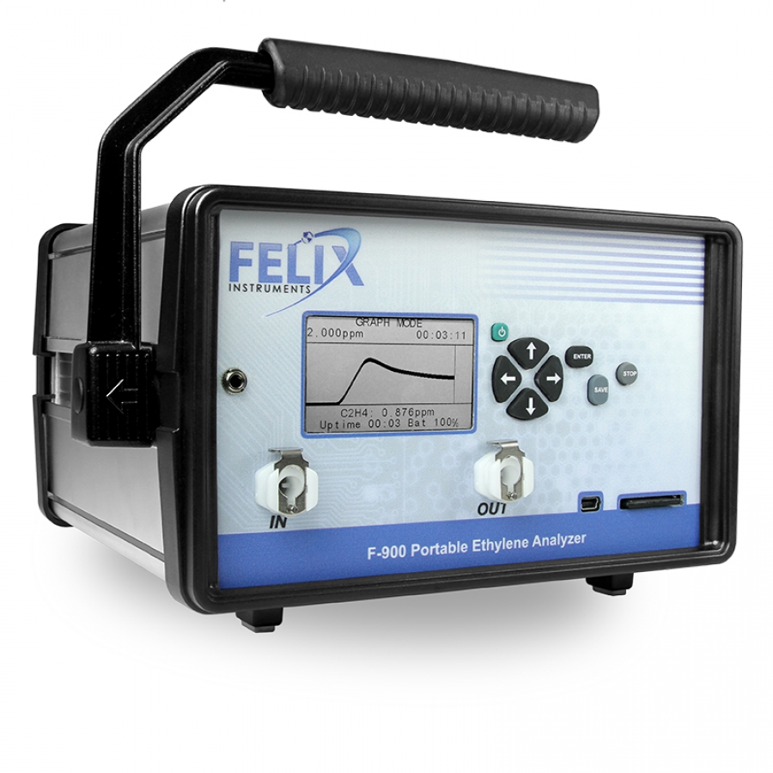
OPERATING THE F-900
Power on
Navigate menus
Monitor mode
Transfer and review data
MUST BE STORED WITH CHARGED BATTERIES!
Notes:
In the next portion of the training, we will be discussing the basic operation of the F-900, the modes of use, data interpretation and user navigation.
Always remember to store the F-900 with charged batteries, the internal batteries must have charge to maintain the accuracy of the sensors, even when the unit is powered off. It is recommend to keep the instrument connected to the power supply for long term storage. For more information regarding battery charging and storage, refer to page 14 in the user manual.

Slide 12
NAVIGATING MENUS
Measure
Setup
View
Files
Up/down arrow to switch options
Right arrow to enter menu
Left arrow to revert
Notes:
From the Main Menu, there are four menu options: Measure, Setup, View and File. Use the up and down arrows to switch between menu options and the right arrow to select. Press the green power button to power unit off and on.

Slide 13
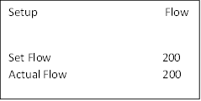
SETUP MENU
Setup Time
03 28 2013 16 : 33 : 24
Measure
Autosave
Sensor
Calibration
Time
Flow
Chamber
Terminals
Board
Notes:
The F-900 has a number of utility functions that allow the user to manage the instrument’s capabilities. These functions are accessed by pressing the right arrow when Setup is highlighted on the Main Menu. The setup utility options are: Measure, Autosave, Sensor, Calibration, Time, Flow, Chamber, Terminals, and Board. Use the up or down arrow to select the desired option and then press the right arrow to verify. Pressing the left arrow will exit to the Main Menu.
We will go over these menu options one-by-one over the next few slides.

Slide 14
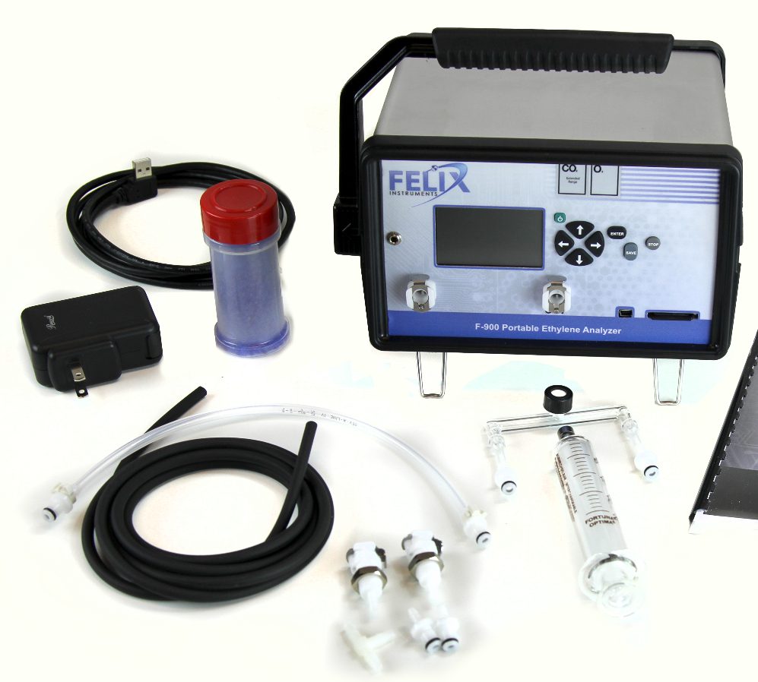
SETUP MEASURE
Monitor Mode
GC Emulation Mode
Notes:
The Setup>Measure menu allows the user to setup a measurement in 1 of 2 different modes: Monitor Mode or GC Emulation Mode.
We will go over Monitor mode first.

Slide 15
MEASURE > SENSOR STABILITY
Data file visible
0-100% stability before progressing into graph and monitor mode
Press down arrow to switch between automatic and manual initialization
Press right arrow to enter measurement modes
Press left arrow to exit to main menu
Notes:
After powering on the unit, and navigating to the ‘Sensor Stability’ screen, the display will show the open File and the gas flow, followed by selection options for ‘automatic’ or ;’manual’ initialization. Once the sensors have stabilized, automatic initialization will proceed directly to measuring in Graph Mode (which is monitor mode displayed graphically). Manual initialization allows the user to initiate Monitor Mode by pressing the right arrow to begin measurements.
It is important to ensure that the IN and OUT ports on the front panel of the instrument are clear from obstruction while taking measurements with the F-900

Slide 16
GRAPH MODE
Visually monitor peaks/spikes in C2H4
Shows stability of sensor over time
Right arrow to get to Monitor mode
Notes:
The unit will enter Graph mode after stabilization has occurred in Sensor Stability mode. Or to enter Graph Mode, press the right arrow when the F-900 is at the Sensor Stability screen. This view graphically displays the measured Ethylene value over time. To switch from Graph Mode into Monitor Mode, press the right arrow.

Slide 17
MONITOR MODE
Real time values are displayed
Press left arrow to enter Graph Mode
Press right arrow to enter Settings menu
Press Stop to stop monitoring and exit
Press down arrow to see more data (flow, CO2, etc.)
Notes:
When the F-900 is in Monitor mode, the large bold value on the top line is the digitally filtered value of the raw ethylene measurements. Next, the relative humidity of the gas stream is displayed (in percent), followed by the temperature in degrees Celsius.
Press the down arrow to view the flow rate (the default is set to 200 milliliters per minute). If the unit has a high resolution CO2 sensor on board, the CO2 value in ppm will be displayed below the ethylene value. If the unit has a low resolution CO2 sensor, or O2 sensor on board, the value will be displayed in percentage (%).

Slide 18
MONITOR MODE AND SETTINGS
Enable/disable conditioning chambers during measurement
Over-ride: PolarCept and offset correction
Closed loop: Closes off valves and recirculates gas internally through unit. Used to clean cell and “burn off” any gases/residue
To reset baseline ( set zero): Must have KMnO4 in Chamber OUT.
Highlight C2H4 next to Set Zeros and press enter twice.
Takes about 25 minutes. Waits for at least 10 min with no more than 40 ppb change to set zero.
Settings
Chamber OUT ON
Chamber IN OFF
Closed Loop ON
Set zeros C2H4
Notes:
The Settings screen is accessed by pressing the right arrow within Monitor Mode, and provides a short list of variables which may be manipulated while measurements are being made. The exterior Conditioning Chambers can be switched On and Off, ‘Closed Loop’ valves can be turned On and Off enabling gas to circulate internally, or the ethylene zero calibration or ‘Set Zero’ process can be initiated. For best accuracy, the set zero process should be done daily for ethylene sensors.
The settings screen also enables the set zero process for sensors, which is part of the daily calibration process of the F-900.

Slide 19
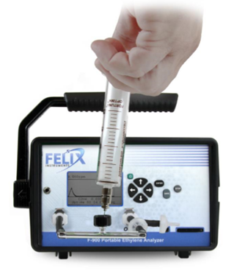
*OPTIONAL* GC EMULATION MODE
Optional mode
Uses injection port (separate accessory)
Small Sample Volume (15 mL)
Requires C2H4 standard gas to calibrate
~3.5 minute sample time
Notes:
GC Emulation Mode is an optional measurement mode designed for small sample volumes and requires the use of an ethylene standard gas and inline injection port seen here.
This mode employs a patent pending Flow Inject Analysis method that integrates the signal from the ethylene sensor for 210 seconds to determine ethylene concentrations ranging from 0.8-20 ppmv with a minimum sample volume of 15ml (larger sample volumes, such as 50 ml, will provide greater accuracy). The resulting value is then compared against a user-definable calibration point and an estimated concentration is determined.
There are several improvements compared to a Gas Chromatograph (GC): There is no need for Nitrogen gas, Hydrogen gas, or bottled air, however Ethylene standard gas is required.
It’s Portable.
There is no heating or oven requirement, and it predicts ethylene concentration without chromatography.
For further information on attachments and known ethylene gas requirements for this mode, please refer to page 25 of the user manual.

Slide 20
SETUP AUTOSAVE
Name individual project files
Repetitive and fast
.CSV file extensions (Comma Separated Values)
Easily functions with Excel
Notes:
To select the Autosave feature, press the right arrow key when Autosave is highlighted. This allows the user to setup the instrument to automatically store measurements, and to start a new measurement without explicitly saving the old one. This mode is convenient when taking fast, repetitive measurements. The files created by the F-900 are saved in .csv (comma separated value) file extensions, to enable ease-of-use with Microsoft Excel or other spreadsheet utilities.

Slide 21
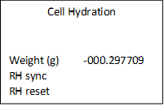
SETUP SENSOR
Sensor Selection: Turn on and off available sensors
Both ethylene sensors should always be ON upon arrival
Sensor Voltammetry: DEEP CLEANING, do not enter unless instructed by a technician, can alter calibration values
Cell hydration: set to 0 when shipped and electrochemical cell full of water
If goes negative (-10 grams of water lost), prompted to hydrate cell utilizing PolarCept
Notes:
The Setup>Sensor Menu has three options, Sensor Selection, Sensor Voltammetry and Cell Hydration. Sensor Selection allows the user to turn on/off the different sensors of the F-900. After selecting any of the menu options from the Setup>Sensor menu, the display will prompt “Are you sure you want to continue?” Press Enter to continue to the selection.
The cell hydration menu outlines details about the water status of the electrochemical sensor. The weight is set to 0.00 grams when the electrochemical cell is completely full, prior to leaving Felix Instruments. As the cell loses water, the weight will become a negative value. If the weight exceeds -10.0 g, the instrument should be hydrated by 10 cc’s, or 10 grams (1cc = 1 g). A positive value indicates hydration gain, a negative value indicates dehydration of the cell.
Sensor Voltammetry settings should only be adjusted by a Felix technician, as this can alter the calibration values.
***** Maybe keep this portion out for a trouble-shooting training
A prompt on the display reading “check cell hydration” indicates 2 possibilities: the ethylene sensor is dehydrated or overhydrated. Rehydrating the ethylene sensor is critical to maintain the instrument and the accuracy of the sensors.
When the ‘check cell hydration’ prompt appears, weigh the entire F-900 (with no water or consumables in the conditioning chambers). Compare this weight to the weight on the Production Check Sheet. To rehydrate the electrochemical sensor, the instrument should be in the closed loop mode. Distilled water should be placed in Chamber In and it should be enabled. Let the instrument run for 12 hours to rehydrate the ethylene sensor. Press stop to exit this mode and return to the Setup Sensor Menu. Re-weigh the instrument to determine if more hydration is needed.
Always have fresh distilled water in Chamber In when rehydrating the electrochemical cell. To dehydrate the sensor, place the instrument in Closed Loop mode with silica gel (humidity scrubber) in one of the conditioning chambers. Enable the chamber with the silica gel and let run overnight. Press Stop to exit this mode and return to the Setup Sensor Menu. Re-weigh the instrument to determine if more dehydration is needed.
Finally, reset the hydration value in the Cell Hydration menu to the current weight minus the shipped weight using the up/down arrows to adjust the value for weight. (Current weight – original weight).

Slide 22
SETUP CALIBRATION
To adjust the offset autocorrection:
Calibration > C2H4 > Offset Autocorrection
Change Enable to “Yes”
Setup interval
Offset (from zero) redone every 24 hours to correct drift-default automatic setting
Happens during sensor stabilization (~30 min)
Always keep KMnO4 in Chamber OUT for zero calibrations!
Calibration Parameters
Internal offset
Internal gain
Calibrated RH
Calibrated t
RH slope
RH offset
t slope
t offset
Notes:
Current Calibration Parameters and re-calibration steps for all sensors can be found in the Calibration Menu. Press Enter to confirm and access the menu. The menu options are Ethylene, Carbon dioxide, oxygen, system DAC and flow.
The ethylene sensor will drift over time making daily manual or auto calibrations a relevant step in gathering accurate data.
Span calibrations of the sensors can be carried out using known gas in the range of each ethylene sensor
***Says “Calibrations to be performed by technicians only” should we change that to :
*Re-calibration or changes to any of the Calibration Parameters for C2H4 must be performed under the supervision of a Felix Instruments technician only?
For more information on individual sensor calibration procedures, please refer to page 44 of the user manual.

Slide 23
SETUP TIME
To change the time and date on the F-900, press the right arrow when “Time” is highlighted on the Setup Menu. This utility allows the user to set-up the instrument in different time zones or to adjust the time after daylight savings.
Notes:
To change the time and date on the F-900, press the right arrow when “Time” is highlighted on the Setup Menu. This utility allows the user to set-up the instrument in different time zones or to adjust the time after daylight savings.

Slide 24
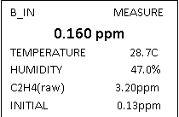
SETUP CHAMBER
Solid Chamber OUT: On/Off
Water Chamber IN: On/Off/Special
Special = PolarCept (bubbler)
Chamber B: Special
Measure Period in min
Cleaning Period in min
Notes:
The Setup>Chamber menu allows you to turn on/off the in-line conditioning columns on the back of the instrument. Once a measurement is in process, conditioning chambers can be turned on/off in the Measurement>Settings menu. If the measurement is started with PolarCept enabled, the measurement must be stopped to make changes to Chamber In at the Setup > Chamber menu.
The removable plastic containers are used to hold the consumables: potassium permanganate, distilled water, soda lime, and silica gel. Keep the plastic containers on the F-900, even when they are empty, to protect the brass intakes.
The purpose of the inbound chamber, ‘Chamber In’ is to condition the air before it reaches the sensor. In “special mode”, ‘Chamber In’ is where distilled water is contained to filter out interfering gases before reaching the electrochemical sensor, you may remember the description of this process from previous slides, called PolarCept Technology.
Chamber Out is the last chamber before the gas OUT port. If the outlet gas stream is connected to the field kit chamber or to the inlet of the unit, it can be used to condition the incoming gas after it leaves the sensor. Chamber Out also houses the potassium permanganate (KMnO4) used during the zero calibration of ethylene sensors.
Additionally, Chamber Out can be filled with soda lime to remove Carbon dioxide from the gas stream, or silica gel to scrub water from air and create a 0% relative humidity OUT gas.

Slide 25
SETUP CHAMBER
Solid Chamber OUT: On/Off
Water Chamber IN: On/Off/Special
Special = PolarCept (bubbler)
Chamber B: Special
Measure Period in min
Cleaning Period in min
Notes:
Chamber In is on the right side of the back panel. This chamber can be enabled in 2 different modes: For PolarCept and for hydration of the cell.
There are three settings for Chamber In: Off, On, and Special (which is used for Polarcept). When Chamber In is set to ON, this enables the use of soda lime to remove carbon dioxide from the gas stream, or silica gel to absorb humidity from air.
Chamber Out is on the left side of the back panel. This chamber can house potassium permanganate (KMnO4) for zero calibration of ethylene sensors, and like Chamber IN can house soda lime or silica gel to condition the gas stream before it is measured by the sensor.
For a diagram and extra direction for the uses of F-900 chambers, please refer to page 54 of the user manual.

Slide 26
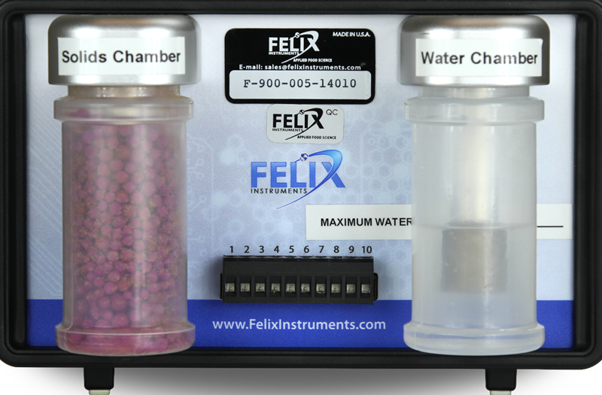
SETUP TERMINAL CONTROL
Users can develop protocols that change the environment of the experiment if an upper or lower concentration is reached.
Increases the versatility of the instrument.
Becomes a Sensor and Controller.
Setup Terminals
VALUE PPB
GAS_HI 00000
GAS_LO 00000
CONTL_OUT DISABLE
CONTL_IN (Clean) DISABLE
Notes:
The Setup>Terminals Menu is where the F-900 can be setup to have an external fan or gas control connected to the terminal block. The terminal block is located between the chambers for consumables on the back panel of the F-900. The F-900 can turn on and off the gas based on the measured ethylene concentration of the room (or chamber). Other control applications using the terminal block are possible, such as controlling ethylene scrubbers or connection to an external control system.
The F-900 will perform action at the high and low levels, when set. If the concentration of ethylene rises above the Gas_Hi, the gas will be shut off. If the ethylene concentration is lower than the Gas_Lo, the gas will be turned on.

Slide 27
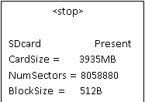
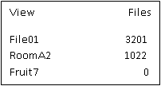
VIEW MENU
Files
Voltage
Battery
Flash
Time
GPS
SDcard
Notes:
The View Menu can be accessed from the main menu screen by pressing the right arrow key when “View” is highlighted on the display. This menu allows the user to navigate to and see the files, as well as check on many features of the F-900. Options from the View Menu are: Files, Voltage, Battery, Flash, Time, GPS, and SD card.

Slide 28
FILE MENU
Clear
Delete
Create
Open
All edits to the SDcard must be made through the file menu
Notes:
The File Menu is accessed by highlighting “File” on the Main Menu and pressing the right arrow key. Here, the user can manipulate files on the F-900, with options to clear, delete, create and open files. The F-900 uses an SD card to store all measurements. This means the user is able to create, clear and delete any measurement file. To view data on a computer, simply insert the SD card into the computer’s SD card reader. The computer should automatically detect the SD card as a new storage device and mount the drive so that measurement data will be accessible by any computer application. The mini-USB port can also be used to establish a USB connection with a computer to transfer data from the F-900.

Slide 29
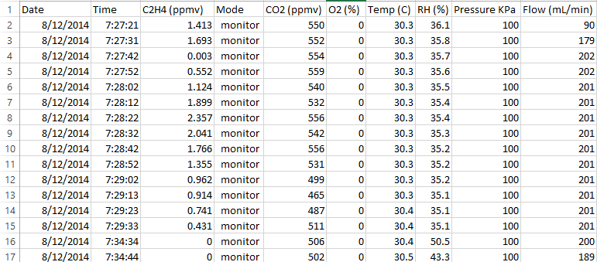
DATA FILE
Notes:
The figure below is an example data spreadsheet. Data values included are the date and time of the measurement, the ethylene level in ppm, the mode (monitor, measure or cleaning, offset or GC emulation), the CO2 and O2 concentration, the temperature of the gas stream in degrees Celsius, the relative humidity (RH) of the gas stream in percent, the atmospheric pressure (KPa) and the flow rate of the gas stream in ml/min. In this example, when the CO2 or O2 sensors are not being used, the concentration values are zero. For the mode, monitor indicates measurements without PolarCept, sm_measure or sm_clean indicate PolarCept, and offset indicates zero calibration.

Slide 30
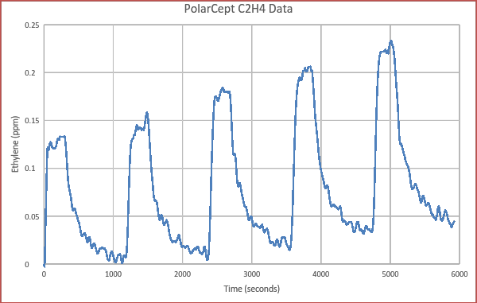
POLARCEPT DATA
Measure
Cleaning
Notes:
This graph displays an example of ethylene data plotted utilizing PolarCept, that shows the typical peaks and valleys for the measure and cleaning cycle. At the end of the cleaning time, the ethylene level should be low (below 0.2 ppm). If a low ethylene concentration is not seen at the end of the cleaning period, lengthen the Cleaning period in Setup > Chamber > Chamber In = Special and test again.

Slide 31
FIRMWARE UPDATE V4.6.6.0
Download instructions
Release notes
Controller software
http://felixinstruments.com/support/f-900-support
Notes:
The latest release of firmware for the F-900 can be found at this link, as well as the release notes providing specific information about what changes have been made in the newest firmware version.
Controller software download is also available, which is used for real-time monitoring and control of the F-900, as well as recalibration of F-900 units. Java is required to run the controller software.

Slide 32
F-900 PACKAGES
Optional PPM CO2 sensor available (0-2000 ppm)
Optional PCT CO2 sensor available (0-20%)
Optional O2 sensor available (0-100%)
Optional GC Emulation accessory port
Annual Maintenance recommended for all F-900 instruments and sensors
Notes:
The F-900 can come with optional sensors and GC emulation accessory ports as we previously discussed, we recommend annual maintenance on your F-900 which is worthwhile to utilize considering the first year is under warranty.

Slide 33
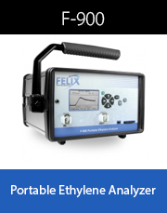
THANK YOU!
support@felixinstruments.com
Notes:
Thank you very much for your time and attention during today’s training.
For additional support, questions or concerns please contact us at support@felixinstruments.com, we are always happy to assist you and to learn about your research applications.
Are there any questions?

