Slide 1
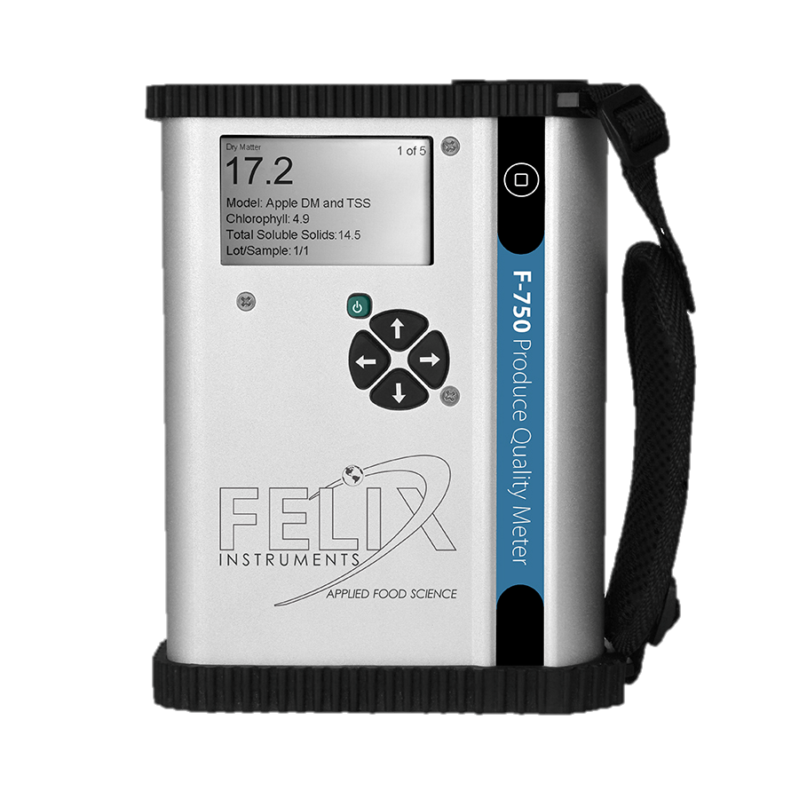

F-750 Produce Quality Meter
Training materials 2/3/16

Slide 2
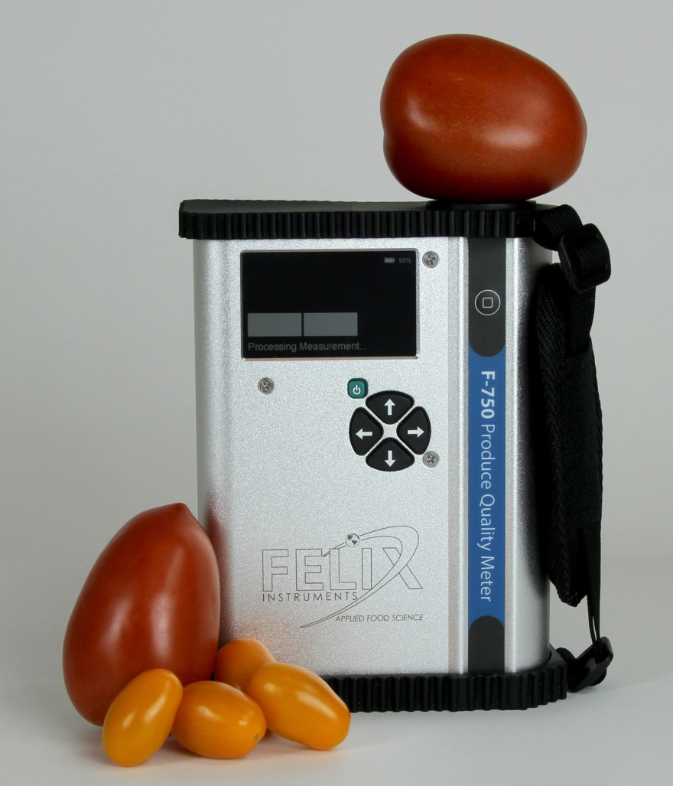
F-750 Features
Portable, lightweight and easy to operate.
One button operation for recording
new measurements.
Repeatable, Precise, and Non-destructive
measurements.
Spectrometer standard deviation > 0.017%
True Sunlight Readable Transflective Display.
The contrast of this display actually increases under brighter sunlight.
Removable, re-chargeable standard sized batteries
Includes a stand-alone battery charger which enables the charging of one set while using another. Two sets of batteries are included with the device.
48 Channel GPS
Allows spatial mapping of collected data

Slide 3
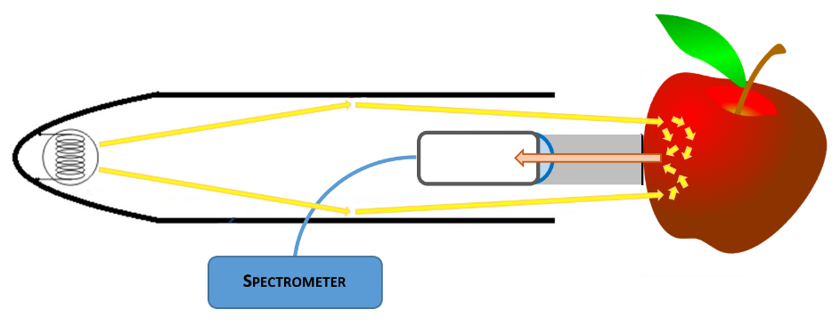
Theory of Operation
Lets you see tissue instead of skin
Fig. Interactance optical design; light rays illuminate an anulus on the sample. The light then interacts with the sample by internally scattering through the tissue. Light that undergoes remission normal to the collimating lens is collected and focused onto the fiber.

Slide 4

Theory of Operation
The F-750 can be used to non-destructively predict major traits in most commodities.
F-750 Can Measure
F-750 Cannot Measure
Sugar content in an Apple
Dry Matter content in a Mango
Acid content in a Clementine
Liquids in Transflection
Acid content in an Apple
Through the skin of an Avocado
Sugar content in a Lime
Spectroscopically differentiate sucrose vs fructose
Useful tool for the study of internal fruit qualities using a non-destructive method

Slide 5
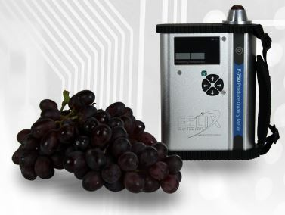
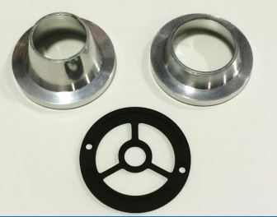
Small Fruit Adapter

Slide 6


Small Fruit Adapter: Theory
Light may still escape around the fruit. (dashed line)
Light will interact with the fruit. (double dot line)
The cone focuses stray towards the fruit, some of which will scatter towards the detector. (solid line)

Slide 7
Small Fruit Adapter: Consistent Sample Presentation
If the 19mm cone is selected during model development, then the 19mm cone must be used (with the model) in the field.
Orientation within the cone should be consistent
If a fruit is larger than most and does not fit into the cone, throw it out, do not force it into the cone!
Fruit must be bigger than the small middle circle of adapter (base plate)

Slide 8
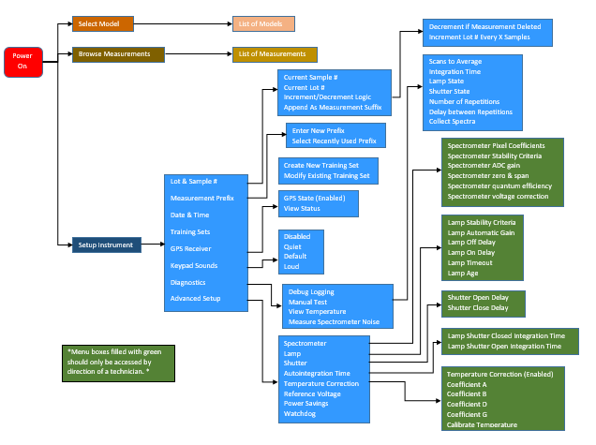
MENU MAP
http://felixinstruments.com/support/f-750-support/training-videos

Slide 9
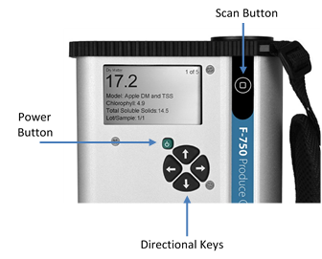
Basic Operation of the F-750
To take a measurement, power on the F-750 Produce Quality Meter. The current model will be displayed.
Hold the sample to the lens so that it makes contact with the perimeter of the bracket around the lens. Press the square scan button to record a new measurement.
The data is stored to a removable SD card which can be downloaded onto a computer for further analysis.
Notes:
With the default model loaded onto the device…

Slide 10
Data Viewer
Allows easy access to all data collect by the F-750. (*.f750ts and *.dat files)
File > Open > select files – loads data into software
File > Export - allows for the export of specific types of information
File > Archive – exports all data into the designated folder.
Notes:
F750ts are special files used for the development of a calibration during the model building process. (Which we will talk about shortly) dat files are the regular buttons scans. These scan contain the same information. Training sets were developed to stream line the modelbuilding process.

Slide 11
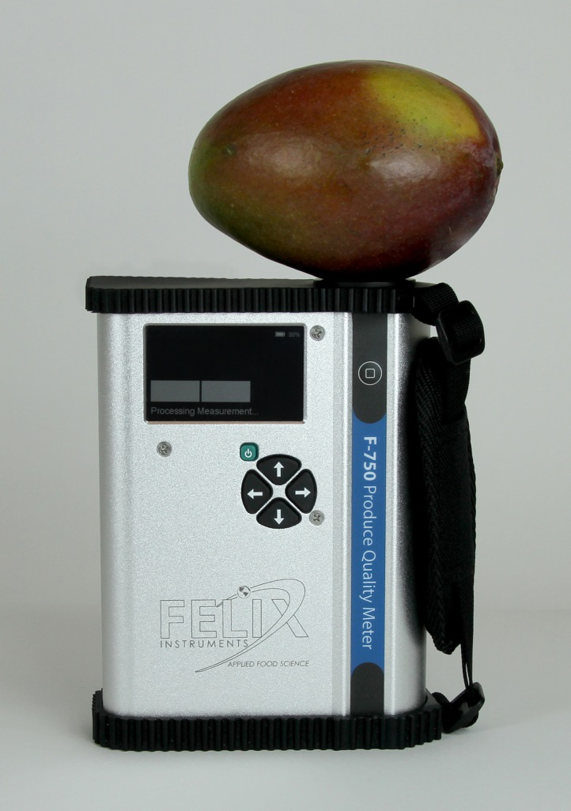
F-750 Initial Setup: Building a Calibration
For every commodity and trait, an initial calibration process, referred to as the model building process, must be under taken.
Once the model is built, it must be validated by testing the calibration against additional fruit.
After the model is built and tested, you can confidently use the F750 for nondestructive testing.

Slide 12
Model Building Process
Step 1: Select a population of fruit, ranging in size and maturity to span all possible variation.
Step 2: Create a training set file and scan the fruit
Step 3: Collect reference data from the scanned location
Step 4: Import training set file and reference data into model builder software
Step 5: Select wavelength window and build the model
Step 6: Save modelbuilder file to the F-750 SD card
Step 7: Validate and use the model

Slide 13
Model Building Process Continued
A detailed procedure of the model building process can be found in the owners manual.
Felix Instruments has also created a Standard Operating Procedure (SOP) for the creation of a Mango model file.
http://www.felixinstruments.com/Manuals/F-750/Mango%20Data%20Collection%20Standard%20Operating%20Procedure.pdf
Notes:
Good lace to go over making a training set file

Slide 14
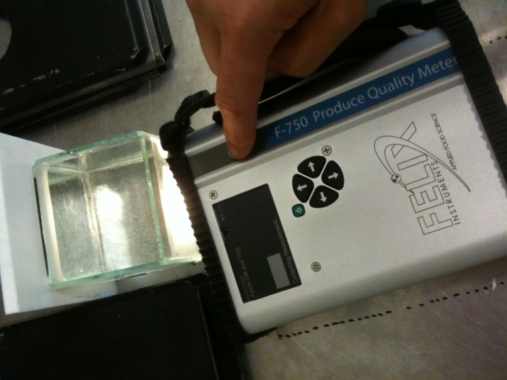
Interactive Demo of Model Builder
Open Model Builder Software
Import the Interactive-Demo.f750ts file
Download demo files:
felixinstruments.com/support/f-750-support/training-session-materials
There is also an interactive tutorial in the owners manual that covers additional techniques to optimize the calibration model.

Slide 15
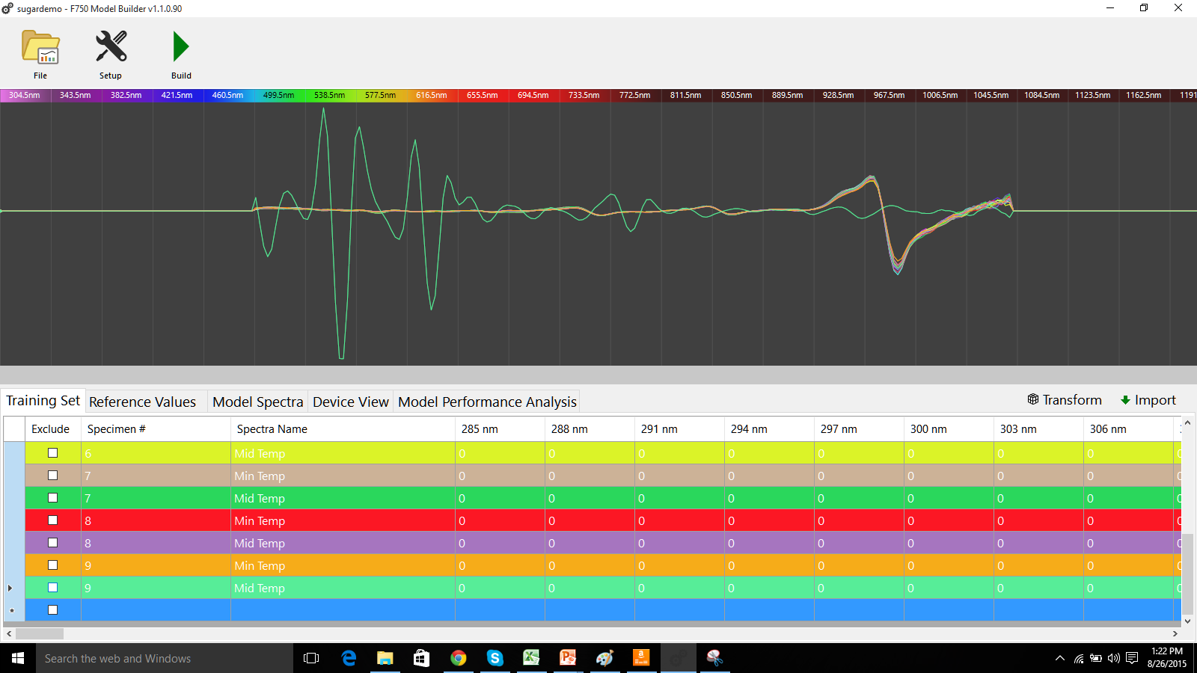
Transfection Brix Demo Data
outlier
Click here
(Highlight all spectra)
Notes:
Outlier is because intern removed f750 from sample during scanning

Slide 16
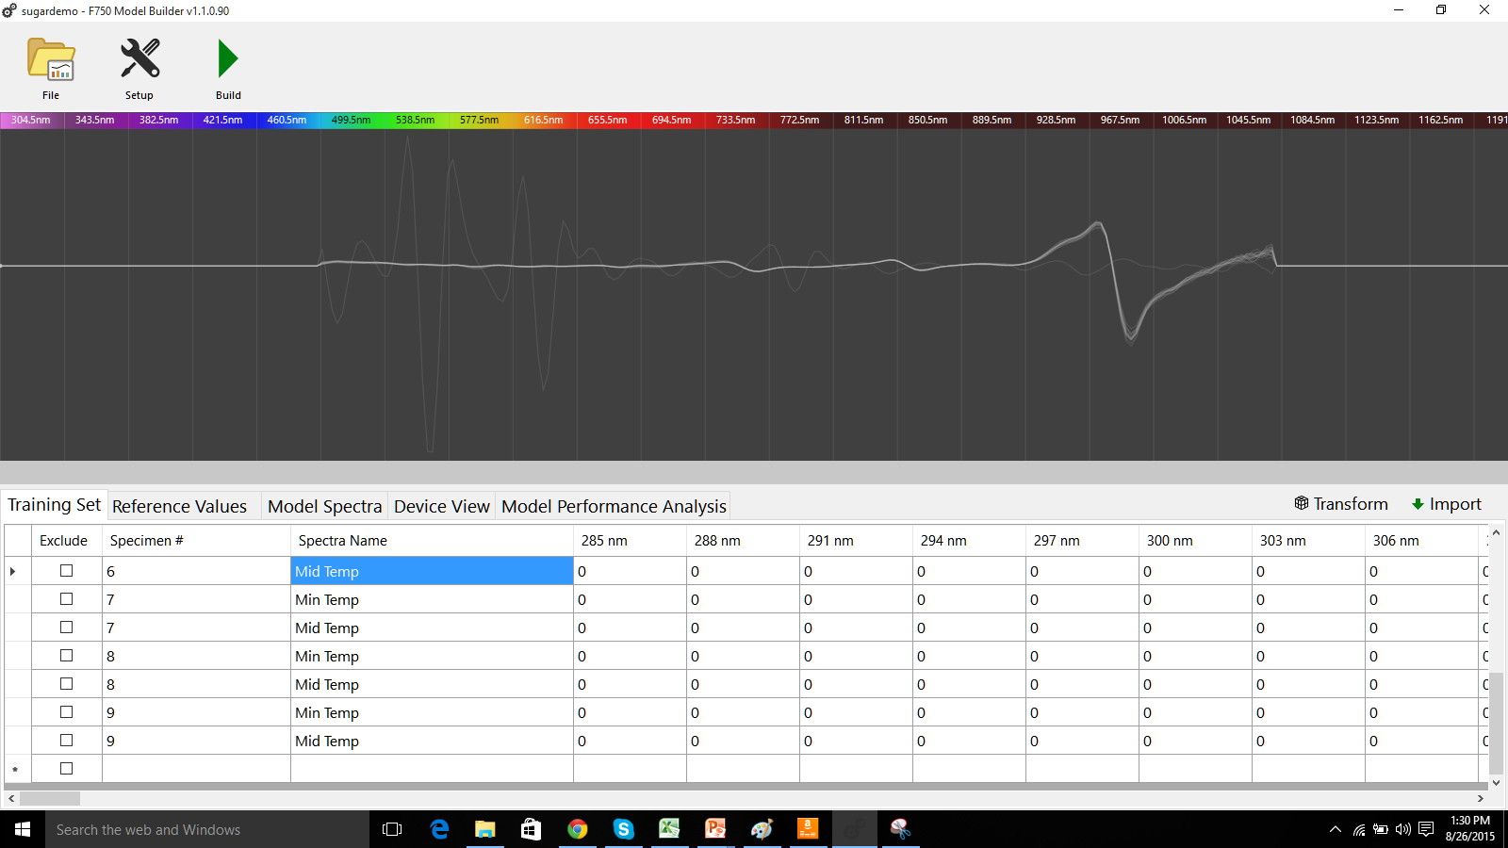
CRTL Click here
NOTE: Might need to zoom to select spectra.
Modelbuilder supports scroll wheel, touch pad,
and CRTL+ keyboard zoom.
(Highlight outlier spectra)
Click here
(Deselect all spectra)

Slide 17
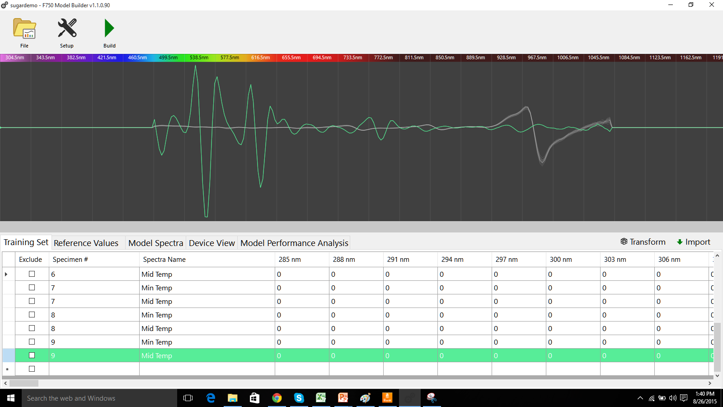
Excluding Specimen
Click here
(Exclude outlier spectra)

Slide 18
Correct Data Entry into Model Builder
Training Set TAB
Reference Value TAB
Scan_1 Specimen #1 min temp
Scan_2 Specimen #1 mid temp
Scan_3 Specimen #1 max temp
Scan_4 Specimen #2 min temp
Scan_5 Specimen #2 mid temp
Scan_6 Specimen #2 max temp
Scan_7 Specimen #3 min temp
Specimen #1 11 brix
Specimen #2 15 brix
Specimen #3 17 brix
Specimen #4 12 brix
Modelbuilder uses a “many:one” mapping of spectra to reference value.
If you have 100 fruit each scanned 3 timed at the same location then you have;
300 scans = 100 specimen = 100 entries for reference values

Slide 19
Improper Data Entry into Model Builder
Training Set TAB
Reference Value TAB
Scan_1 Specimen #1 min temp
Scan_2 Specimen #1 mid temp
Scan_3 Specimen #1 max temp
Scan_4 Specimen #2 min temp
Scan_5 Specimen #2 mid temp
Scan_6 Specimen #2 max temp
Scan_7 Specimen #3 min temp
Specimen #1 11 brix
Specimen #2 11 brix
Specimen #3 11 brix
Specimen #4 15 Brix
Specimen #5 15 brix
Specimen #6 15 brix
Specimen #7 17 brix
Inputting data in this format WILL NOT WORK AND WILL GIVE POOR RESULTS
If you have 100 fruit each scanned 3 timed at the same location then you have;
300 scans = 100 specimen = 300 entries for reference values
Modelbuilder will only use the first 100 entries in the reference value tab,
because there are only 100 specimen indicated in the training set tab.

Slide 20
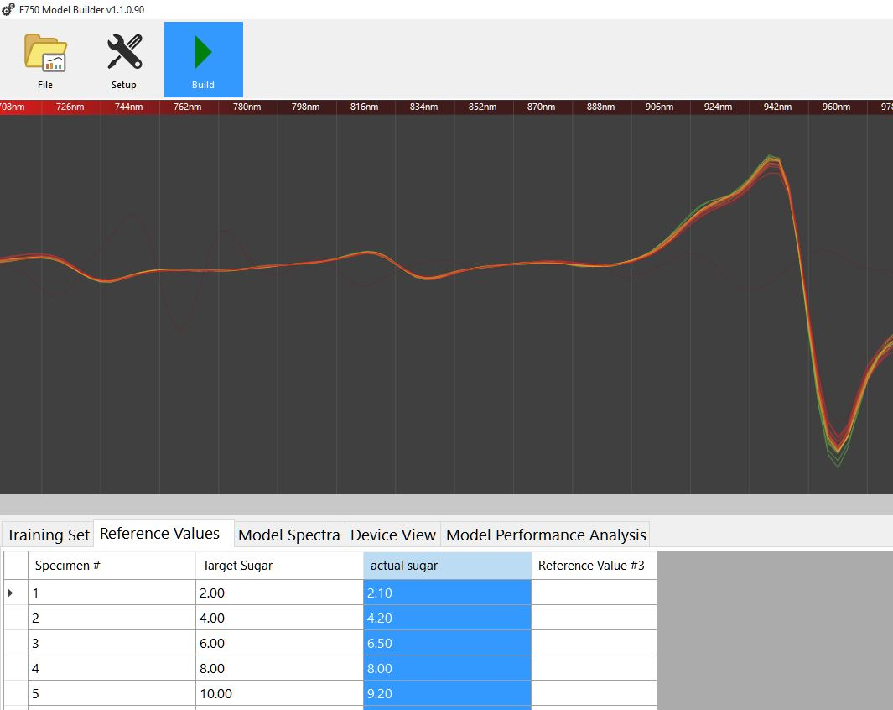
Step 3: Importing Reference Values into Model Builder
If they are in CSV format, they can be directly import. If they are not in CSV format, they can be manually entered or copied and pasted from Excel.
Be sure that all specimens included in the training set also have corresponding Reference Values.
To change the column headers, double-click to rename them (e.g. Dry Matter or TSS).

Slide 21
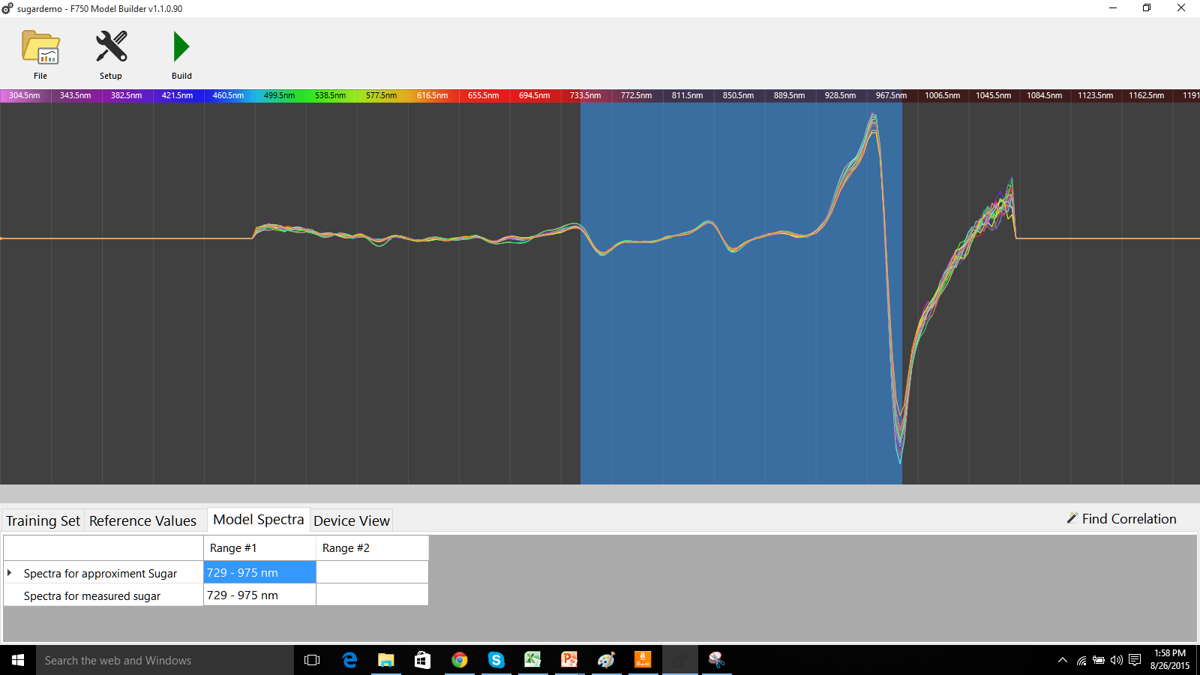
Step 4: Select Spectra and Build Model

Slide 22
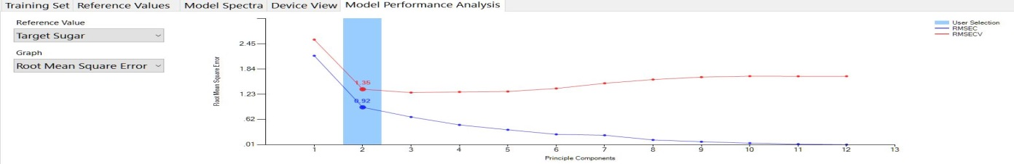
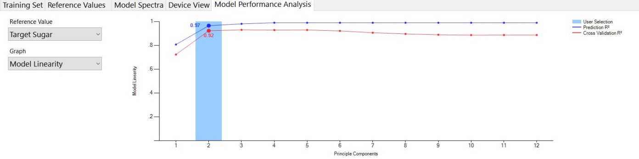
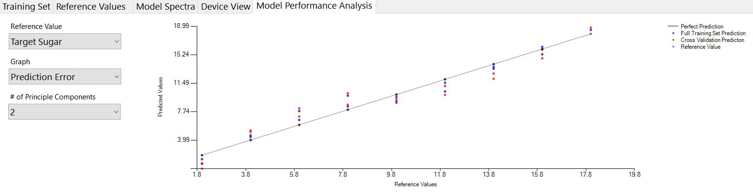
Step 4: Creating a Model Continued
Root Mean Square Error: Average uncertainty (error) of any individual measurement.
Model Linearity: ‘Goodness of fit’ for the selected number of principle components.
Prediction Error: This graph depicts reference versus predicted values for each specimen. Cross validation uses ‘leave one out’ grouping by specimen number to simulate an independent data set.
Notes:
These are the only graphs of primary importance. RMSE is used to determine the optimal number of PCs. Jackknife like method

Slide 23
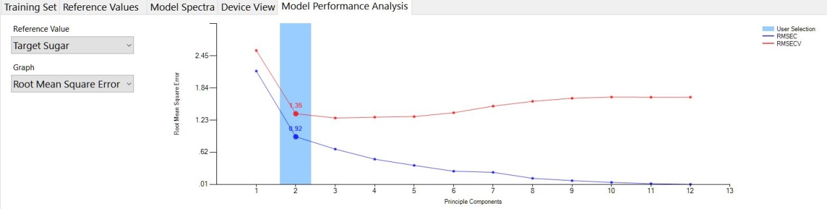
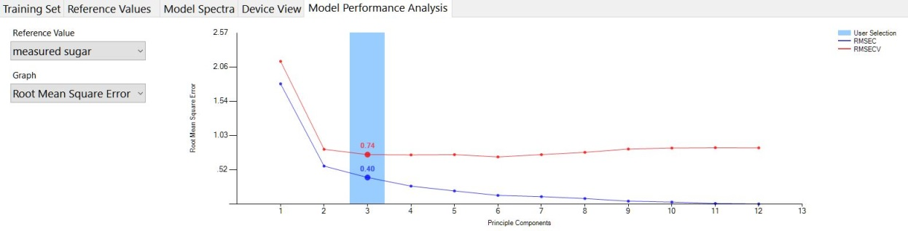
Affect of Error in Reference Method
A Partial Least Squares Regression can only be as accurate as the reference method used.
In the case of the demo, the model build with estimated Brix has double the error of the Measured Brix.
Specimen | Estimate | Actual
1 | 2.00 | 2.10
2 | 4.00 | 4.20
3 | 6.00 | 6.50
4 | 8.00 | 8.00
5 | 10.00 | 9.20
6 | 12.00 | 10.40
7 | 14.00 | 12.70
8 | 16.00 | 13.90
9 | 18.00 | 16.00

Slide 24
Validating the Model
After a model has been created and saved back to the SD card for use on the F-750, it is important to validate that the model is working correctly. You can then use your selected reference method (used to calculate Reference Values) to verify that these values are accurate to those that the device shows.
Important notes:
  The model’s margin of error is based on the training set, quality of reference method and if the region selected in the training set has a direct correlation.
  Specimens above or below the range of Reference Values used to create the model will not predict accurately. This is why it is so important to select a wide range of fruit at various stages of maturity when you are creating the initial training set.
  Model performance reflects how well the training set represents prediction subjects.

Slide 25
Questions

Slide 26
Appendix of old slides

Slide 27
Appendix Step 1: Creating a Training Set
For training set creation, use pieces of fruit across the full range of fruit maturity. In general, the more specimens used to make the model, the more accurate it will be at predicting values.
Each specimen should be labeled with a specimen number
Specimen should be measured at three temperatures (Minimum, Mid, and Maximum). This increases the accuracy of the predictions. For example, 10ºC, 20ºC and 30ºC.
After a new training set file is created on the F-750, Place your first specimen on the eyepiece, and with “Specimen 1” highlighted on the list, Press right arrow to collect the training spectra. The instrument will indicate “Processing”. Do not press the square/scan button to gather training set spectra.
Repeat for all specimen at all three temperatures.

Slide 28
Step 2: Collecting Reference Values
To collect Reference Values, the same fruit specimens used in training set creation will be measured. The Reference Values are those values determined by your reference method (i.e. a destructive measurement of TSS or DM). For example, if you intend to measure brix, Reference Values could be measured with a refractometer, or total acids could be measured through acid titration.

Slide 29
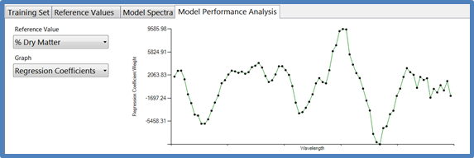
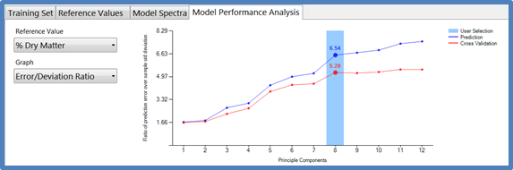
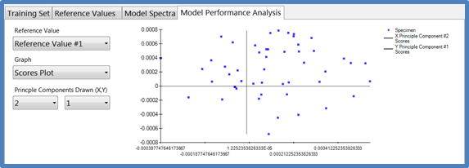
Appendix Step 4: Load Model Onto F750
Regression Coefficients: Mathematical significance of each pixel, selected in spectra selection, which is used to make predictions.
Error/Deviation Ratio: Ratio of standard error of prediction to the standard deviation of the reference population. This represents a qualitative goodness of fit
Scores Plot: Displays how close each spectra is to the principle components used to create the model. Distinct groups of points indicate “like” specimen.

Slide 30
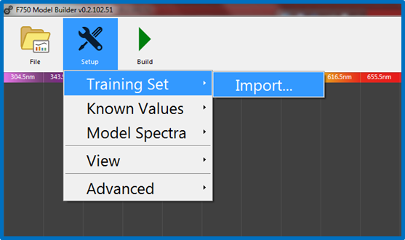
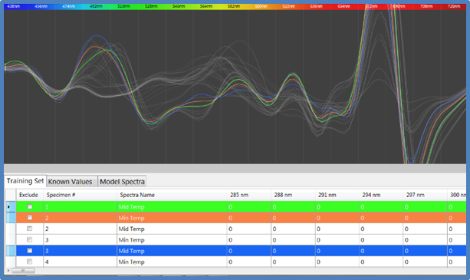
Step 3: Importing a Training Set and Reference Values into Model Builder
Open the Model Builder software. This software is located at www.felixinstruments.com
Insert the SD card into the computer, and Import the training set.
You will be prompted with the message “Would you like to overwrite the existing training set?” Select “Yes.”
Model builder will automatically populate the training set and the spectra should now be displayed on screen. Specimen number, Spectra Name (Min, Mid, Max temp), and the pixel values can be found under the training set tab at the bottom of the screen.

Slide 31
F-750 Specifications
Spectrometer | ZEISS MMS1 VIS-NIR
Wavelength Range | 300 - 1100nm (+/- 10nm)
Spectral Sampling | 3nm
Spectral Resolution | 8-13nm
Accuracy | +/- 0.5 Brix RMSEP (root mean square error of prediction)
Battery Life | 1600 samples (Variable based on operation)
PC Interface | USB and SD card
Data Recorded with Each Measurement | Raw Data Reflectance Absorbance Second & First Derivatives Second Derivative Absorbance
Temperature Range | 0-50^{O}C
Weight | 2.43 kg
Dimensions | 7.1 x 4.75 x 1.75 inches ( 18 x 12 x 4. 5 cm )

