Slide 1
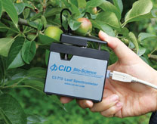
CI-710 Instrument Training
Conducted by: Brienne Meyer
bmeyer@cid-inc.com

Slide 2
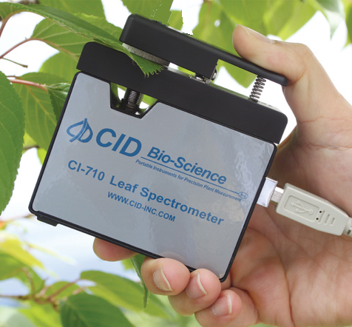
CI-710 Miniature Leaf Spectrometer
Truly portable
Field-ready with leaf probe
Wide-range spectrum
400nm-950nm (PAR & NIR)
High-resolution (~1.5nm)
Real-time display
Lightweight (~290g)

Slide 3
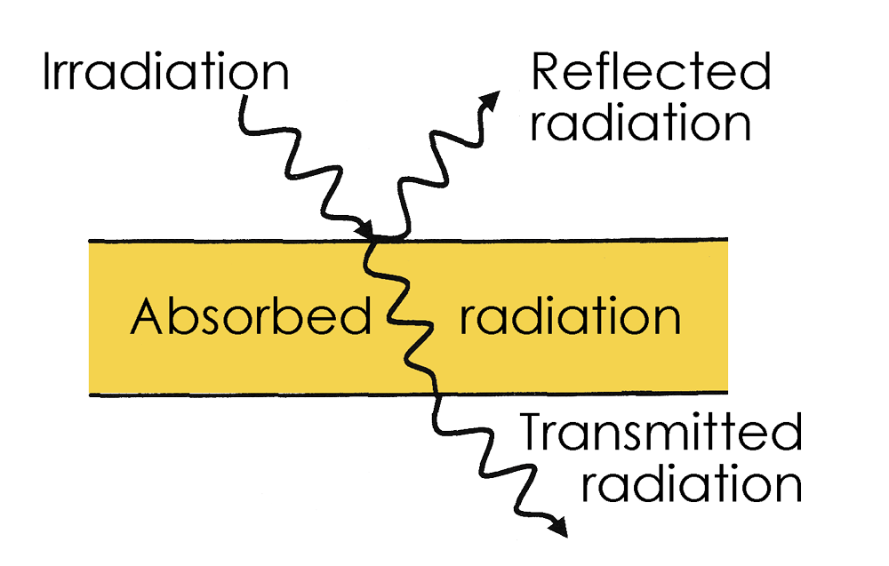
What does the CI-710 measure?
Transmission/absorbance mode:
Light passing through the leaf
Reflectance mode:
light reflecting from leaf surface
Source: www.ceramicx.com/infrared-heat/

Slide 4
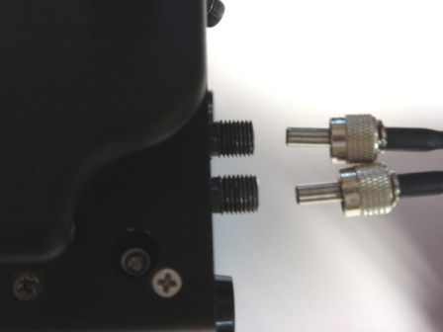
CI-710 Theory of Operation
Bifurcating fiber optic cable
Range 400-950nm
Reference light beam from 2 sources
Blue LED & Incandescent lamp
Output in the visible-to- infrared range

Slide 5
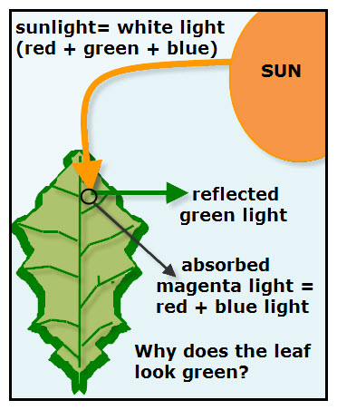
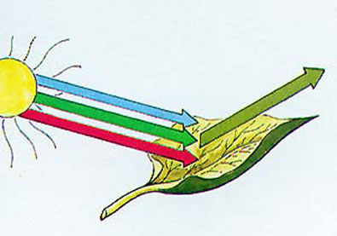
CI-710 Theory Continued
Most photosynthetically active green leaves:
strongly absorb blue/blue-green and red light
reflect green and yellow light
Source: scienceprojectideasforkids.com
Source: www.shortcourses.com

Slide 6
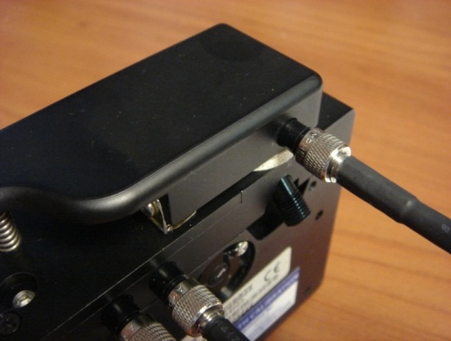
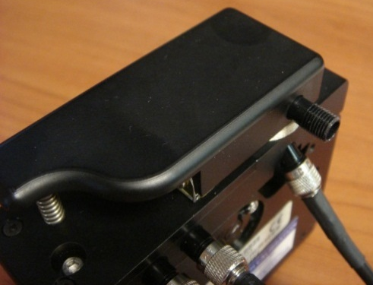
CI-710 Theory III
Light source has 2 positions:
transmission/absorbance or reflectance mode
Transmission and
Absorbance Mode
Reflectance Mode
Light travels through fiber optic to leaf probe and leaf

Slide 7
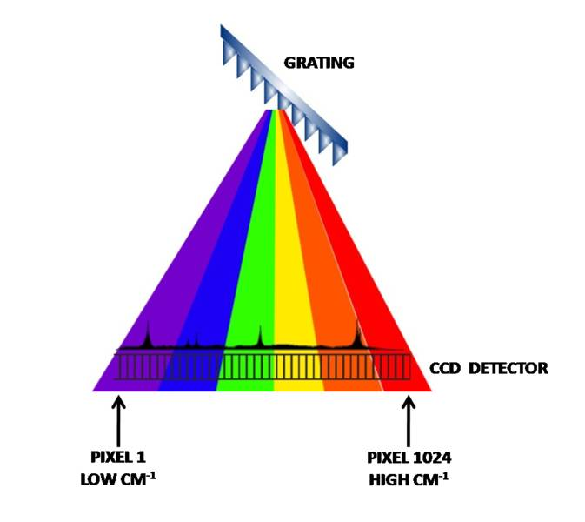
CI-710 Theory IV
Disperses light by a diffraction grating
Projects the dispersed light onto a CCD array
Each pixel corresponds to a specific wavelength of light
SpectraSnap! displays light intensity of each pixel
Source: www.horiba.com

Slide 8
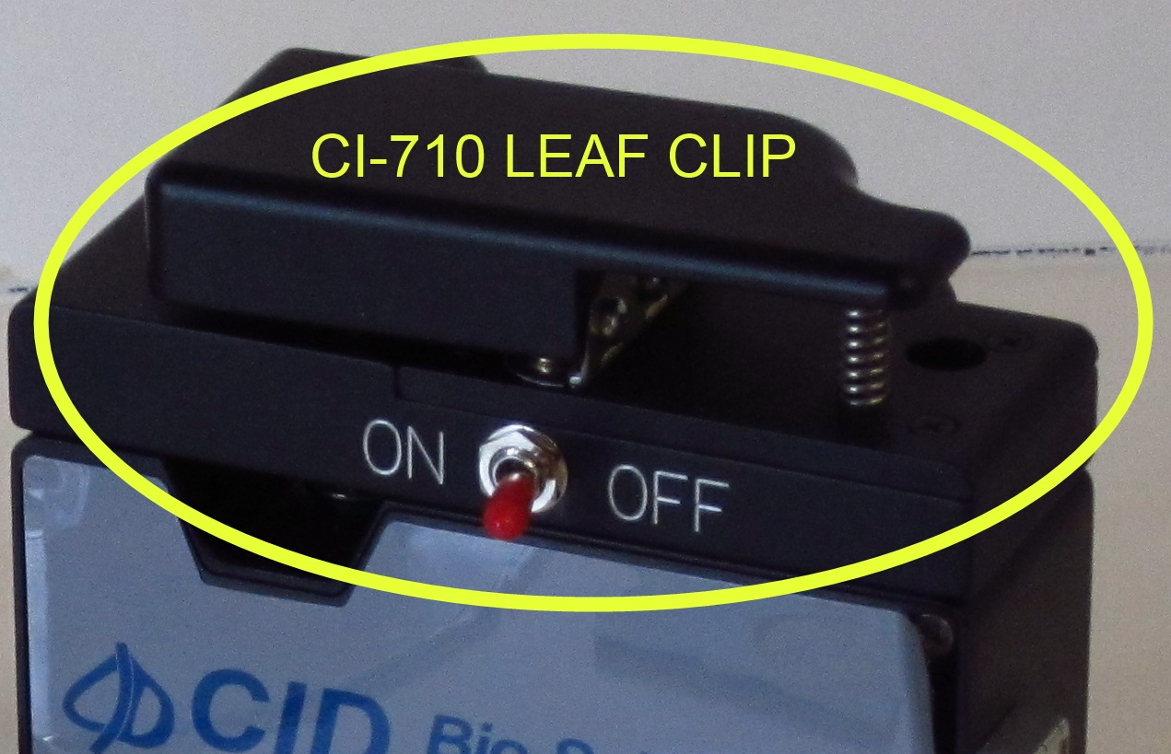
CI-710 Leaf Clip
Also referred to as leaf probe
Isolates stray light
Secures specimen
In transmission or absorbance mode,
the leaf clip scatters
the source beam

Slide 9
CI-710 Applications
Measures light transmission, absorption and reflection of leaves
Measure optical properties of glass
Weng JH. et al. RELATIONSHIPS BETWEEN PHOTOSYSTEM II EFFICIENCY AND PHOTOCHEMICAL REFLECTANCE INDEX UNDER DIFFERENT LEVELS OF ILLUMINATION: COMPARISON AMONG SPECIES GROWN AT HIGH-AND LOW ELEVATIONS THROUGH DIFFERENT SEASONS. Trees-Structure and Function, volume 26, issue 2, pages 343-351, April 2012
National Chung Hsing University, Taiwan

Slide 10
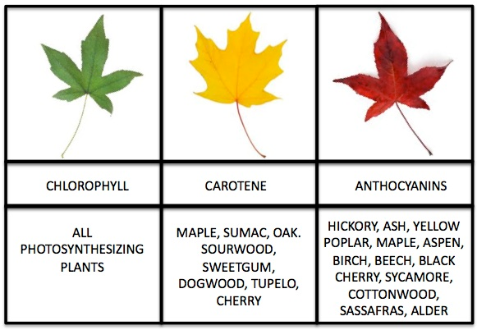
CI-710 Applications Cont’d
Qualitative spectral data from interaction of light with leaf
Pigments, organic compounds, and inorganic chemicals exhibit distinct wavelength characteristics
Common Plant Pigments
Leaf surface characterization
Photochemical reactions
Index of refraction
Source: www.cameratechnica.com

Slide 11
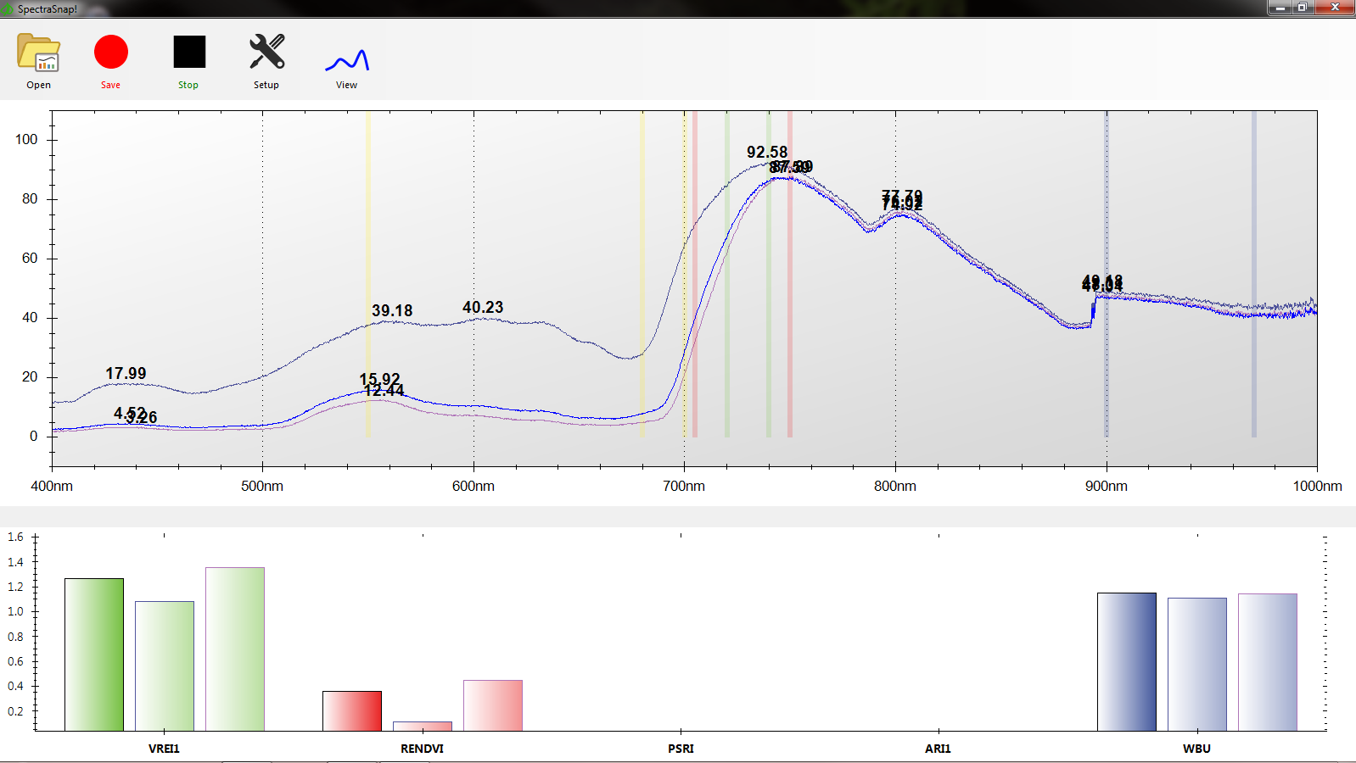
CI-710 General Points
USB powered by tablet or laptop PC
SpectraSnap!
Waveform and wavelength values
Peaks
Pre-loaded
indices
SpectraSnap!

Slide 12
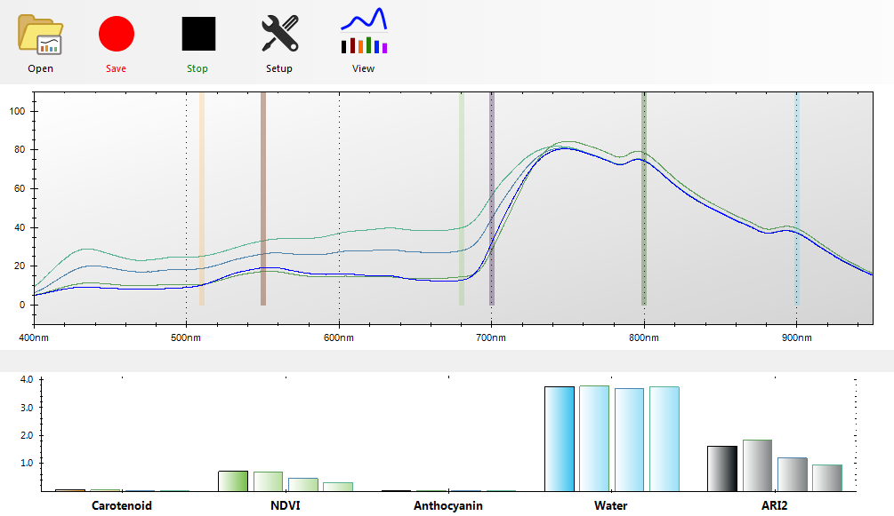
SpectraSnap!
Driver installation built in to software
Analyze multiple peaks
Integrate across wavelength bands
Compare specimens
Add layers
Import previously
saved layers

Slide 13
SpectraSnap! Indices
Normalized Difference Vegetation Index (NDVI)
Plant Senescence Reflectance Index (PSRI)
Pigments: Anthocyanin, Carotenoids
Add custom algorithms/indices
Simultaneously monitor and record indices
Source: www.exelisvis.com

Slide 14
Are the index measurements direct?
The index measurements are relative.
Example:
The CI-710 can measure the green-ness of leaves, which is related to chlorophyll content.
A researcher can combine measurements from the 710 and data from chlorophyll extraction to develop a species-specific correlation for absolute quantitation.

Slide 15
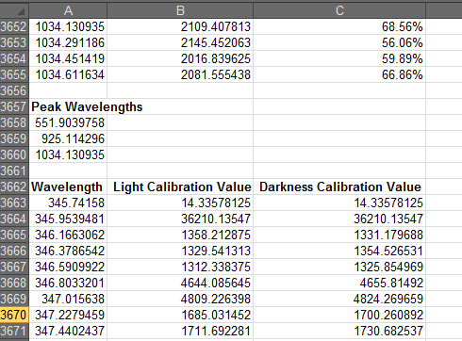
SpectraSnap! Data

Slide 16
CI-710 Tips
Warm-up time: 15-30 minutes
Recalibrate often
Use reflectance standard to calibrate in reflectance mode
white circle faces down
Use a black backing on other side of leaf in reflectance mode

