Slide 1
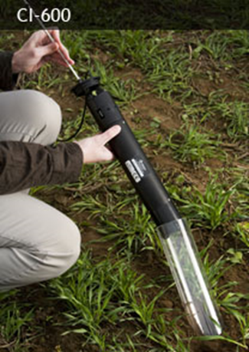
CI-600 & CI-690 Product Training
Conducted by: Brienne Meyer
bmeyer@cid-inc.com

Slide 2
CI-600 In Situ Root Imager
Provides a high-resolution underground color image of living roots in the soil
Observation of root growth and behavior over time; one or multiple growing seasons
Portable and field ready for fast accurate root and soil images
  One scanner with multiple tubes for many field sites

Slide 3
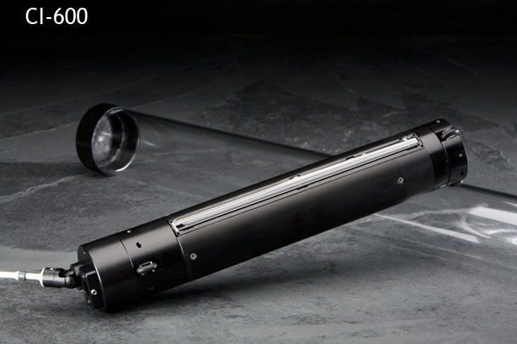
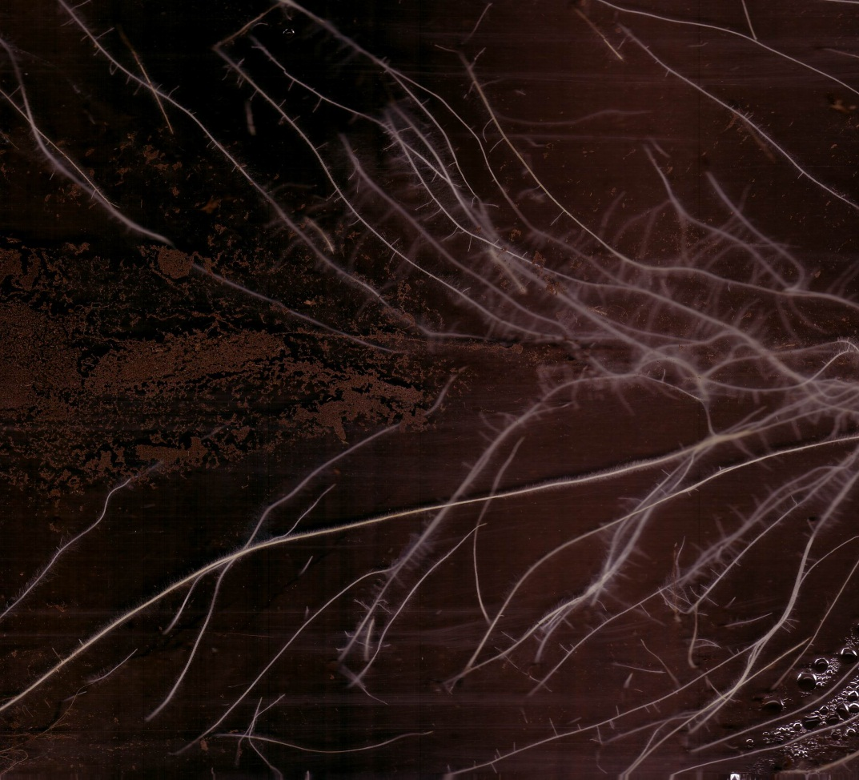
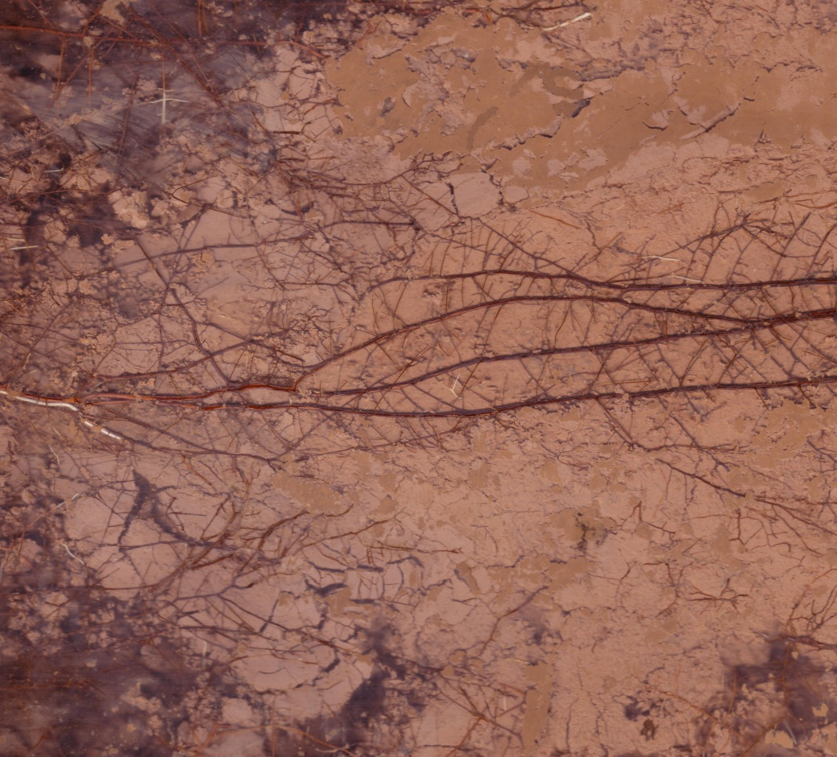
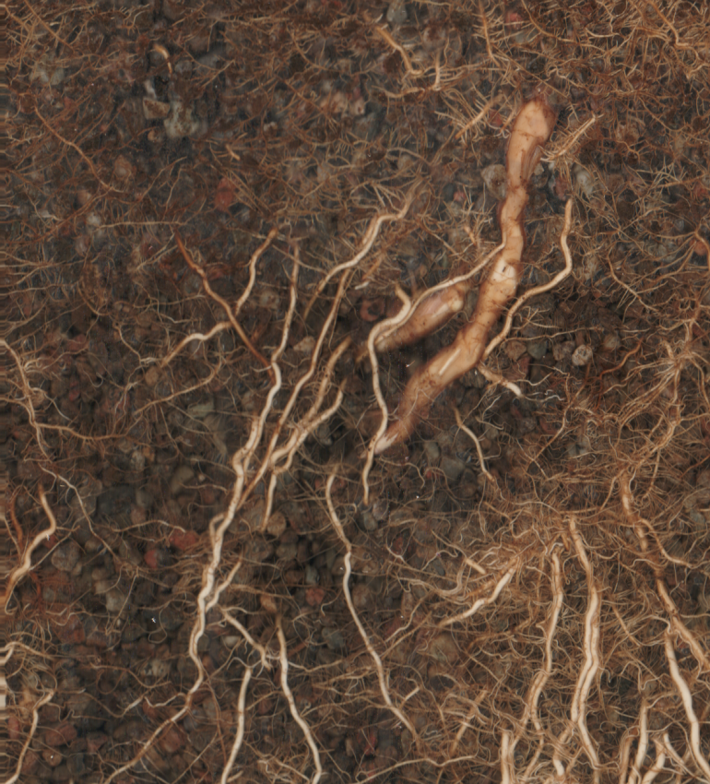

Slide 4
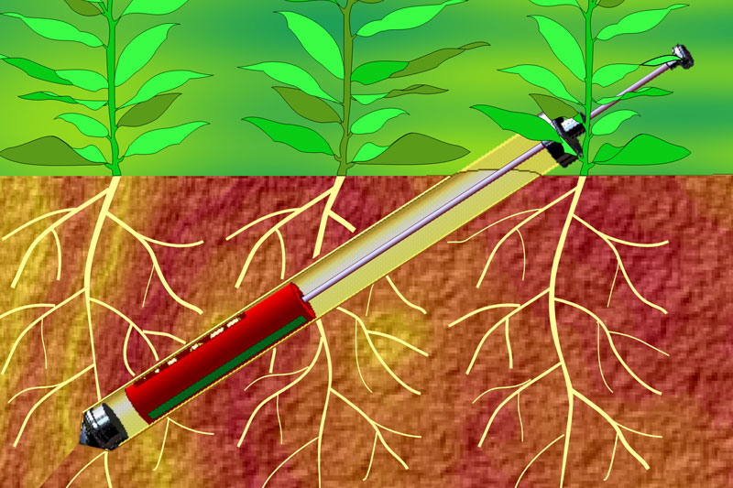
Theory of Operation

Slide 5
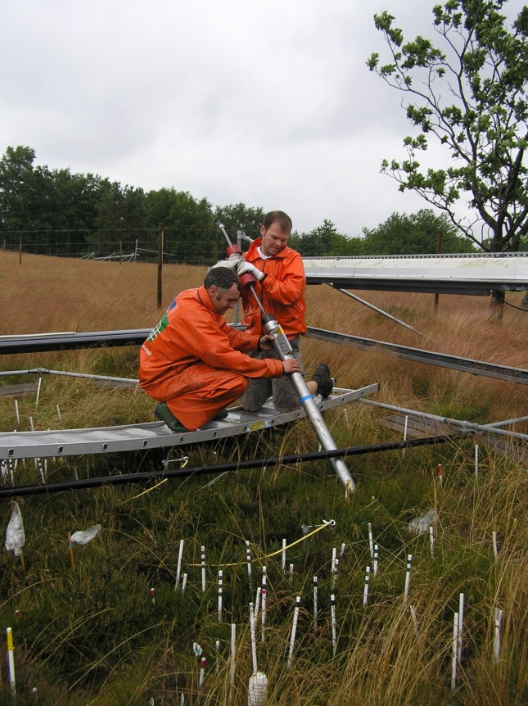
Root Tube Installation
How do I install the root tube?
  Each situation different
  Gas-powered auger
  Trenching
  Other methods
At what angle should the tube be?
  45^{O} or 60^{O} angle
  Vertical or horizontal
  depend on the species, type of study
Dr. Marie Arndal
University of Copenhagen
Center for Permafrost (CENPERM)
Notes:
Tube angle variability = versatility of minirhizotron

Slide 6
CI-600 Software
CI-600 requires a USB connection (tablet computer included)
  Run the software
  Store and save root images
  Store images with ICAP naming for easy importing into CI-690 root analysis software
    Tubes, window, session, user

Slide 7

What’s in a root image?
Over time researchers can study:
  Root turn-over (growth & death)
  Fine root growth
  Root hair formation
  Branching patterns & behavior
  Standing stock
  Control vs. treatment
  Root distribution
  Root interactions with parasites or mycorrhizae
  High-definition of objects smaller than 0.1 mm
Root Hairs

Slide 8
Acquire Root Images
Rotate to Home
  Always line up the silver dots before you calibrate or insert into the tube
  Home position is where scan will start from
Calibrate
Scan
Collapsible Rod

Slide 9
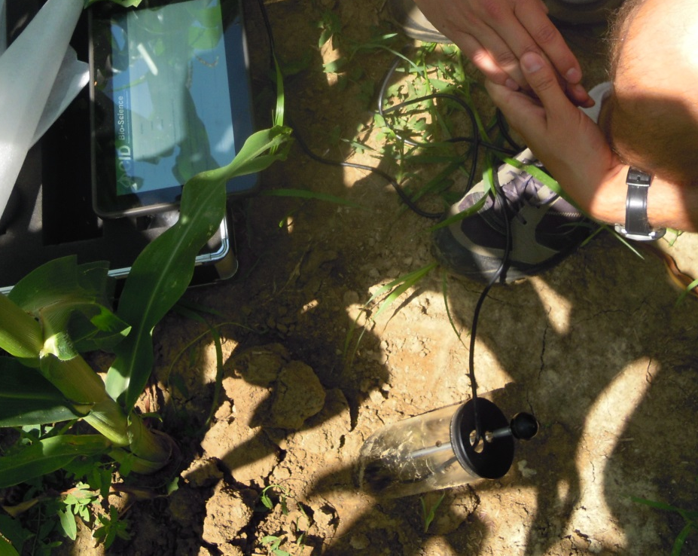
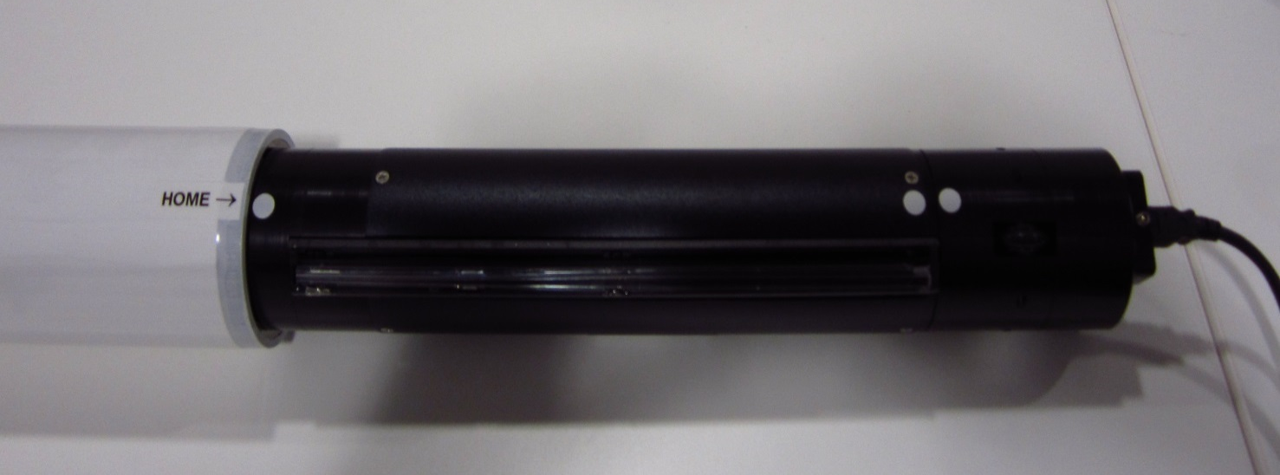
CI-600 Home Position
  Line-up silver dots before calibrate or scan
  Helps align images for later software analysis
Dr. Zoltan Toth
University of Pannonia
Hungary
CI-600 & Calibration Tube
Notes:
Another time-saver for the CI-600 is the “home position”. This is how your whole team lines up root images. First, line up the sliver dots on the CI-600 scanner body. This is where the scanner will rotate to before it starts taking an image. If you rotate the scanner to the home position and always insert it at the same position on the root tube, it will help align images for later analysis in the software.

Slide 10
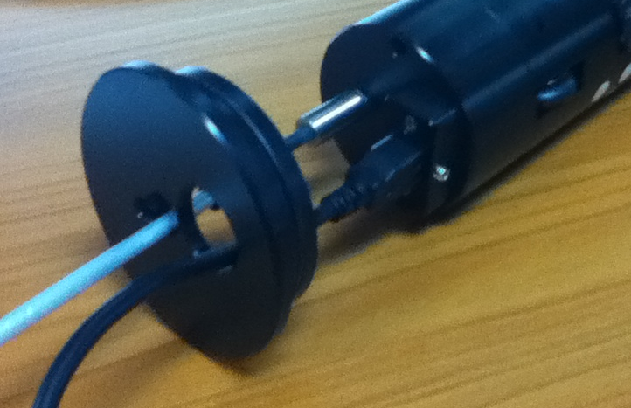
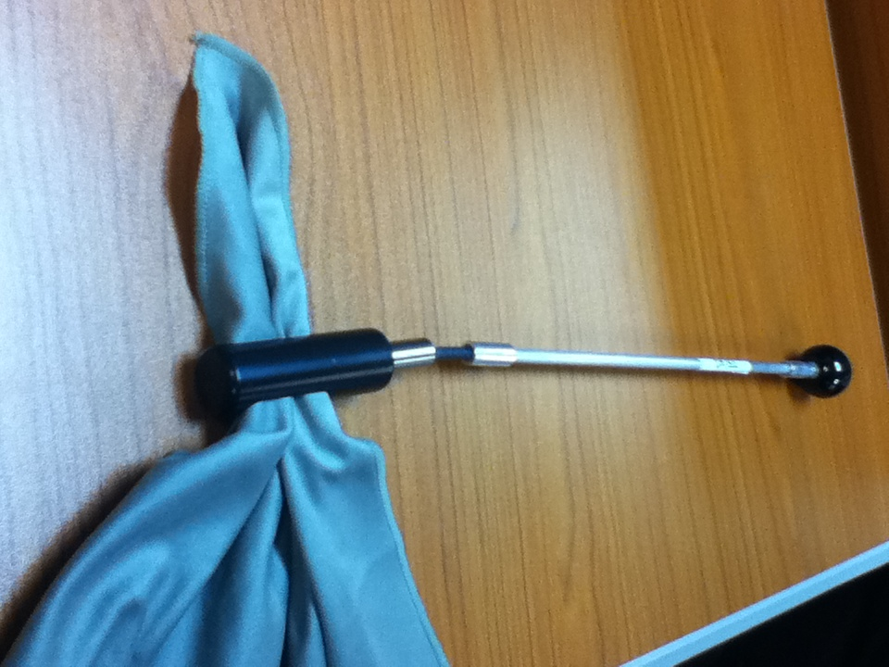
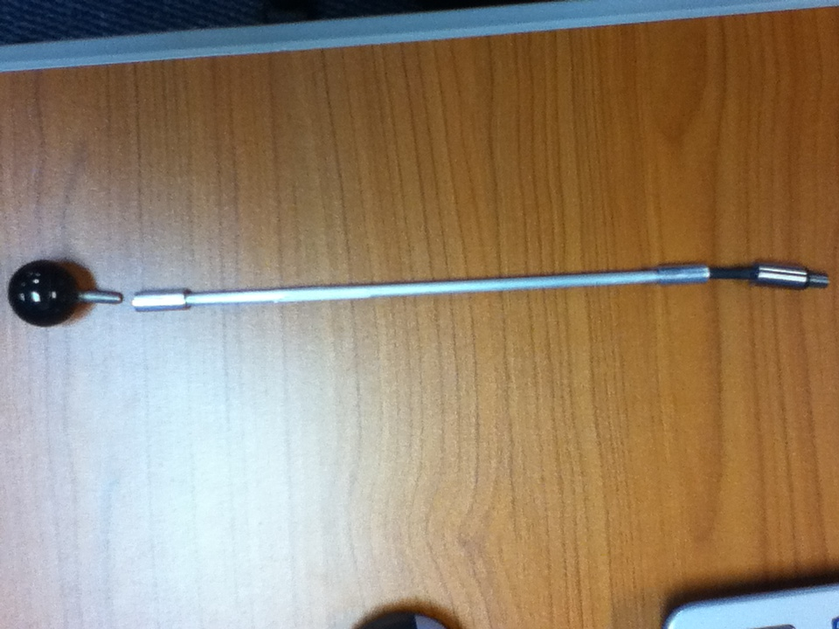
Collapsible Indexing Rod or Handle
All users can get the same image at each tube
Dry root tube
Each section of the rod is the length of the scan window
Notes:
The collapsible rod is used to lower the CI-600 into the root tube. The sections of the rod screw into each other and there is also a flexible section directly above where the rod screws into the top of the CI600, to minimize stress on the joint. Each section of the collapsible rod is the length of the scan window of the CI-600. When used with the USB root tube cap (pictured in the upper right), the adjoining section of the rod can be rested in the groove of the cap, so you can remove your hands from the CI-600 and collapsible rod. This also helps when there are multiple users of the CI-600, trying to image the same root tubes. There is an accessory to use the collapsible rod to dry the inside of the root tube, before lowering the CI-600 into the tube, if there is condensation.

Slide 11
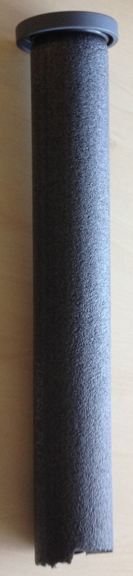
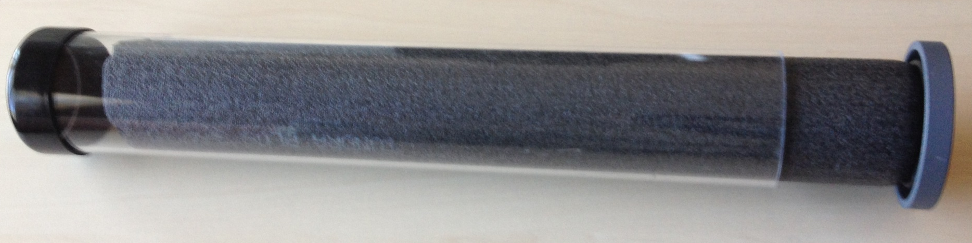
Root Tube Insulating Caps
  Prevent temperature fluctuation
  Decrease condensation
  Decrease disturbance in soil
Notes:
CID Bio-Science recently released root tube insulating caps for the CI-600. The insulation, connected to the tightly fitting root tube cap, is designed to decrease temperature fluctuation in the root tube, which will decrease condensation forming inside the tube.

Slide 12
CI-600 Operational Software
Software and driver pre-installed on tablet
Calibrate once at each resolution at factory
Adjust resolution/DPI
Save image type
  ICAP file naming: Tube, Window, Session
Open software…..
Calibrate before each use or if image quality decreases

Slide 13
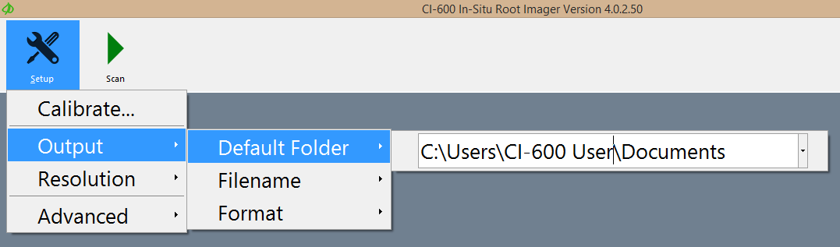

Slide 14
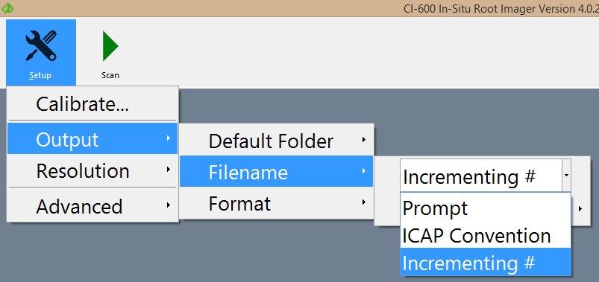
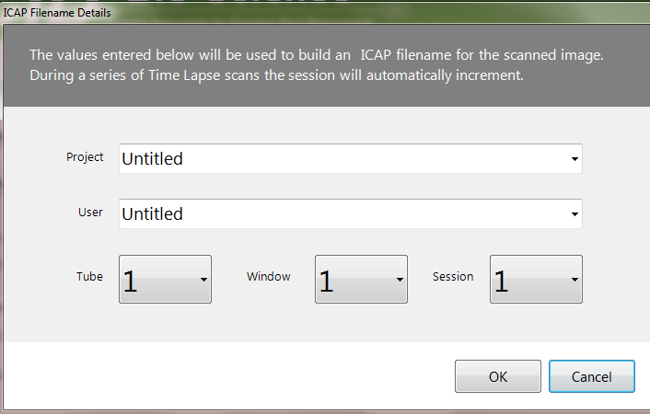

Slide 15
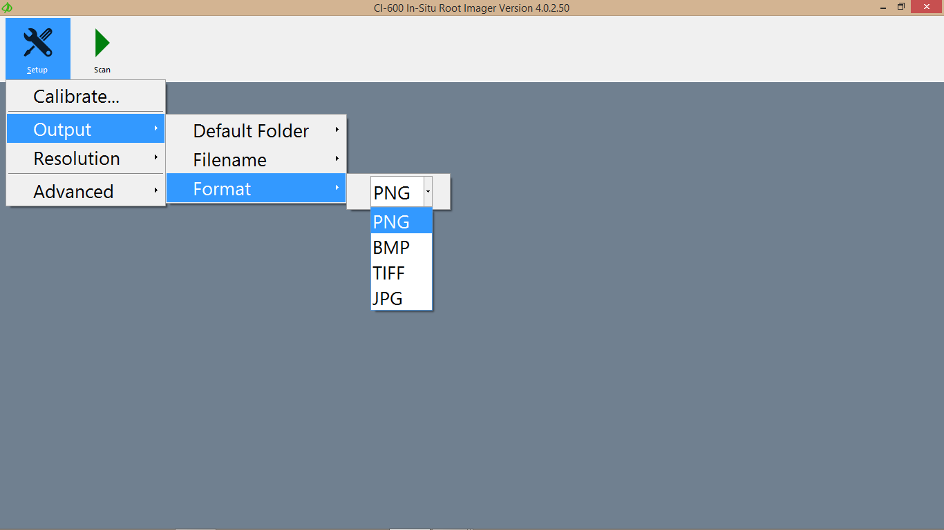
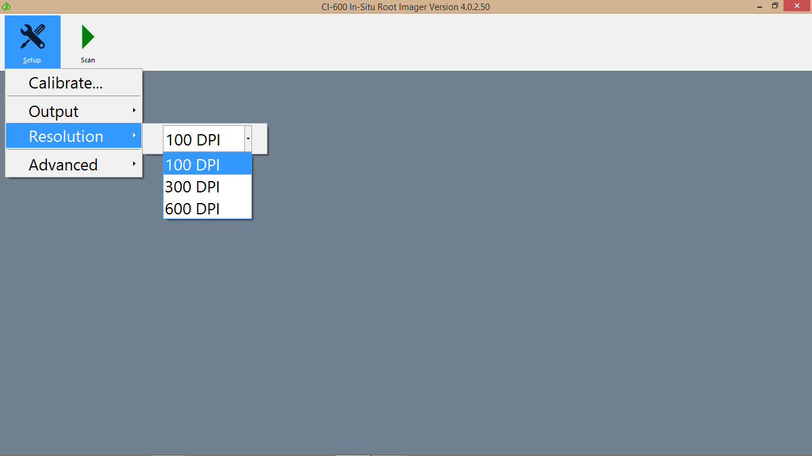

Slide 16
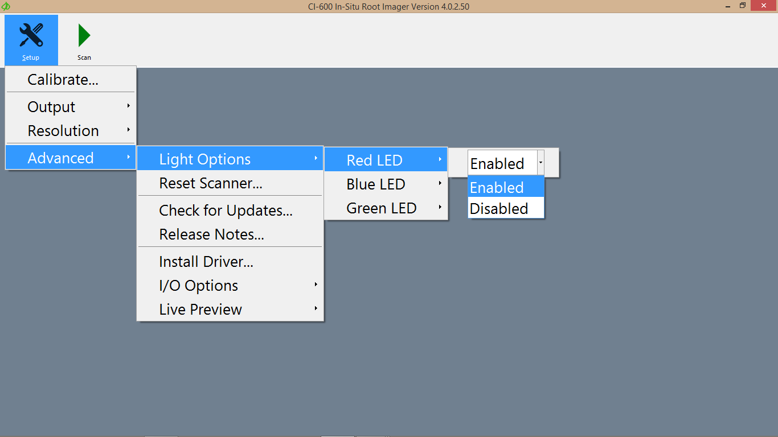

Slide 17
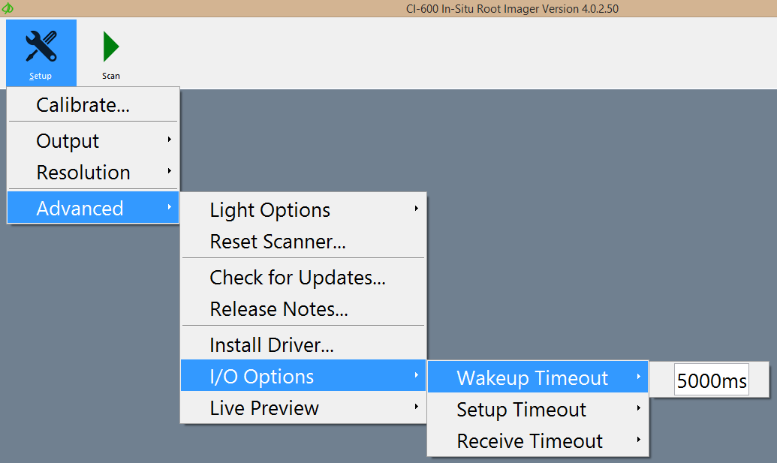

Slide 18
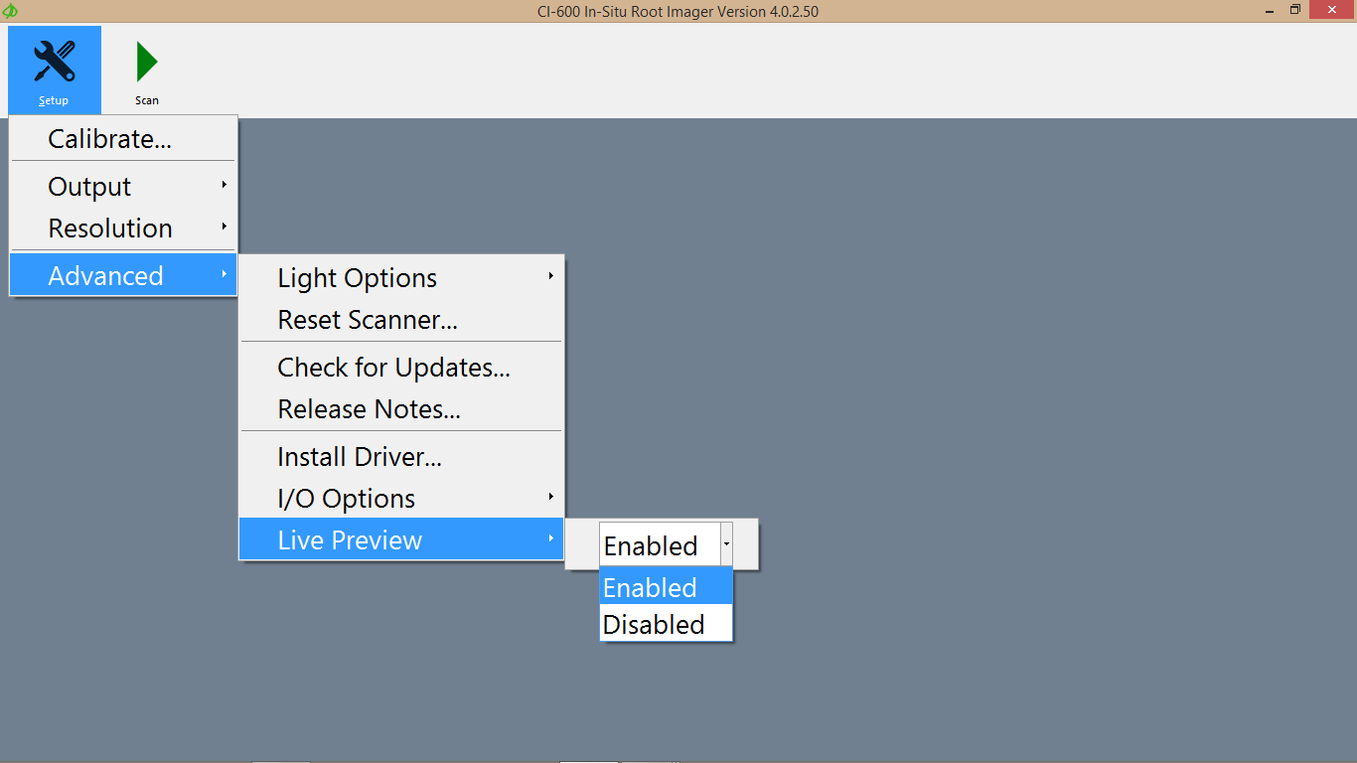

Slide 19
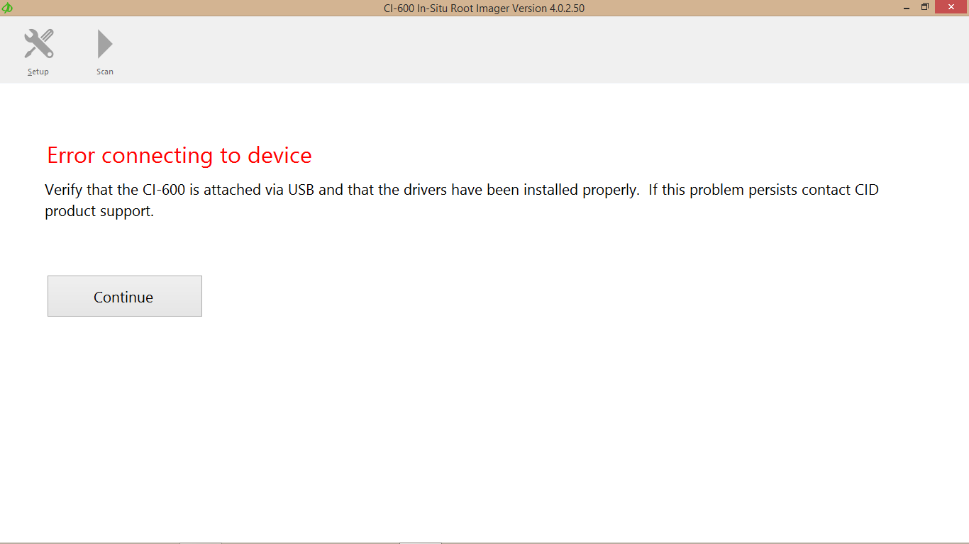
Troubleshooting
    Disconnect and reconnect the CI-600.
    If the error appears again, re-start the computer.
    Check the USB cable and connection of the instrument. Try a different USB port of the computer. Try a new USB cable.
    Check that the software and driver are up-to-date and properly installed

Slide 20
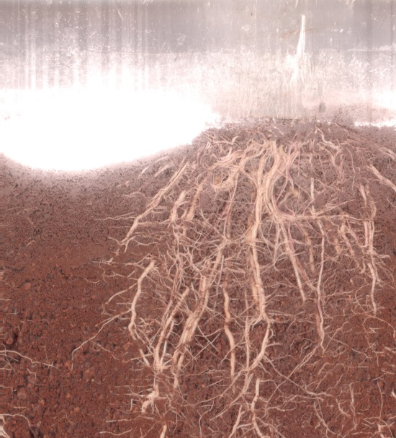
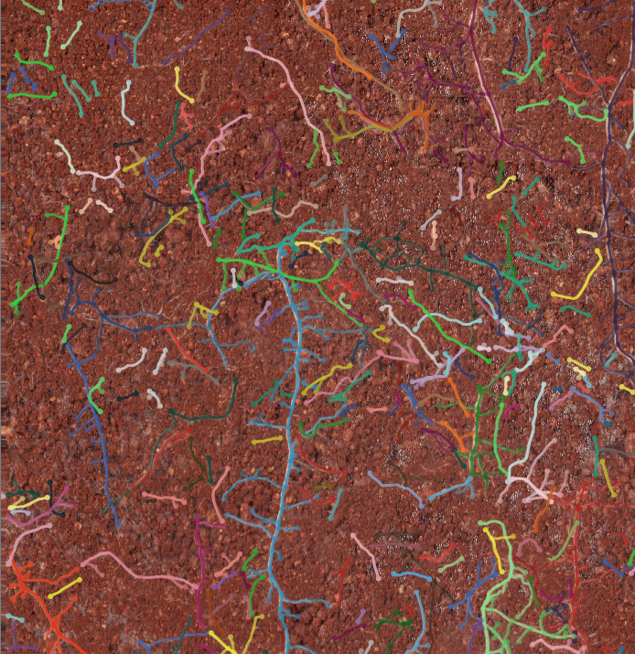


Dr. Maruthi
CRIDA, India
Roots mapped using RootSnap!
Notes:
Utilizing the home position will help minimize the left/right offset between windows in the same root tube. Here is an example of a single root tube that has 3 windows. The windows are already practically lined-up, even before Window 3 at the bottom of the tube was analyzed using RootSnap. There is almost no need for image alignment because the researcher rotated the CI-600 to the home position before imaging. These images are of maize root and are courtesy of Dr. Maruthi at the Central Research Institute for Dryland Agriculture.

Slide 21
CI-690: RootSnap!
Software to analyze root images
  CI-600, other root scanners, digital pictures
  Semi-automatic root mapping feature
Uses a touch-screen interface to make analysis quicker and easier
Monitor root growth, disease, dynamics and behavior over time
  Root length, area, volume, diameter

Slide 22
Using RootSnap!
Demonstrate small project in RootSnap!
  Import sample image 4 and show detect growth tool working
  Run through all feature of software and show exported data

