Slide 1
CI-340 Photosynthesis System Training
Conducted by: Brienne Meyer
bmeyer@cid-inc.com

Slide 2
CI-340 Handheld Photosynthesis System
Entire photosynthesis system in hand-held case
Lightweight and truly portable
Open and closed system measurements
Light, temperature, CO₂ and H₂O control
Chlorophyll fluorescence and soil respiration

Slide 3
CI-340 Features
Infrared CO₂ gas analyzer
H₂O/humidity analyzer
PAR sensor
Temperature sensors to measure leaf, air, and internal temperature
Wide selections of leaf chambers to operate as an open or a closed system
Complete set of environmental control modules

Slide 4
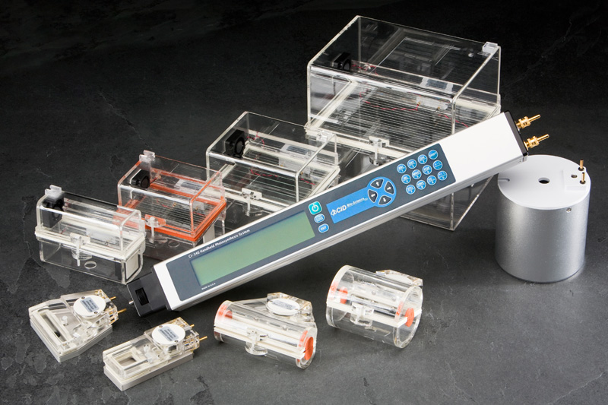

Slide 5
CI-340 Features - continued
Three gas concentration measurement modes:
  Differential (Photosynthesis, P):
  Measures CO₂/H₂O concentration differences between inlet and outlet: at least 40 seconds
  Absolute (Single channel absolute, S):
  Measures absolute CO₂/H₂O concentration from a single source (inlet)
  Continuous (Continuous photosynthesis, C):
  Measures gas concentration from inlet once, then measuring from outlet continuously: at least 20 seconds
  Only use with standard gas

Slide 6
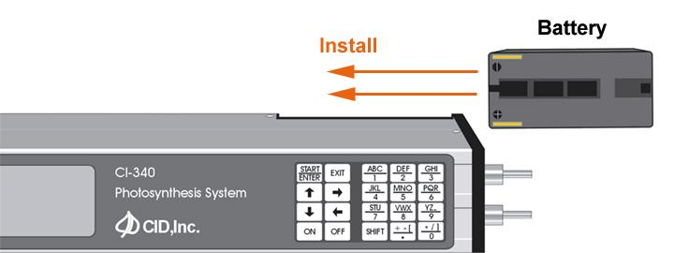
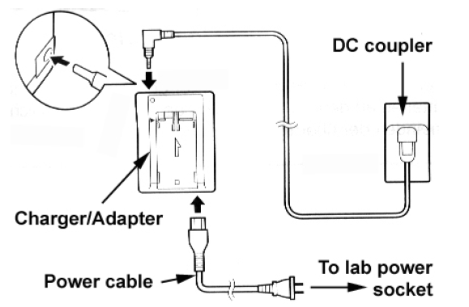
Powering Up
The CI-340 can be powered by a rechargeable battery or AC power through a DC coupler

Slide 7
Powering Up
Press and hold the power key for a couple seconds
The display will read “Waking Up”
Allow instrument to warm up for 4 to 30 minutes before using

Slide 8
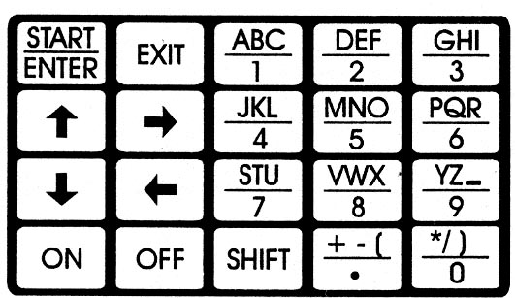


Using the Keypad
Enters numeric characters (and alpha characters when preceded by )
Switched to upper-level character commands. Pressing several times allows user to enter the various shifted characters.

Slide 9



Keypad Commands
Aborts the operating function or stops measurements
Enters selected operation mode (measurement, calibration, etc) and enters data in the operation
Starts measurements without saving the data

Slide 10
Taking Measurements with an Open System Leaf Chamber
  Leaf chambers overview:
  Installing an open-system leaf chamber
  Setting up for a measurement
  Reviewing measurement results

Slide 11
Function of a Leaf Chamber
Stable environment with fixed leaf area
Housing for sensors
Self-contained fan for air circulation

Slide 12
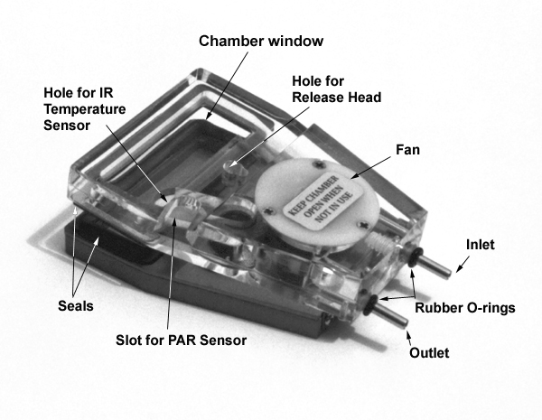
Installing a Leaf Chamber
Make sure O-rings are on the end tubes
Insert the end tubes into the CI-340
Align and tighten the end screw
Connect the IR Temperature sensor and PAR sensor
Notes:
Demonstrate on Instrument
The instrument may be kept on; however, do not start measurements without first attaching a chamber.
The IR Temperature sensor and PAR sensor should be inserted into their respective locations on the chamber (see Figure 9-2). Check that the IR Temperature sensor is plugged securely (without bending the tiny wire by the sensor lens) and the PAR sensor is firmly slid in to acquire ideal measurement conditions. Connect the IR Temperature sensor and PAR sensor plugs into their respective locations on the “head” end of the CI-340. The IR Temperature sensor should be handled with great care.

Slide 13
Using a Leaf Chamber
Set up the main console in a stable station (it can be set up on a tripod)
Place sample in the leaf chamber
Gently close, and push the latch backward to lock the chamber
Allow chamber environment to stabilize for 30 seconds before measuring
Push the latch forward to open the chamber once measurements are complete
Notes:
Demonstrate on Instrument and Demo Plants

Slide 14
Setting up for a Measurement
Press the key
Enter the desired file name
  *If the filename ends with a number, same settings can be used without re-entering for subsequent measurements with incremental filenames as default
Enter “P”, “S” or “C” for the measurement type
Enter console-controlled module; “0” if not using any
Notes:
Press the start/enter key
The display will read “File name?”
Enter the desired file name and press start/enter
The display will read “Measure Photosynthesis, Single Channel Absolute, or Continuous Photosynthesis? (P S C)”
Enter P S or C and press start/enter
The display will read “Control CS, AD, or LA?”
Enter “0” if not using accessories and press start/enter

Slide 15
Setting up for a Measurement
Enter the area of the leaf sample (in cm²)
Enter the intended flow rate (0.2~0.999 lpm)
* 0.3 lpm is generally used unless very active leaves are measured
For open system, press “enter”
* Press “C” for closed system
Notes:
The display will read “Leaf area? (cm2)”
Enter the area of the leaf sample, or the window if the leaf takes up the entire chamber and press start/enter
The display will read “Flow rate? (lpm – liters per minute)
Enter the intended flow rate (in lpm) – should be between 0.1 and 1 lpm
The display will read “Open or Closed?”
Press the start/enter key for open system or “C” for a closed system

Slide 16
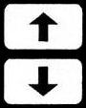
Taking Measurements
Display will read “Warming Up” while the chamber environment stabilizes
Once the unit is done warming up, the display will read “Working” and count down to 0
The data will display, use the keys to view both data displays
Notes:
Display will read “Warming up” while chamber environment stabilizes
Display will read “Working” while it takes measurements
The data will display, use the arrow keys to view the data displays

Slide 17
Graphic Data Display
Switch to graphic mode from numerical data
press “G” (shift, 3)
upper 1/8th of graph will be erased when switching between modes (a memory limitation with the current hardware)
best for large data set

Slide 18
Working around Files
This Lab will cover:
  Software installation
  Finding and deleting files
  File download
  Saving files on computer
  Viewing data on computer

Slide 19
Data Storage in CI-340
Measurement data is stored in the built-in memory of the CI-340
Once saved, the measurement results cannot be seen on the instrument. The data file(s) has to be transferred to PC via USB connection and viewed on PC

Slide 20
Software Installation
Load CD into CD drive of computer
Open the CD
Visit webpage for downloads:
http://www.cid-inc.com/photosynthesis-system/ci-340-software.php
Double-click “Setup.exe” to install
Follow installation instructions

Slide 21
Finding Files
Press key when “Enter → File menu” displays
Use the “up arrow” and “down arrow” to view the stored files
Files stored chronologically
Press “EXIT” to leave the menu.
Notes:
The CI-340 has a file system that allows a great range of data to be stored internally. It has been designed to emulate the familiar DOS of personal computers. Note that this menu will not be accessible when there are no files stored in memory; the message “no files” on the top display line will be briefly displayed when this situation occurs.
To use the File Menu or check if any files are stored, press the key when “ENTER ® file menu” is displayed. Press the key to access the “file menu” when the instrument is first turned on.
Enter ® File menu 13:05:49
Use the and keys to view all stored files. Pressing the key will exit this menu.
Files are stored in chronological order, with the names and data affiliated accordingly. Up to 1200 files or 2 MB of data are allowed for storage.

Slide 22
Deleting Stored Files
Press “D” (SHIFT + “DEF”) to delete last file saved
Press “Y” (SHIFT + “YZ_”) to delete all files
Notes:
Press the “SHIFT” + “DEF” key (for the letter “D”) to delete the last file saved, or “SHIFT” + “YZ_” key (for the letter “Y”) to delete all files saved. The shift and keys will have to be pressed again to confirm erasure of all files. Deleting a file removes it permanently! Be sure to transfer important data before deleting it from the CI-340. The RS232 port in the instrument can transfer data stored. Refer to the DATA TRANSFER section for related information.

Slide 23
File Download
Connect the USB cable to the CI-340 and a computer
Start “C340DF.exe” on the computer
Click “File – Open”
Select files to download and click “Open”

Slide 24
Saving Files on Computer
After downloading, select File, Save to save the data
Power down the instrument or press to take more measurements
View the files with spreadsheet program before deleting from CI-340

Slide 25
CI-340 Data Summary

Slide 26
CO₂ Zero and CO₂ Span Calibration
CO₂ Zero: daily to weekly, each time used
Use soda lime or 0 ppm CO₂ gas
CO₂ Span: every 6-12 months with standardized CO₂ gas between 100-1000 ppm
Always use T-connector to relieve excess pressure if using bottled gas

Slide 27
H₂O Zero and H₂O Span Calibration
H₂O Zero: weekly to monthly
Use silica gel or 0% RH gas
H₂O Span: every 6-12months with moisture generator, need to have precise control over temperature to perform H₂O Span
Always use T-connector to relieve excess pressure if using bottled gas

Slide 28
CI-340 Annual Maintenance
12 Point Maintenance and Calibration Includes:
Inspect Chamber Seals and replace if necessary.
Inspect Tygon tubing (hoses) and replace if necessary.
Set temperature off sets.
Calibrate CO₂ and H₂O sensors.
Recalibrate air flow through leaf chamber.
Test accessory cables for control modules (if applicable) and replace if necessary.
Test USB cable and replace if necessary.
Recalculate H₂O/CO₂ compensation.
Recalculate CO₂ TCAL (temperature calibration).
Recalibrate PAR Sensor.
Inspect Rotary Valve for leakage and replace if necessary.
Replace lithium battery.
Cost of $780 USD includes all parts, labor and return shipping
**first year included with purchase (international users must cover cost of shipping to/from)

Slide 29
Using the Light Module, CI-301LA
Lab will cover:
  Introduction to CI-301LA
  Installing CI-301LA
  Making measurements with CI-301LA

Slide 30
Introduction to CI-301LA
The CI-301LA is used as an intensity-controlled light source on flat, open leaf chambers
The light intensity ranges from 0 to 2000 μmol/m²s and can be controlled by the main console or the control unit
The emitted light covers the photosynthesis wave band
Notes:
Features/What it does

Slide 31
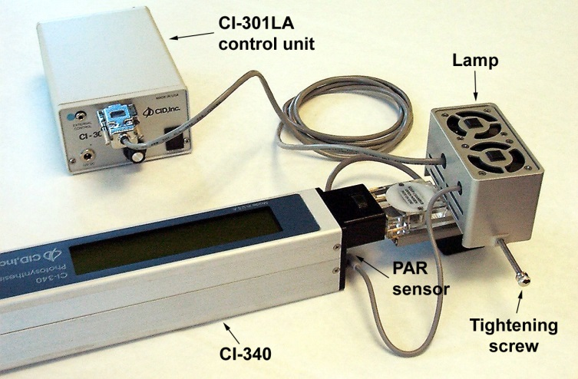
Installing CI-301LA
Mount the CI-301LA on the leaf chamber
CI-301LA is equipped with a PAR sensor with a small grey cable. Plug in the grey cable in place of the external PAR sensor
Connect the eight-pin cable to the control unit. Make sure the control unit is powered off before connecting the cable
From the Accessory cable, insert the plug with a blue-color band if the light intensity is to be controlled by the main console*
*In order to use the main console to control the light intensity, turn the intensity control knob counter-clockwise all the way down during the setup

Slide 32
Making Measurements with CI-301LA
Similar procedure as operating the main console
When using the console to control the light intensity, follow the procedure below
    In the “Control CS, AD, or LA?”, enter the appropriate number for the module used:
      CI-510CS – 1
      CI-301AD – 2
      CI-301LA – 4. For multiple, add the numbers. Press “Enter”
    Enter the desired PAR (0 – 2000 μmol/m2s). Press “Enter”. The light should come on at this point if the setup is correct
When using the control unit to control light intensity, turn on the power will turn the light on

Slide 33
Response Curve: Pn vs. PAR
Press “L” when measuring photosynthesis with CI-301LA being controlled by the CI-340.
L = shift, shift, shift, 4
Prompt to enter number of steps for light response
CI-340 will control CI-301LA and increase the light intensity from very low to very high in that number of steps.
Make sure the intensity knob on the CI-301LA is turned all the way counterclockwise

Slide 34
Using the Adjustable CO₂ & H₂0 Control Module – CI-301AD
Lab will cover:
  Introduction to CI-301AD
  Installing CI-301AD
  Making measurements with CI-301AD

Slide 35
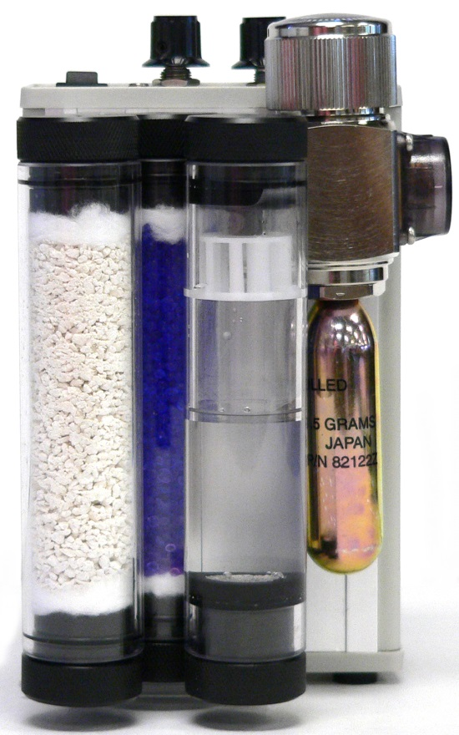
Introduction to CI-301AD
The CO₂ concentration can be regulated from 0 to 2000 ppm at flow rates up to 0.5 lpm by a CO₂ cartridge and soda lime
The H₂O concentration can be regulated from 5% to 20-30% above ambient humidity (up to 95% relative humidity) by water vapor and Silica gel
Notes:
Features/What it does

Slide 36
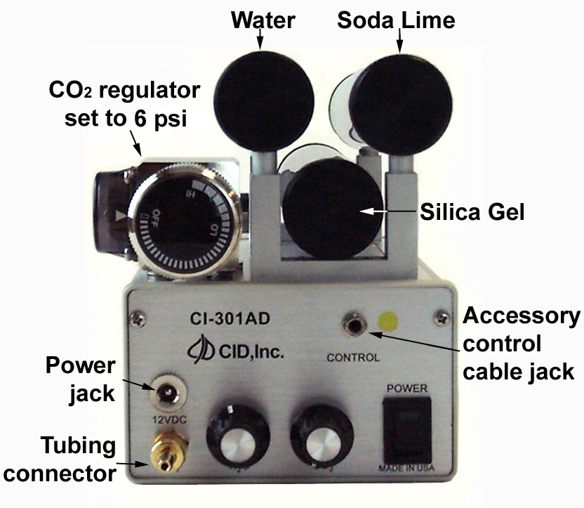
Installing CI-301AD
Before operating the CI-301AD, proper consumable materials need to be added and installed at correct positions
Connect the “Out” port on the CI-301AD to the “Intake” port on the main console
Turn on the power and purge the system with pure CO₂ for 5-10 min before using
Adjust the H₂O and CO₂ concentration. If concentration is to be remotely controlled, the CO₂ knob should be turned counterclockwise and the H₂O knob clockwise

Slide 37
Making Measurements with CI-301AD
Enter a flow rate less than 0.5 lpm
When using the console to control the CO₂/H₂O concentration, follow the procedure below
    In the “Control CS, AD, or LA?” enter a proper number corresponding to the modules used. Press “Enter”
    Enter the desired concentration of CO₂ (0 – 2000ppm) and/or H₂O (5%-95% RH). Press “Enter”

Slide 38
Response Curve: Pn vs. CO2
Press “C” (shift, shift, shift, 1) when measuring photosynthesis with CI-301AD being controlled by the CI-340
Prompt to enter step size to make the CO2 adjustments
CI-340 will control CI-301AD and slowly step from the lower limit to the upper limit, using approximately the specified step size.
Make sure the intensity knob on the CI-301AD is turned all the way counterclockwise

Slide 39
Using the Temperature Control Module, CI-510CS
Lab will cover:
  Introduction to CI-510CS
  Installing CI-510CS
  Making measurements

Slide 40
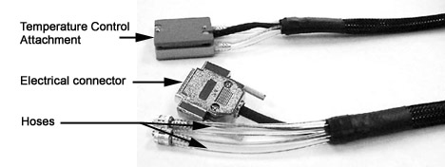
Introduction to CI-510CS
CI-510CS consists of a peltier thermoelectric heat pump and a cooling water reservoir
Temperature control range is ± 25°C from the ambient temperature
Notes:
Features/What it does

Slide 41
Installing CI-510CS
Fill the reservoir with distilled water
  Connect a hose to the “IN” fitting on the controller
  Connect one end of the cooling unit to the “OUT” fitting on the controller, and the other end to the hose with a connector
  Put both free-end hoses into a distilled water bath
Turn the power on and observe the water flow. Once no air bubbles in the hoses, turn off the power.

Slide 42
Installing CI-510CS – Continued
Detach both free end hoses from the “IN” fitting and one end of the cooling unit. Attach the free hose of the cooling unit to the “IN” fitting
Connect the five-pin electrical connector to the controller
Attach the cooling unit to the leaf chamber
Turn the control knob counterclockwise all the way to end before powering on
  * The peltier heat pump can only be operated when the water reservoir is filled

Slide 43
Making Measurements with CI-510CS
Turn the power on to allow water circulating through the cooling unit and the reservoir
When using the console to control the temperature, Turn the control knob counterclockwise all the way down before powering on. Enter the desired temperature
Notes:
Features/What it does

Slide 44
Response Curve: Pn vs. Temperature
Press “T” (shift, shift, 7) when measuring photosynthesis with CI-510CS being controlled by the CI-340
Prompt to enter number of steps for light response
CI-340 will control CI-510CS and increase the light intensity from very low to very high in that number of steps.
Make sure the intensity knob on the CI-510CS is turned all the way counterclockwise

Slide 45

Using the Chlorophyll Flourescence Module, CI-510CF
Lab will cover:
  Introduction to CI-510CF
  Installing CI-510CF
  Making measurements
  Interpreting CF measurements

Slide 46
Introduction to CI-510CF
The CI-510CF is modulated chlorophyll fluorescence measurement module
Performs two functions:
  Chlorophyll fluorescence trace data
  Individual pulse data (calculated)
Modulation frequency from 8 Hz to 80 Hz

Slide 47
Installing the CI-510CF
Screw on the 2 connectors on the “Y” end of the fiber optic cable to the CF Module.
Insert the end of the cable into the hole in the side of the leaf chamber.
Insert the power plug for the CF module.
Connect the 4 and 8-pin accessory control cable to the CI-340 and CI-510CF module.
Insert the plug with the green color band into the jack on the CI-510CF control unit.

Slide 48
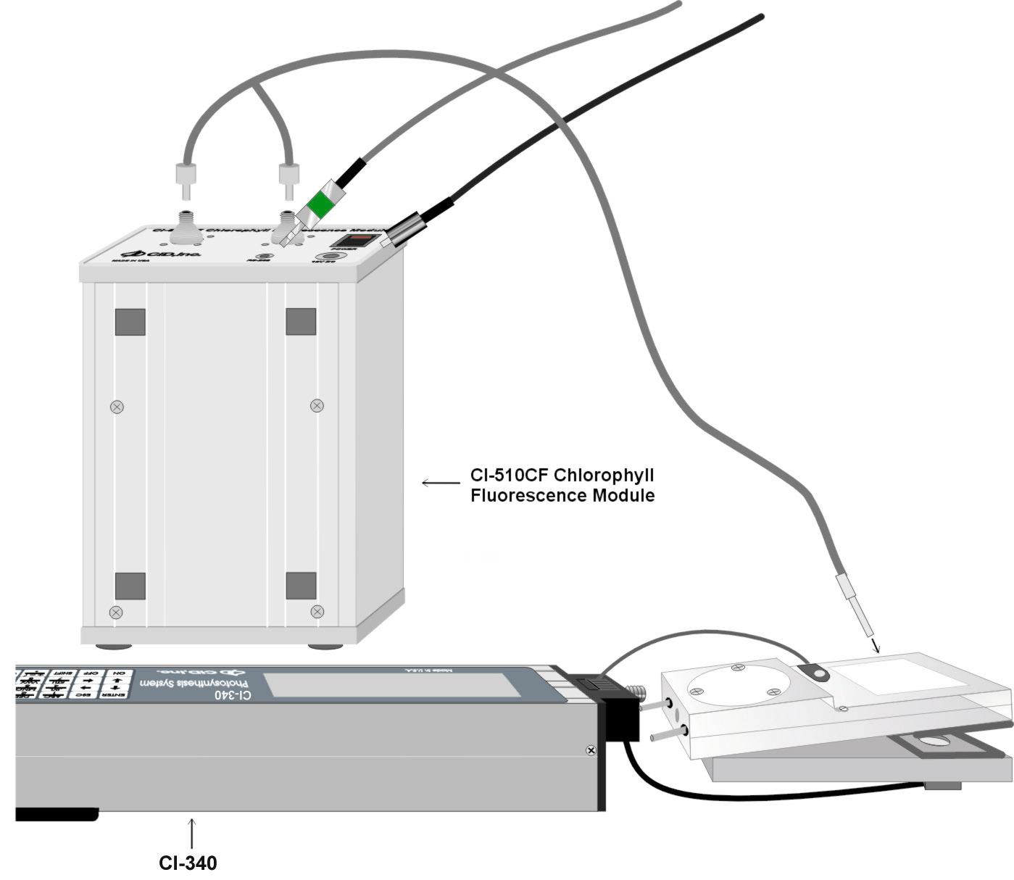
Connect the 4 and 8-pin accessory control cable to the CI-340 and CI-510CF module.
Insert the plug with the green color band into the jack on the CI-510CF control unit.

Slide 49
Making Measurements with CI-510CF
Activate the CI-510CF by turning on the CI-340 and CI-510 module.
  Start the measurement by pressing “SHIFT SHIFT SHIFT 2” for “F” or fluorescence
  Enter a file name to save data under
  Enter a pulse length from 0.8 to 3 seconds
    The default saturation pulse length is 1 second

Slide 50
Interpreting CF Measurements
Download the CF files to a PC
Fluorescence numbers represent the chlorophyll fluorescence in A/D (analog to digitla converter) counts.
  Generated at 16 Hz

Slide 51
CF DATA
Ratio value should be interpreted as 0.xxx (xxx is the # displayed in table)
  Ex: if the number is 99, the ratio is 0.099
Low Fluor. value | Fo – dark Fs - ambient
High Fluor. value | Fm – dark Fms - ambient
Ratio of DHL:H | Fv/Fm – dark Y – ambient
Fv = variable chlorophyll fluorescence:
  Fv = Fm – Fo
Fv/Fm = Yield: the quantum efficiency of the primary photochemical reaction of photosynthesis

