Slide 1

CI-202 Leaf Area Meter Instrument Training
Conducted by: Brienne Meyer
bmeyer@cid-inc.com

Slide 2
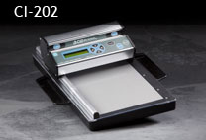
CI-202 Portable Leaf Area Meter
Fast, non-destructive measurements
  Length
  Width
  Area
  Perimeter
  Aspect Ratio: leaf length to its maximum width
  Shape factor: ratio of leaf area to leaf perimeter
    Shape factor of a circle = 1

Slide 3
CI-202
High resolution of 0.1mm
Transfers data to computer via USB connection
Scan board with plastic sheet or cover
  Protects fragile or delicate leaves
  Leaf can still be attached to plant or removed
  hand-hold on back for easy use in field

Slide 4
CI-202 Specifications
Scanner: | 675 nm Laser Diode
Max. Measuring Length: | 36cm
Max. Measuring Width: | 150mm
Max. Measuring Thickness: | 15mm
Max. Scanning Speed: | 127 mm/second
Area Units: | cm²
Accuracy: | ±1% for samples > 10cm²
Data Storage: | 8,000 Measurements
Computer Interface: | USB 2.0
Display: | 16 characters × 2 line LCD
Battery: | 7.2V rechargeable NiMH
Battery Life: | 15hrs
Operating Temperature: | 0-50ºC
Weight: | 1.50 Kg

Slide 5
CI-202 Use
Create a File to save measurements to
  File<Create
Start taking and saving measurements
  Autosave feature
Can also measure the length of harvested, washed roots
  Put CI-202 in Root Mode
  Place roots under plastic sheet on scan board

Slide 6
CI-202 Menu System
Measure
View
File
Setup
Use the Up/Down arrow to select a menu
Use the right arrow to select a sub-menu

Slide 7
Measure Menu
The options are:
to select another mode with the up or down arrow keys
to select another file (if there is more than one file) with the right or left arrow keys
to take measurements

Slide 8
Taking a Measurement
Place leaf under plastic sheet on scan board
Position CI-202 scan head at top of scan board
  Catch at end of scan board rail
Press “enter” or “start.”
Display will read “Stabilizing”--“Spinning Up”— “Measuring”
Move the scan head down scan board

Slide 9
Results on the CI-202
File name
Parameter
Parameter value
Press right/left arrow to bring another parameter into view
Press Save to save measurement
Press Stop to discard the measurement

Slide 10
View Data Menu
Files
Voltage
Battery
After select a file, press ENTER to see data
Press Up to see “total” data
Press Up again to see “average” data

Slide 11
File Menu
Clear
Delete
Create
Close
  move all temporary records to file system
You must always create at least 1 file before measuring.

Slide 12
Transfer Data to PC
Use USB cable
Install LIBUSB driver for CI-202
Run CI202DF.exe program
  Transfer files from 202
Save files as .csv
Re-open in Excel

Slide 13
Setup Menu
Use the Right/Left arrows to select the desired Setup option
Press the Start/Enter to enter the sub-menu
    Measure (leaf/root)
    Scanner
    Autosave (yes/no)
    Storage

Slide 14
Setup Measure
Leaf Area
Root Length
Up/down to modify value
Press Save to save
Press Stop to abort

Slide 15
Setup Scanner Thresholds
Normally, there is no need to adjust the threshold of the CI-202.
The CI-202 is factory-adjusted to a threshold level that is ideal for “all-around” use.
If out-of-the-ordinary measurements are being recorded or if the instrument has suffered from abuse or excessive aging, the manual threshold setting may need to be adjusted.
Follow instructions in CI-202 User Manual to adjust width and length calibration

Slide 16
Setup Storage
Check memory space or erase
    16 bytes use per measurement recorded
Use “Format Storage” to erase all data and all files (up/down arrow)
  Good when starting a new project or new year

Slide 17
Setup AutoSave
When “Yes” is on display, all leaf measurements will be saved automatically
Use Up/down arrow to change option
Press Save to save
Press Stop to abort

Slide 18
Re-compute the Timing Parameters
This procedure should be carried out whenever the CI-202’s threshold settings are changed or if the instrument isn’t measuring accurately. Re-computing the parameters will recalculate the effects of any changes made on the other parameters.
From the "Measure" menu, press the LEFT and RIGHT arrow keys at the same time.
Hold the buttons until the motor begins to spin. The motor should spin for about 4 seconds.
Do this twice by pressing the LEFT and RIGHT arrow keys simultaneously again and making sure that the motor spins up.
Take a test measurement and try to determine if the Length or Width readings need adjustment.

Slide 19
Technical Support
Email Brie (bmeyer@cid-inc.com or support@cid-inc.com)
Skype: cidbiosciencesupport
Phone: 360-833-8835
http://www.cid-inc.com/support
  FAQs
  Software
  Troubleshooting
  Support Forum

Slide 20
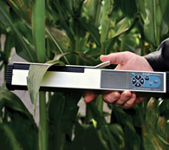
CI-203
Provides additional data beyond leaf area:
  Length, width, perimeter, voids, aspect ratio, shape factor, GPS tagging
  Graphic display of leaf image for verification of successful scan
  Removable SDcard for easy data transfer (or USB)

Slide 21
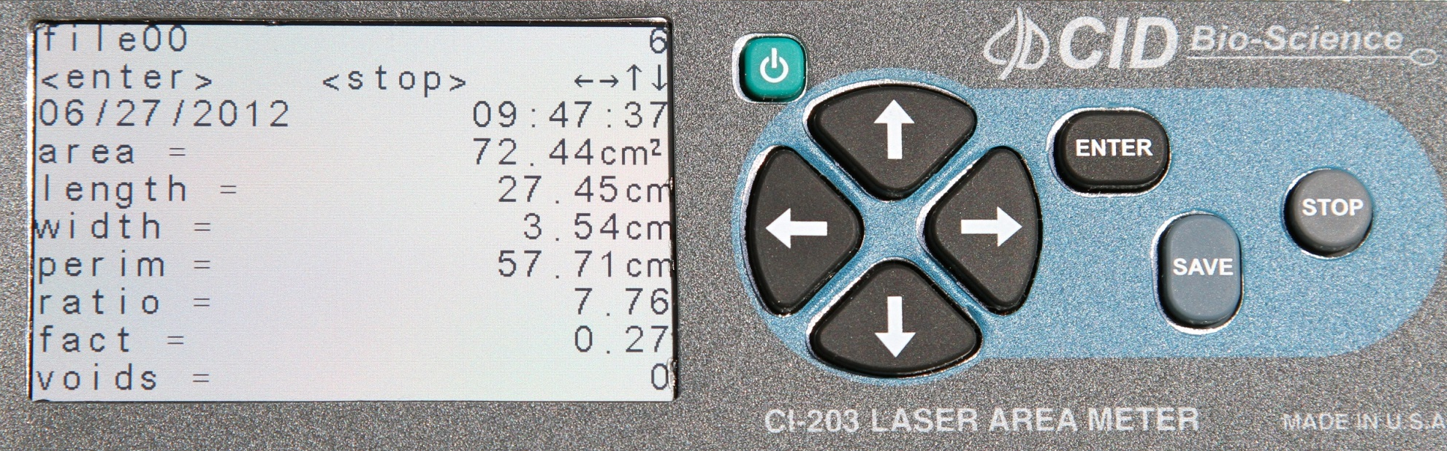
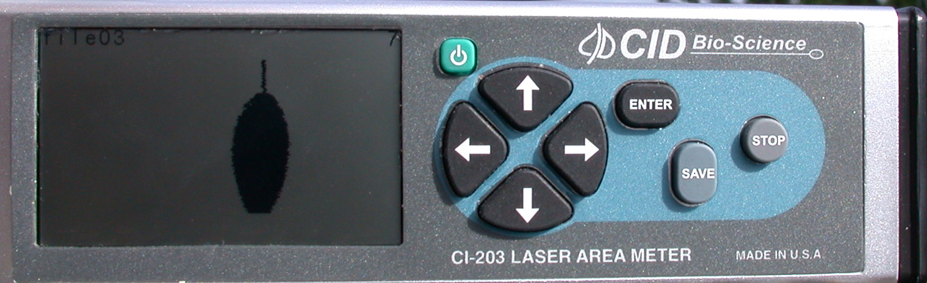

Slide 22
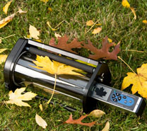
CI-203 Handheld Leaf Area Meter
  Non-destructive measurement by sliding leaf under arm
  CI-203 CA: Conveyor
  Rapid measurements
  Destructive, harvested leaves
  Requires external power supply

