Slide 1
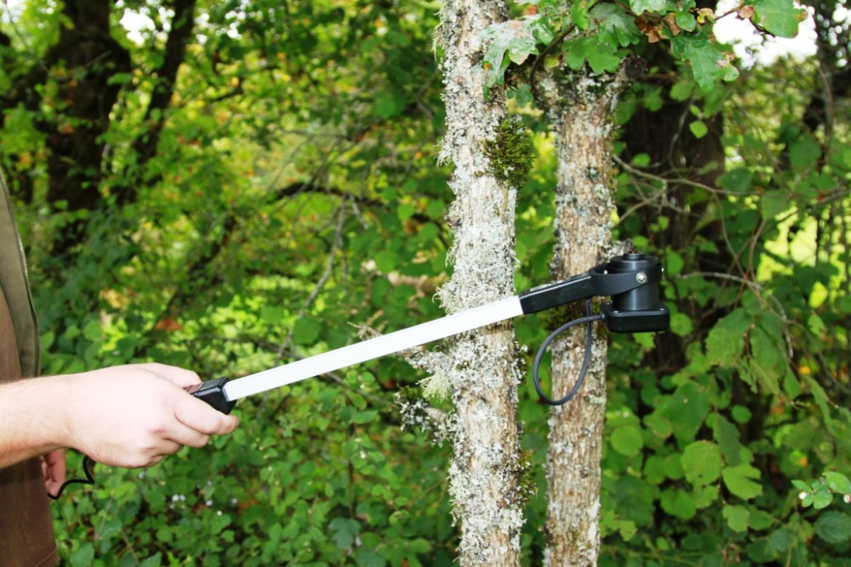
CI-110 Plant Canopy Analyzer Instrument Training
Conducted by: Brienne Meyer
bmeyer@cid-inc.com

Slide 2
CI-110 Plant Canopy Imager
Provides the researcher with:
Leaf Area Index (LAI)
Mean Leaf Angles
Photosynthetically Active Radiation (PAR)
GPS and Compass Data
Canopy Image (170º hemispherical picture) file is saved on computer
  .ci110

Slide 3
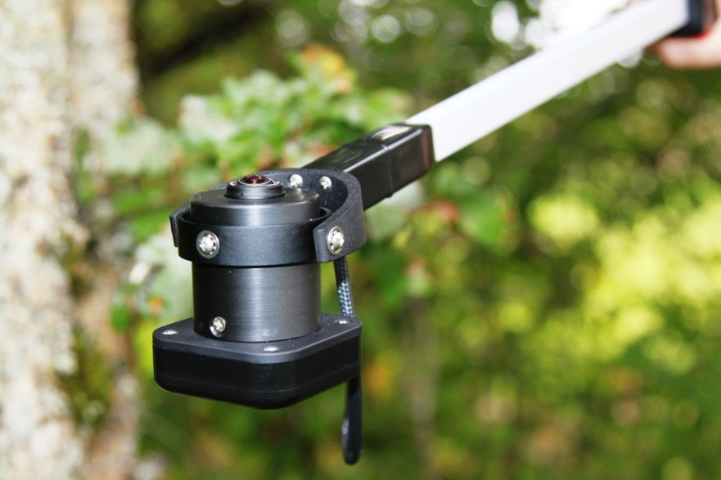
CI-110 Software
Allows researcher to capture canopy image and analyze immediately or analyze later
Adjustable image settings:
  Brightness, contrast, gamma
  Sky and leaf filter
  GAP Fraction Threshold
  Azimuth & Zenith Divisions
  Location (Tags)

Slide 4
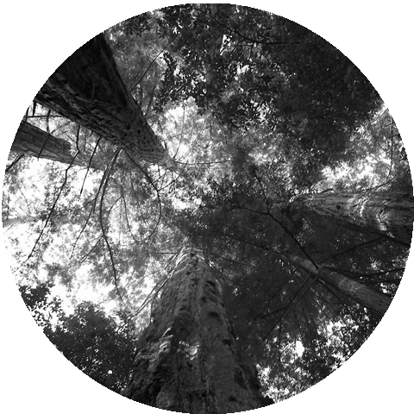
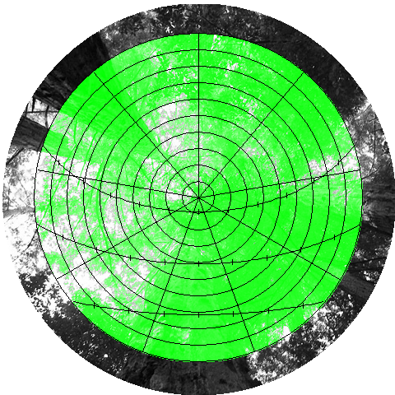
CI-110

Slide 5
CI-110 Hardware
Slide camera head onto arm
  Make sure to line up “top” stickers
Connect USB to tablet computer
Start CI-110 Plant Canopy Analysis Software

Slide 6
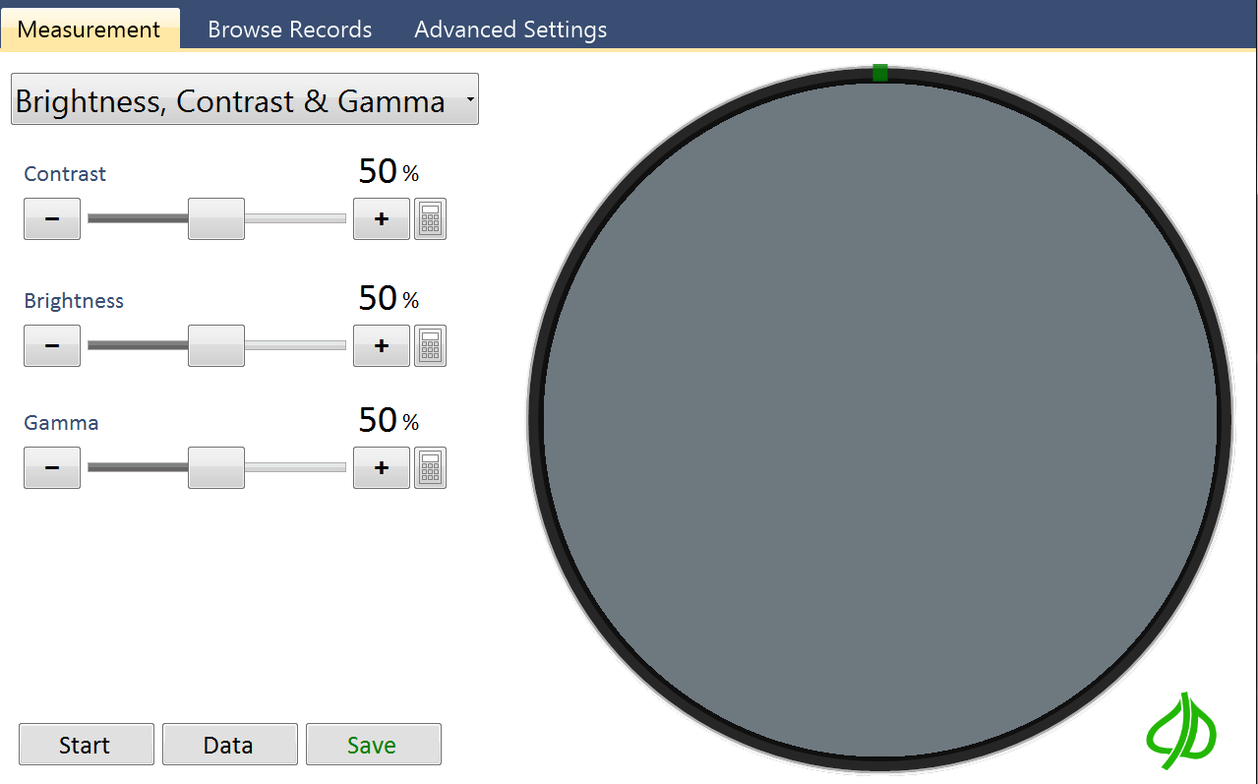
Using the CI-110 Software
Open the CI-110 software on the tablet.
  Measurement
  Browse Records
  Advanced

Slide 7
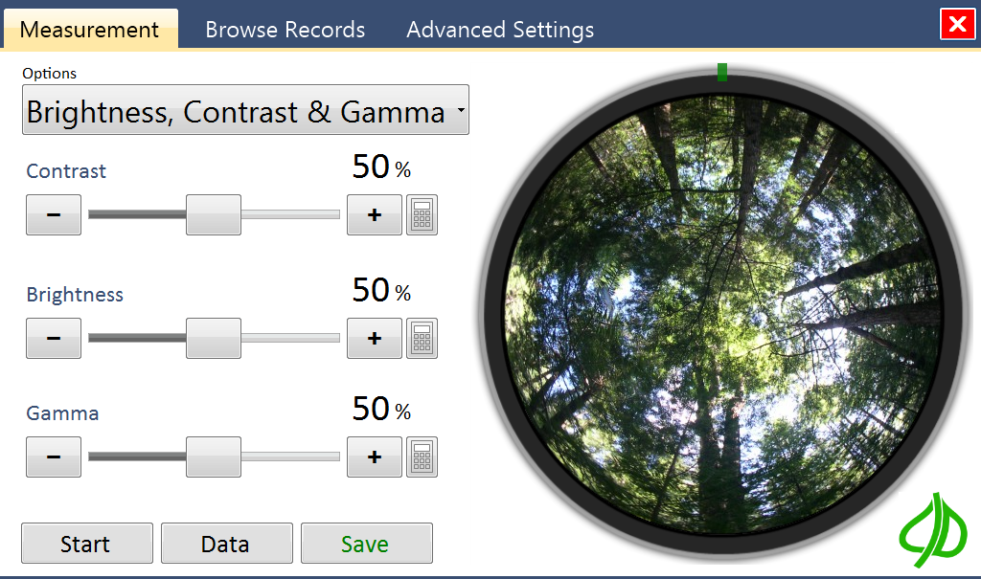
Click the Start button.
-round image area on the right will be a live video stream
Place CI-110 under canopy.
  Face camera north for accurate readings (needle turns green when aiming north)
Click the Pause button to preview your measurement.
Adjust the Exposure, Brightness, Contrast & Gamma as needed to increase the contrast between sky and foliage.
Click Data and Edit to view your measurement details and make changes.
Click the Save button. Hold the camera steady for the 1-2 second delay while the image is saving. The application will save your measurement.

Slide 8
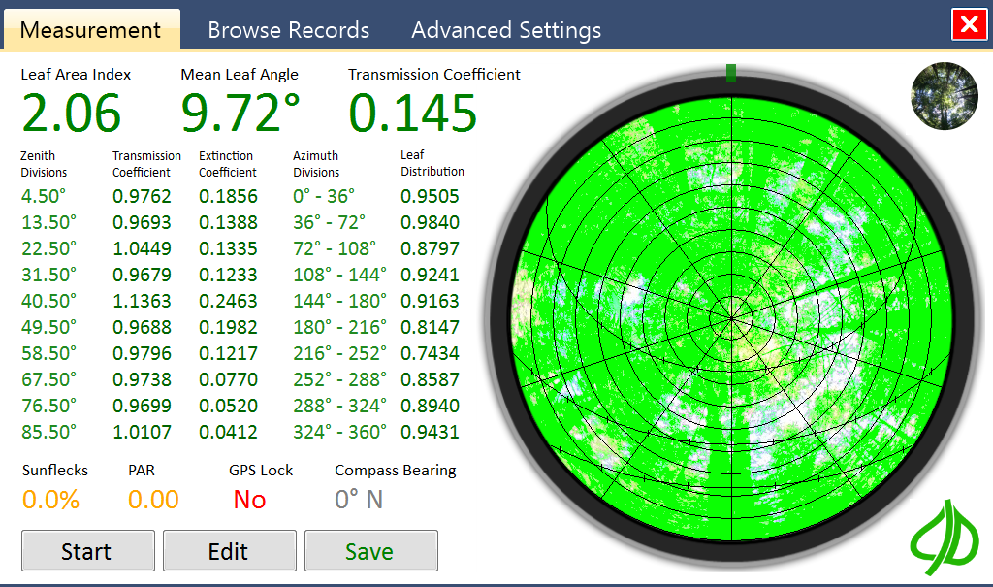
Start/Pause button: enable or stop the live video feed
Data/Edit button: measure current image and show data/manipulate image menus
Save button
Original / Measured Image Toggle button
GPS Lock

Slide 9
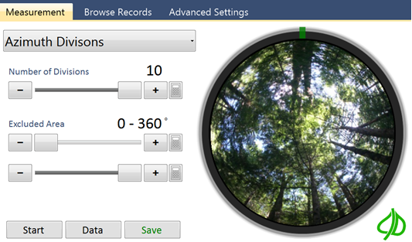
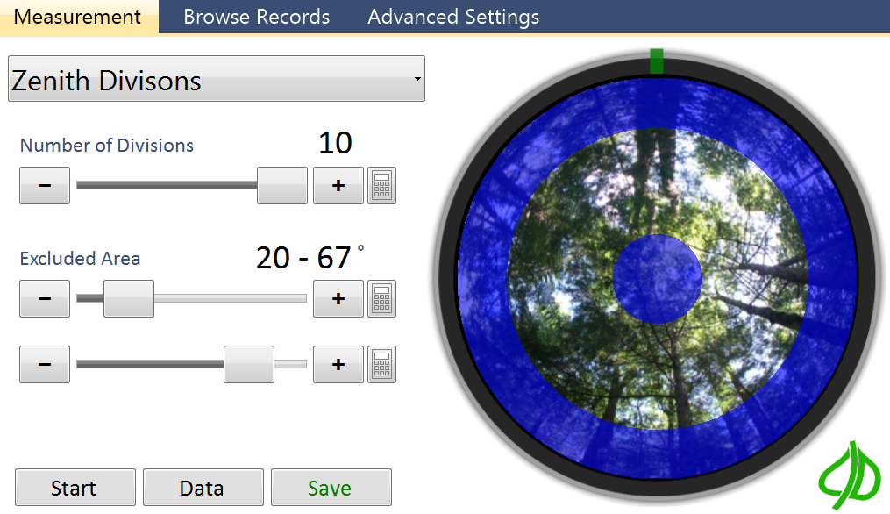
Azimuth and Zenith Divisions

Slide 10
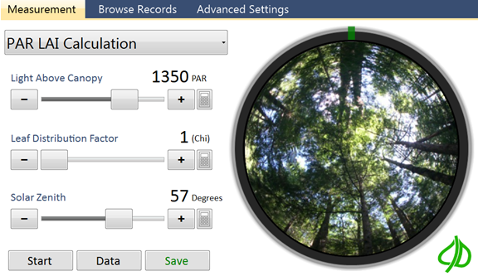
PAR LAI Calculation
Change the way PAR data is recorded

Slide 11
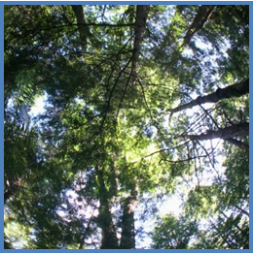
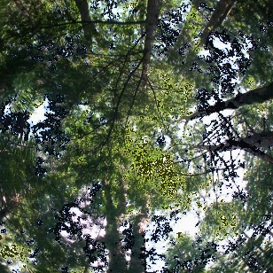
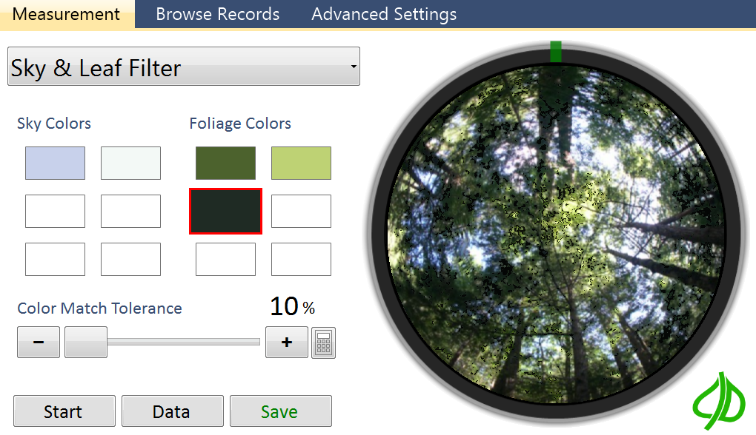
Sky and Leaf Filter
Here, foliage colors that should be green are blurred by the sky with a blue hue.
Click on a color square, click on the color in the image to work with
Select the “Color Match Tolerance” --increase this tolerance to include pixels with colors similar to the selected color.

Slide 12
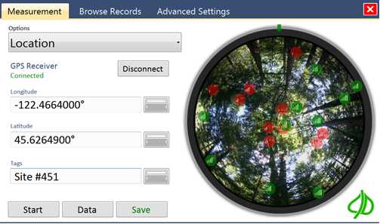
GPS Location
Use Tags to identify a location, plot or field site
Tags appear in Browse Records
GPS accuracy: ~2.5m CEP (circular error probability)

Slide 13
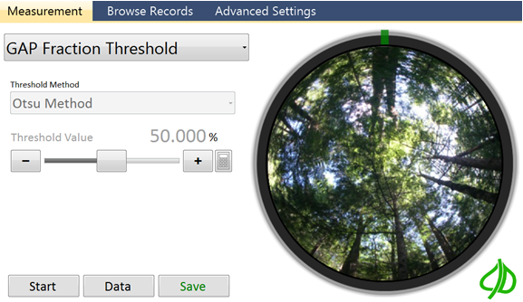
GAP Fraction Threshold
Manual Threshold
Entropy Crossover
Otsu
For more information on Gap Fraction Methods please refer to the article by Juarez et al.
"An improved estimate of leaf area index based on the histogram analysis of hemispherical photographs."

Slide 14
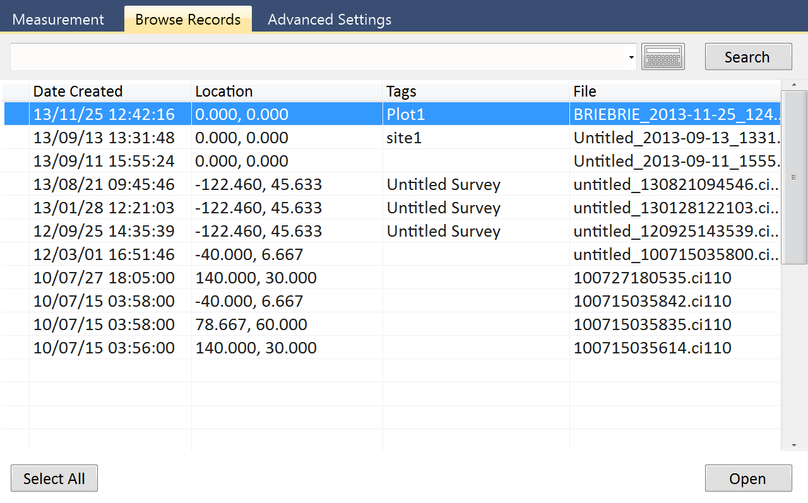
Browse Records

Slide 15
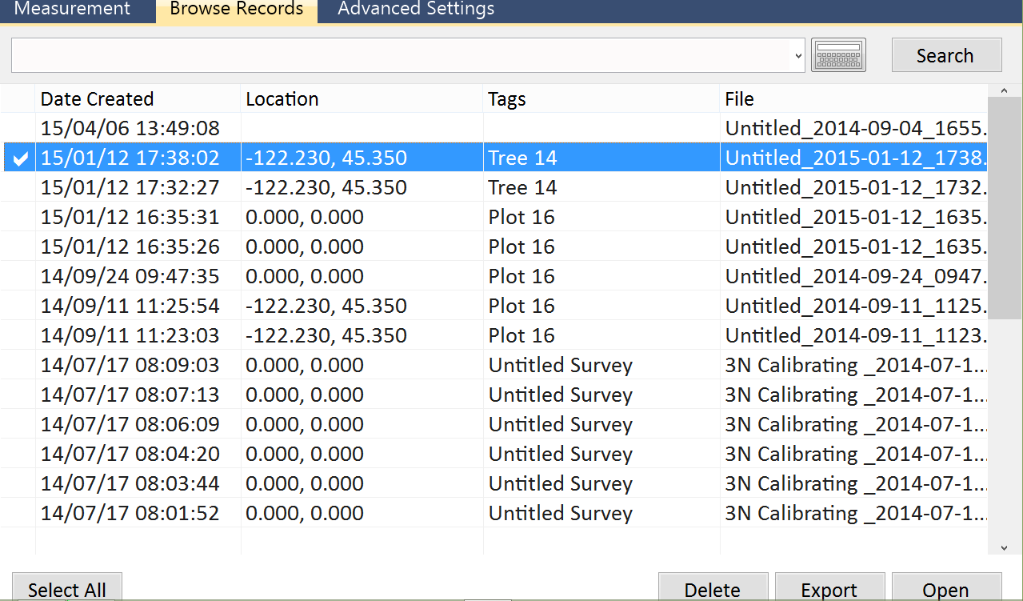
Export Data
CSV (Excel spreadsheet)
KML (Google Earth)
Option to export pictures as well

Slide 16
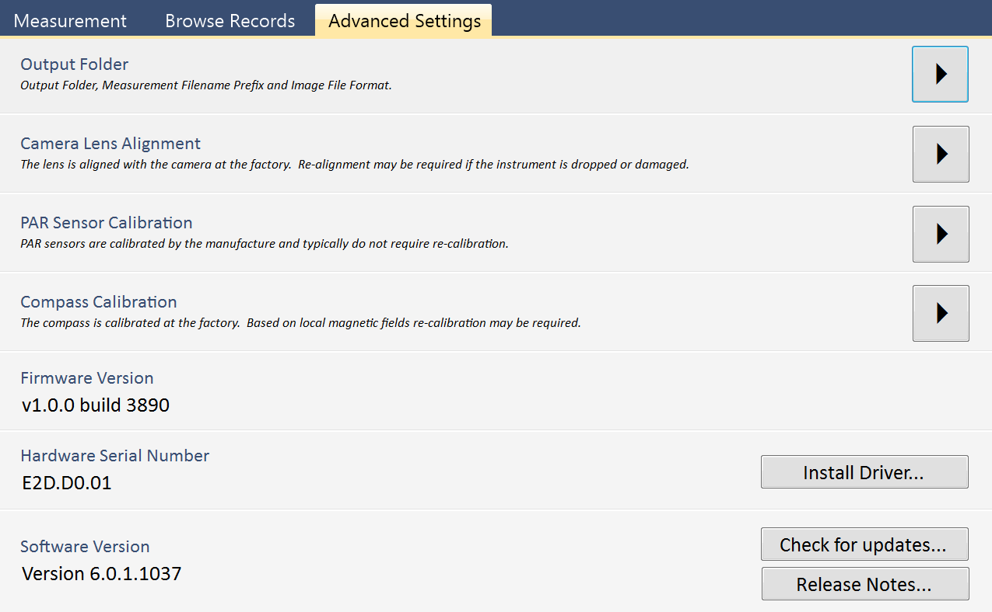
Advanced Settings
Lens and camera settings found in back of user manual
PAR sensor calibration done by technician
Compass calibration done by user

Slide 17
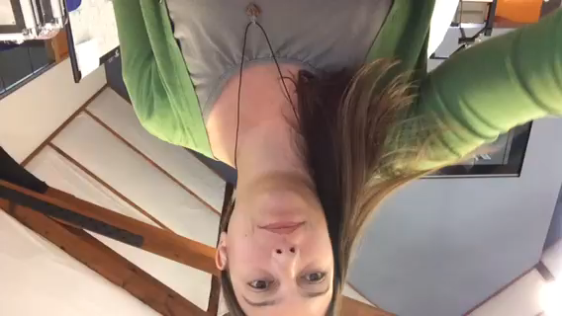
Compass Calibration

Slide 18
Install on Windows 7/8
32 or 64 bit
Windows 8: disable driver signature enforcement to have hardware work
Must install driver and plug in hardware: then input Advanced Settings > Camera/lens alignment to have image display properly (centered)

Slide 19
Application Output
1 .ci110 file contains:
Raw image file
Measured image file
Settings file
  Azimuth & Zenith information
  Image Threshold
  Viewable Range
  Sunflecks & PAR calibration
Data file
  Timestamp
  Sunflecks
  PAR
  Leaf Area Index
  Mean Leaf Angle
  Transmission coefficient for defuse penetration
  Zenith Divisions, Transmission coefficient, Extinction coefficient
  Azimuth Divisions, Leaf Distribution
  Longitude and Latitude
  GPS Quality, Number of Satellites, GPS Lock indicator

